Slide 1
Assisted Vaginal Birth
Sri Lanka College of Obstetricians & Gynaecologists
Scientific Activities & Research Committee
.

Slide 2
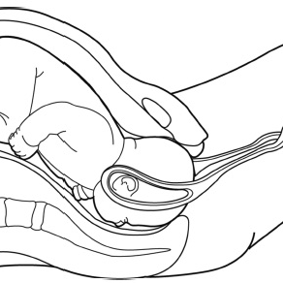
Learning objectives
Introduction and background
Indications / contra-indications
Classification for assisted vaginal birth
Preparation and safety criteria for AVB
Consent
Where should AVB be undertaken
Choosing your instrument to undertake AVB
When to stop
After care

Slide 3
Introduction and background
Assisted vaginal birth by vacuum or forceps is used to assist birth for maternal and fetal indications.
Incidence UK – Between 10% to 15%
Almost one in every 3 nulliparous.
Rise in the rates of caesarean births in the second stage - ? Concerns about assisted vaginal birth morbidity or a loss of clinical skills.

Slide 4
Prevention? Can it be avoided?
Continuous support during labour – can reduce the risk.
Women not on epidural if maintained an upright or lateral positions in second stage will reduce the risk.
Epidural may increase the risk – Less likely with newer anaesthetic techniques.
For women on epidural – delaying pushing for 1 – 2 hours will reduce the need.

Slide 5
Indications

Slide 6
Contraindications?
No indication is absolute and clinical judgement needed in all situations.
Suspected fetal bleeding disorders (eg - alloimmune thrombocytopenia)or a predisposition to fracture (eg. - osteogenesis imperfecta) are relative contraindications.
Blood borne viral infections in the mother are not an absolute contraindication.
Vacuum extraction is not contraindicated following a fetal blood sampling procedure or application of a fetal scalp electrode.
Vacuum birth should be avoided before 32 weeks and used with caution between 32 to 36 weeks.
Due to susceptibility of the preterm infant to cephalohaematoma, intracranial haemorrhage, subgaleal haemorrhage and neonatal jaundice.

Slide 7
Classification

Slide 8
Prerequisites

Slide 10
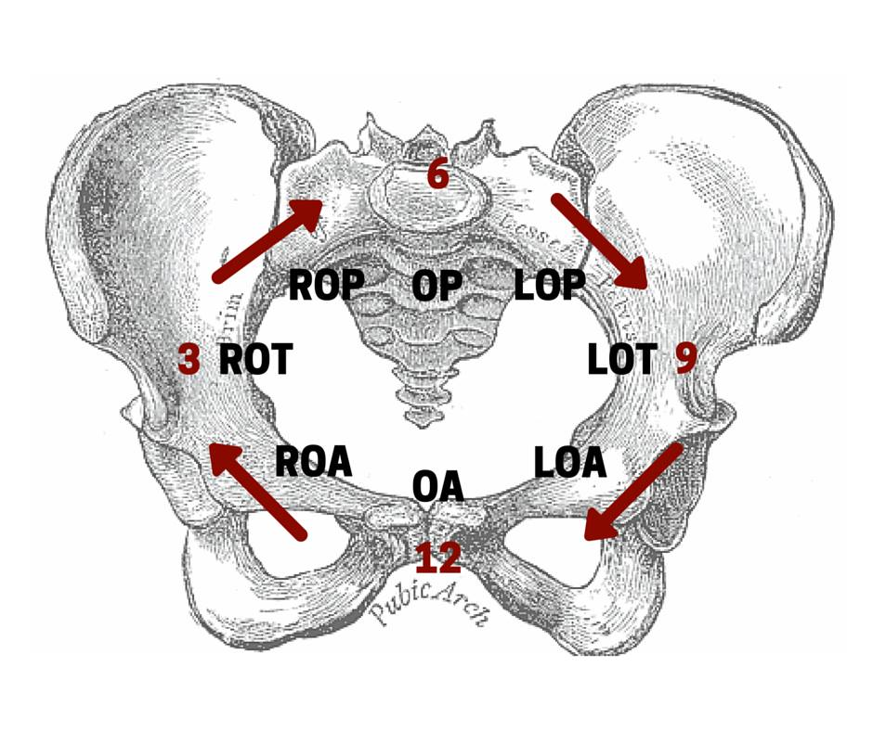

Slide 11
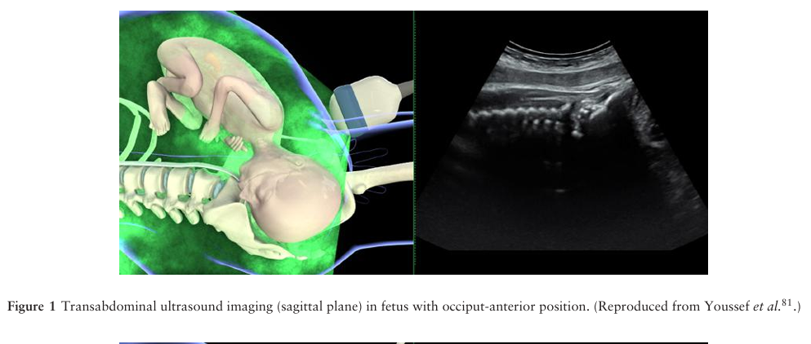
Role of USs prior to assisted vaginal birth
US assessment of fetal head position prior to assisted vaginal birth is more reliable than clinical examination.

Slide 12
However, routine USS is not recommended

Slide 13
CONSENTING
Birth room procedures – usually verbal consent
Trial of vaginal delivery; mid-cavity or rotational forceps – written consent

Slide 14
DECISION ON ASSISTED VAGINAL BIRTH?
RISK OF 2nd STAGE LSCS
RISK OF INSTRUMENTAL DELIVERY

Slide 15
communication
Communicate with mother
Communicate with consultant(SBAR)
Communicate with neonatology team, blood bank, anaesthetic team, theatre team

Slide 16
Place of assisted vaginal birth
Non rotational low pelvic and lift out assisted vaginal births have a low probability of failure and most procedures can be conducted safely in a birthroom.
Assisted vaginal birth that have a higher risk of failure should be considered a trial and attempted in a place where immediate recourse to caesarean birth can be undertaken.

Slide 17
Higher rates of failure are associated with
maternal BMI greater than 30
short maternal stature
estimated fetal weight of greater than 4 kg or a clinically big baby
head circumference above the 95th percentile
occipito–posterior position
midpelvic birth or when one-fifth of the head is palpable per abdomen.

Slide 18
Instruments which can be used
Operator should choose the instrument most appropriate to the clinical circumstances and their level of skill.
Forceps and vacuum extraction are associated with different benefits and risks.
failure to complete the birth with a single instrument is more likely with vacuum extraction, but maternal perineal trauma is more likely with forceps.
Soft cup vacuum extractors have a higher rate of failure but a lower incidence of neonatal scalp trauma.
Rotational births should be performed by experienced operators;
Options - Kielland’s rotational forceps, manual rotation followed by direct traction forceps or vacuum, and rotational vacuum extraction.

Slide 19
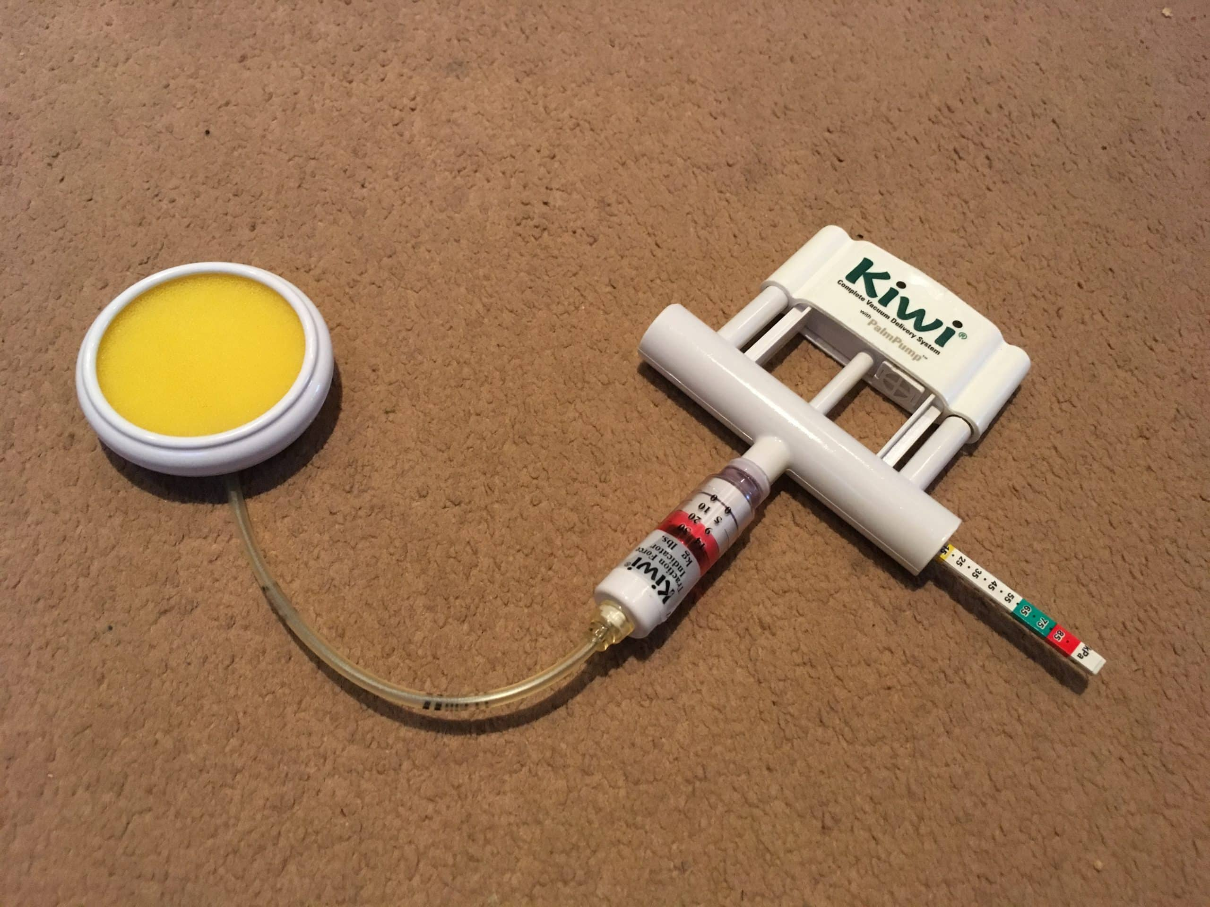

Slide 22
Forceps demonstration

Slide 23
Kiwi demonstration

Slide 24
Vacuum extraction compared to forceps
 | Advantages | Disadvantages
Ventouse | Less maternal trauma Less analgesia required Less likely to need an episiotomy (50% vs. 90% with forceps) Less likely to have OASI (1-4%) | More likely to fail Cephalhaematoma Retinal haemorrhage (17-38%) Increased risk of subdural / cerebral haemorrhage with sequential instruments
Forceps | Greater chance of success | More maternal trauma More likely to have OASI (8-12%) More analgesia required

Slide 25
When to discontinue vacuum
Complete
Complete vacuum-assisted birth in the majority of cases with a maximum of three pulls to bring the fetal head on to the perineum. Three additional gentle pulls can be used to ease the head out of the perineum.
Consider
IF minimal descent with two first pulls, consider suboptimal application, fetal position or CPD. If less experienced seek second opinion
Discontinue
Discontinue vacuum-assisted birth where there is no evidence of progressive descent with moderate traction during each pull of a correctly applied instrument by an experienced operator.
Discontinue
Discontinue vacuum after two pop offs. If less experienced seek senior help after one.

Slide 26
sequential instruments??
Use of sequential instruments is associated with increased risk of trauma to the infant.
However, balance the risk of caesarean section with risk of forceps after failed vacuum
Increased risk of OASI with sequential instrument use.

Slide 27
When to discontinue forceps
Discontinue
Discontinue attempted forceps when forceps cannot be applied easily, handles do not approximate easily or if there is a lack of progressive descent with moderate traction.
Discontinue
Discontinue rotational forceps, if rotation is not easily achieved.
Discontinue
Discontinue if birth is not imminent following three pulls.

Slide 28
Aftercare
Prophylactic antibiotics – A single dose of IV amoxicillin and clavulanic acid. – Significantly reduces confirmed or suspected maternal infections.
Good standards of hygiene and aseptic conditions are recommended.
Reassess women for venous thromboembolism risk and the need for thromboprophylaxis.
Analgesia – Offer regular NSAIDS and PCM routinely.
Bladder care – Educate women about the risk of urinary retention and importance of bladder emptying in the postpartum period.
Monitor the time and volume of the first void urine.
If retention is suspected, a post-void residual should be measured.
If regional anaesthesia is provided for the trial of the instrument, recommend indwelling catheter

Slide 29
Documentation
Should include detailed information on the assessment, decision making and conduct of the procedure, a plan for postnatal care.
Paired cord blood samples
Adverse outcomes

Slide 30
Debrief and share information
High probability of spontaneous vaginal birth in subsequent births
Individualise care for whom have sustained a third or 4th degree perineal tear or who have ongoing pelvic floor morbidity.
? May increase the risk of future anorectal damage in subsequent births

Slide 31
References
ISUOG Practice Guidelines: intrapartum ultrasound. Ultrasound Obstet Gynecol 2018.
Assisted Vaginal Birth Green-top Guideline No. 26April 2020.

Slide 32
THANK YOU
Special Acknowledgement for compiling Presentation
Dr Buddhika Asela Amarasena

