Slide 1
Managing Hypertensive Emergencies in Pregnancy Case based Discussion
Sri Lanka College of Obstetricians & Gynaecologists
Scientific Activities & Research Committee

Slide 2
Case scenario:
21 years primi-gravida
32wekks and 3 days of POG pregnant
Presented to the antenatal clinic for routine antenatal care
The midwife from the ANC reports that her blood pressure is 146/96 mmHg, proteinuria 2+.
Q1. What are the questions you would ask to check for the severity of the problem?

Slide 3
What are the questions you would ask to check for the severity of the problem?
o Do you have headache?
o Do you suffer from blurred vision?
o Do you notice light flashes?
o Do you have any abdominal pain, epigastric pain?

Slide 4
Case scenario Continued:
Patient complains of headache, blurred vision since morning.
Repeat BP 162/ 102
Q2. What else do you want to do, Examination??

Slide 5
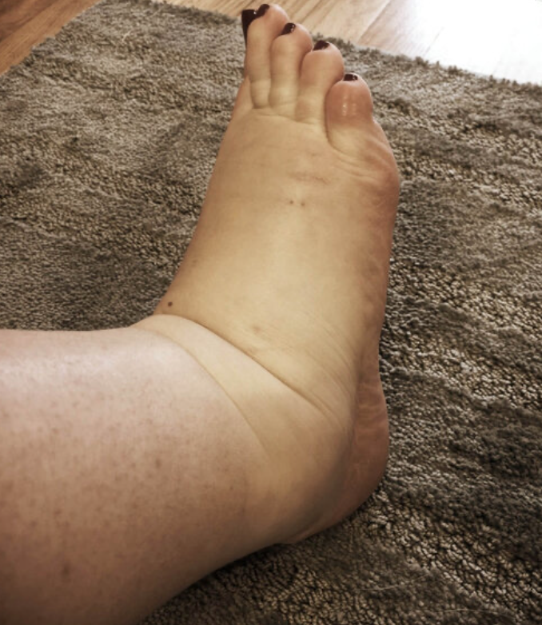
What else do you want to do, Examination??
o Exaggerated tendon reflexes with clonus
o Right hypochondrial tenderness /palpable liver
o Fundus of eye for papilledema
o Symphysiofundal height
o Feta Heart Rate
O Odema

Slide 6
Case scenario Conti:
Patient has clonus >3 beats.
No RHC tenderness
How will you proceed?

Slide 7
How will you proceed?
o Admit
o Canula , What blood investigations??
o Investigations - FBC or Serum Creatinine/ Blood Urea & electrolytes
o UPCR if available
o Fetal assessment- USS , CTG
o Vagina Examination

Slide 8
Case scenario Conti:
Q. Now BP value is 184/116
What is severe preeclampsia?

Slide 9
Preeclampsia devided in to two
Mild
Severe

Slide 10
Criteria to diagnose severe preeclampsia
Blood pressure increased substantially
Presence of end organ damage on assessment positive – History, Examination and Investigations
Presence of fetal growth restriction

Slide 11
What are the three arms of managing severe preeclampsia
BP control
Fluid Mangement
Prevention of eclampsia
Deliver Foetus and Placenta

Slide 12
How would you control her blood pressure?
Labetalol
Oral – 200mg followed by second dose after 30 minutes.
IV - Bolus 10-20mg IV over 5 minutes.
Followed by 20-80mg every 15 - 30minutes to a maximum of 300mg
Then labetalol infusion of 1-2mg/min
Regimes may differ in various guidelines
Nifedipine 10-30mg tablets repeat in 30- 45 minutes if needed
Hydralazine 5 mg, IV or IM, then 5 to 10 mg every 20 to 40 minutes.
Once BP controlled repeat every 3 hours.
For infusion: 0.5 to 10.0 mg/h

Slide 14
How would you manage her hydration?
O Pathophysiology – Endothelial dysfunction/ damage and fluid leakage
o Keep them dry.
o Intravenous fluid maintenance – 80ml/hr

Slide 15
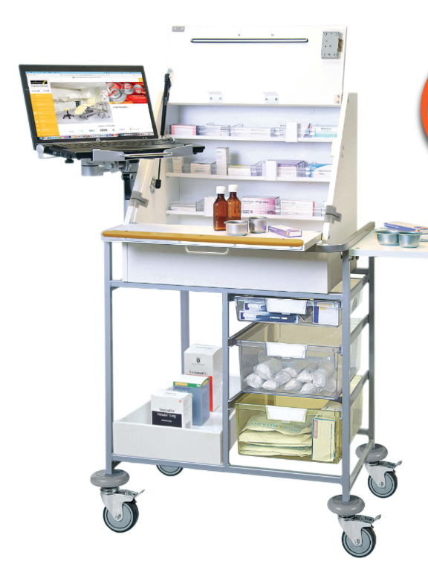
Magic drug to prevent eclampsia ??
Give magnesium sulphate intravenously or intramuscularly.
Loading dose:
IV 4g (20% solution) made up to 20 ml (water for injection) slowly over 15 minutes
Immediate side effects that can occur.........( Not an indication to stop the medication,
consider stopping only if toxicity occur during infusion)
IV maintenance can only be used if a pump is available.
This is given at 1g/hour until 24 hours after delivery or after last siezure

Slide 16
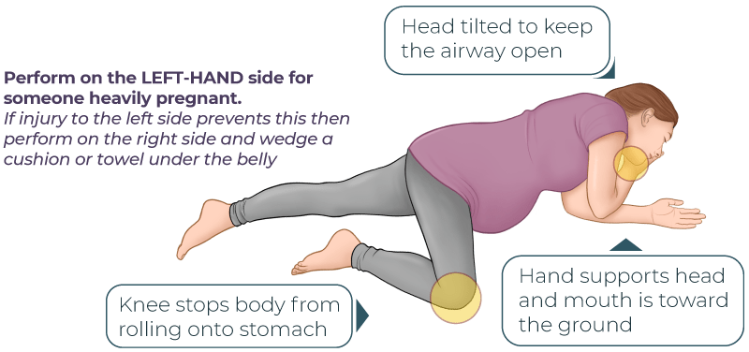
While in the ward patient’s blood pressure controlled but remains symptomatic and develop a seizure. How will you proceed?
o Call for help, seniors, and anyone available (Multidisciplinary Team Approach)
o Assessment of airway: "Hello, how are you Mrs…….
o Recovery position (Not left lateral here, aim is to clear air way)
o Breathing: look for chest movements, listen for breath sounds and feel for breathing.
o Circulation: Intravenous access, Blood for invstigations
o Magic drug/ Antiepileptics

Slide 17
How would you monitor while giving Mg SO4?
Patella reflexes(If absent-concerning)
Respiratory rate and SpO2 (If RR less than 16 breaths/minute or SpO2 on air <92% - concerning)
Urinary output (If < 0.5ml/kg/hour-concerning)
Antidote: 10 ml 10% calcium gluconate over 10 minutes

Slide 18
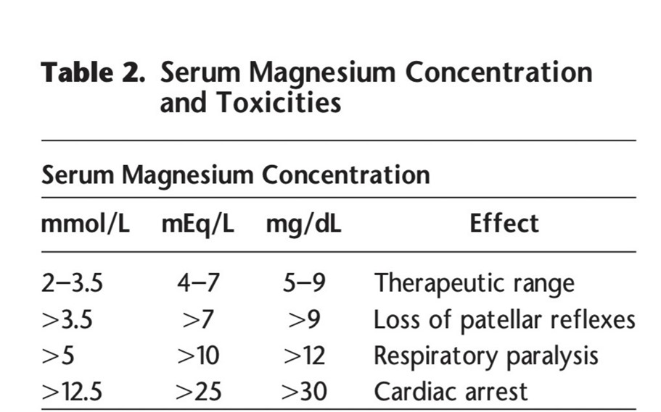
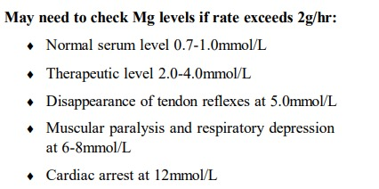

Slide 19
Case scenario 2
27 year old primi, presented with seizures to OPD and directly taken into ETU
While revelaing previous notes she is 36 weeks in her pregnancy, So far uneventful.
Patient is oedematous , with poorly visible veins
Taken to ETU and put into recovery/ lateral position.

Slide 20
If no IV access, how can we deliver MgSo4?
IM 5g to each buttock with 1ml 2% lignocaine
Maintenance: Continue 5 g IM with 1 ml 2% lignocaine every 4 hours until 24 hours after delivery or since last fit.

Slide 21
Fit was settled with initial bolus of MgSo4, What is the next step in management?
Assess whether vaginal delivery is likely to proceed quickly
or
Whether need to transfer for LSCS

Slide 22
Case scenario 2 conti..
Vaginal examination revealed not suitable for induction
Decided for LSCS
IV access gained
During preparing for LSCS patient develop another siezure?

Slide 23
During preparing for LSCS patient develop another fit What now??
o Give additional 2-4 g IV (lower dose, 2 g, if weight less than 70 kg)

Slide 24
Can we give more MgSO4 (>2 doses)? If further recurrence what are the options
IV/ Rectal Diazepam 10mg
Can repeat 10 mgs
MDT / Medical input / ICU care
Check SPO2 and for features of aspiration

Slide 25
What is the ultimate cure for eclampsia/ preeclampsia?
Delivery
Post-delivery care
May need ICU care
Repeat blood pressure
Repeat blood investigations
Debrief

Slide 26
Post-delivery patient deteriorates with confusion. What would be the next steps in management?
o Imaging – Brain
o Re-evaluate from head to toe for a cause.
o Can be unrelated to preeclampsia.
o MDT

Slide 27
Thank you…
Sri Lanka College of Obstetricians & Gynaecologists
Scientific Activities & Research Committee

