Slide 1
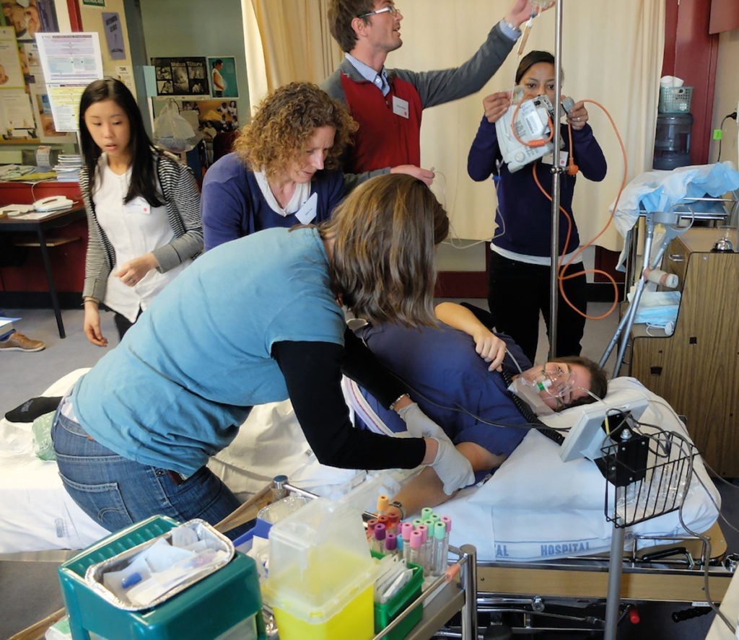
MATERNAL COLLAPSE

Slide 2
Definition
Acute event involving cardiorespiratory system or CNS
Result in reduced or absent conscious level
During pregnancy and upto 6 weeks pospartum period

Slide 3
Identifying impending collpase
Modified Early Warning Score combined with Clinical Judgement

Slide 4
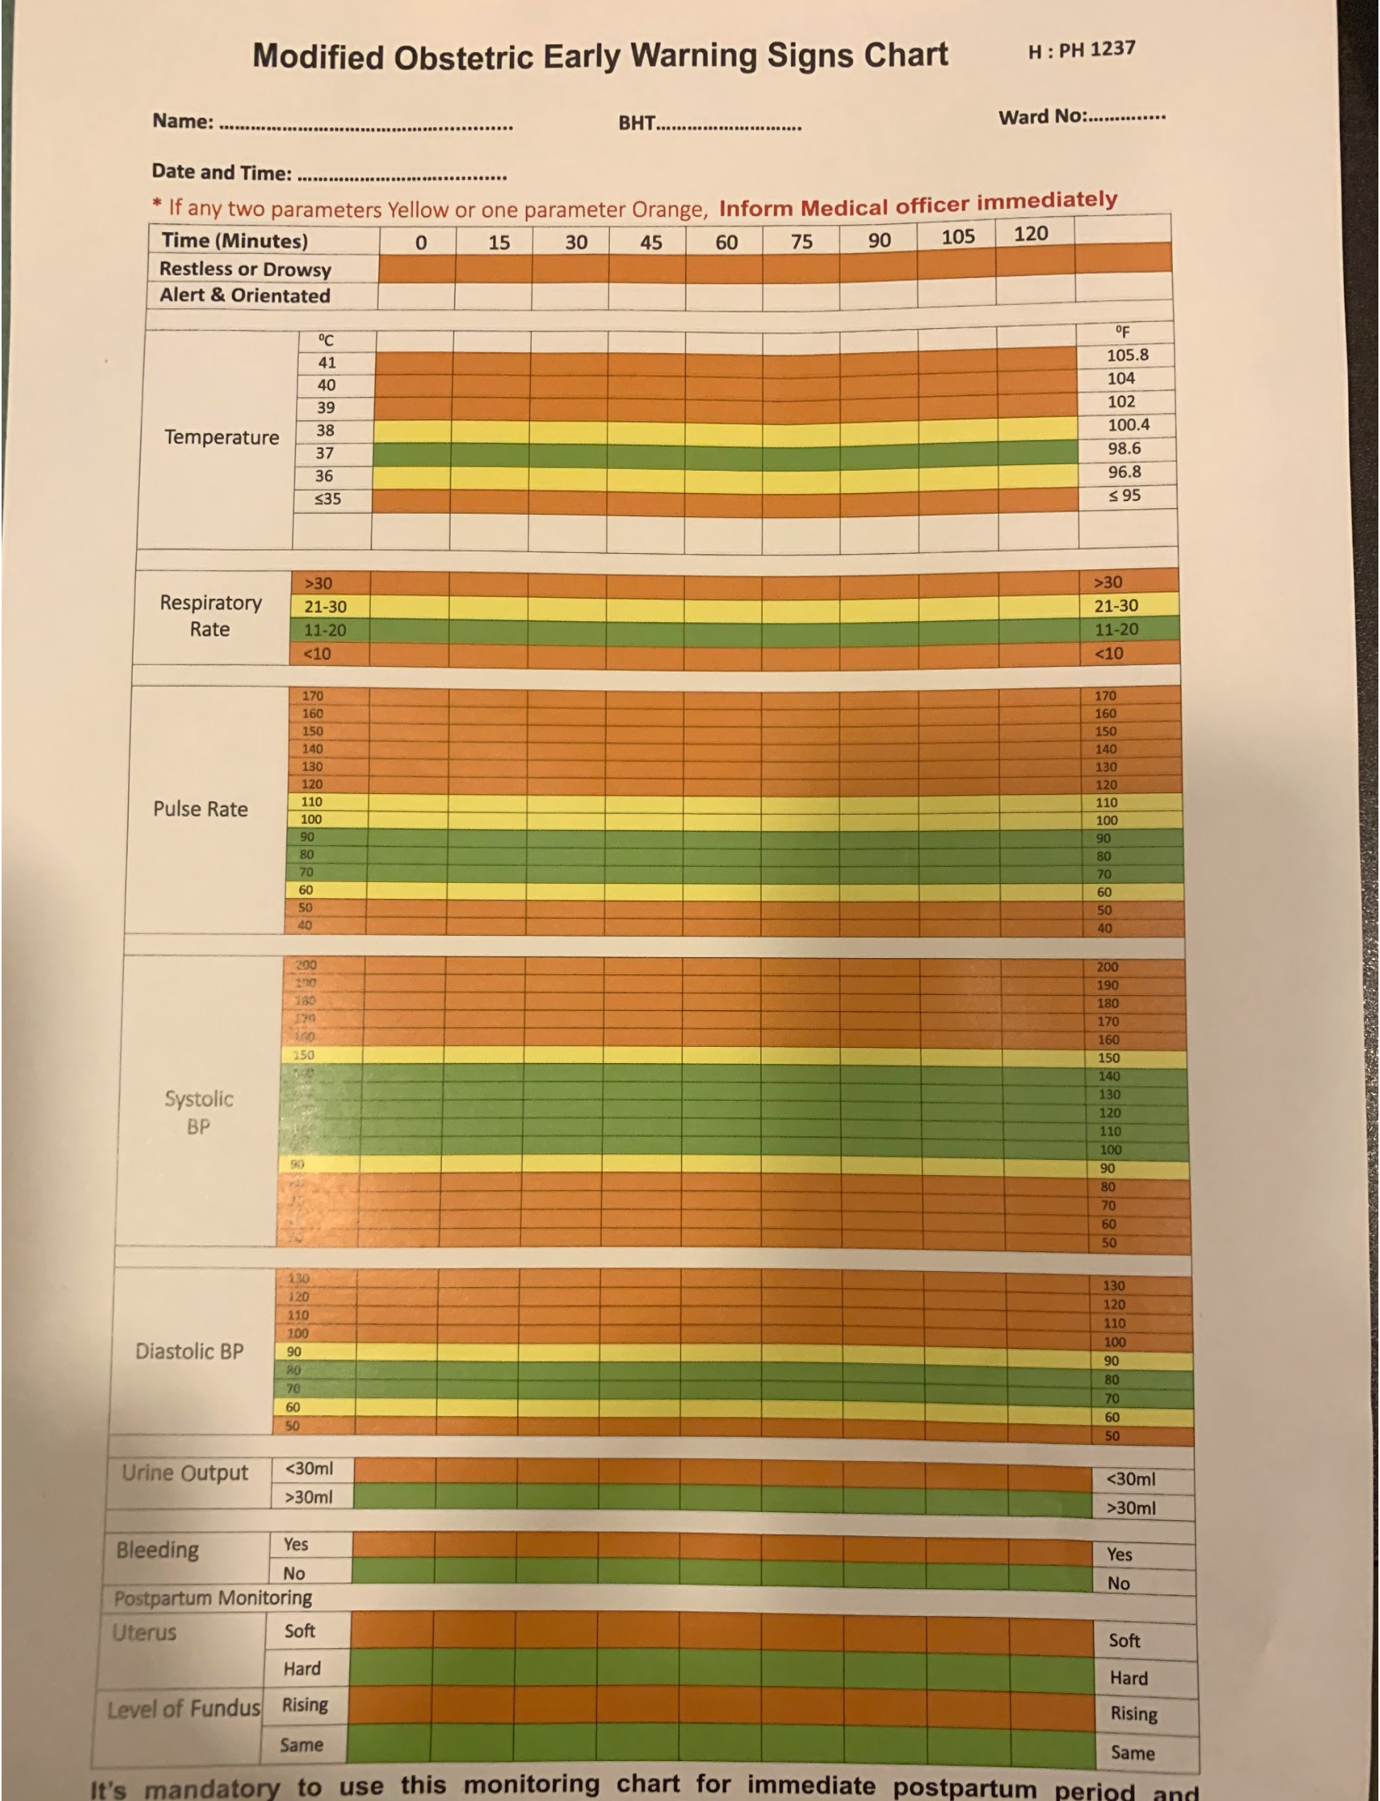

Slide 5
Causes

Slide 6
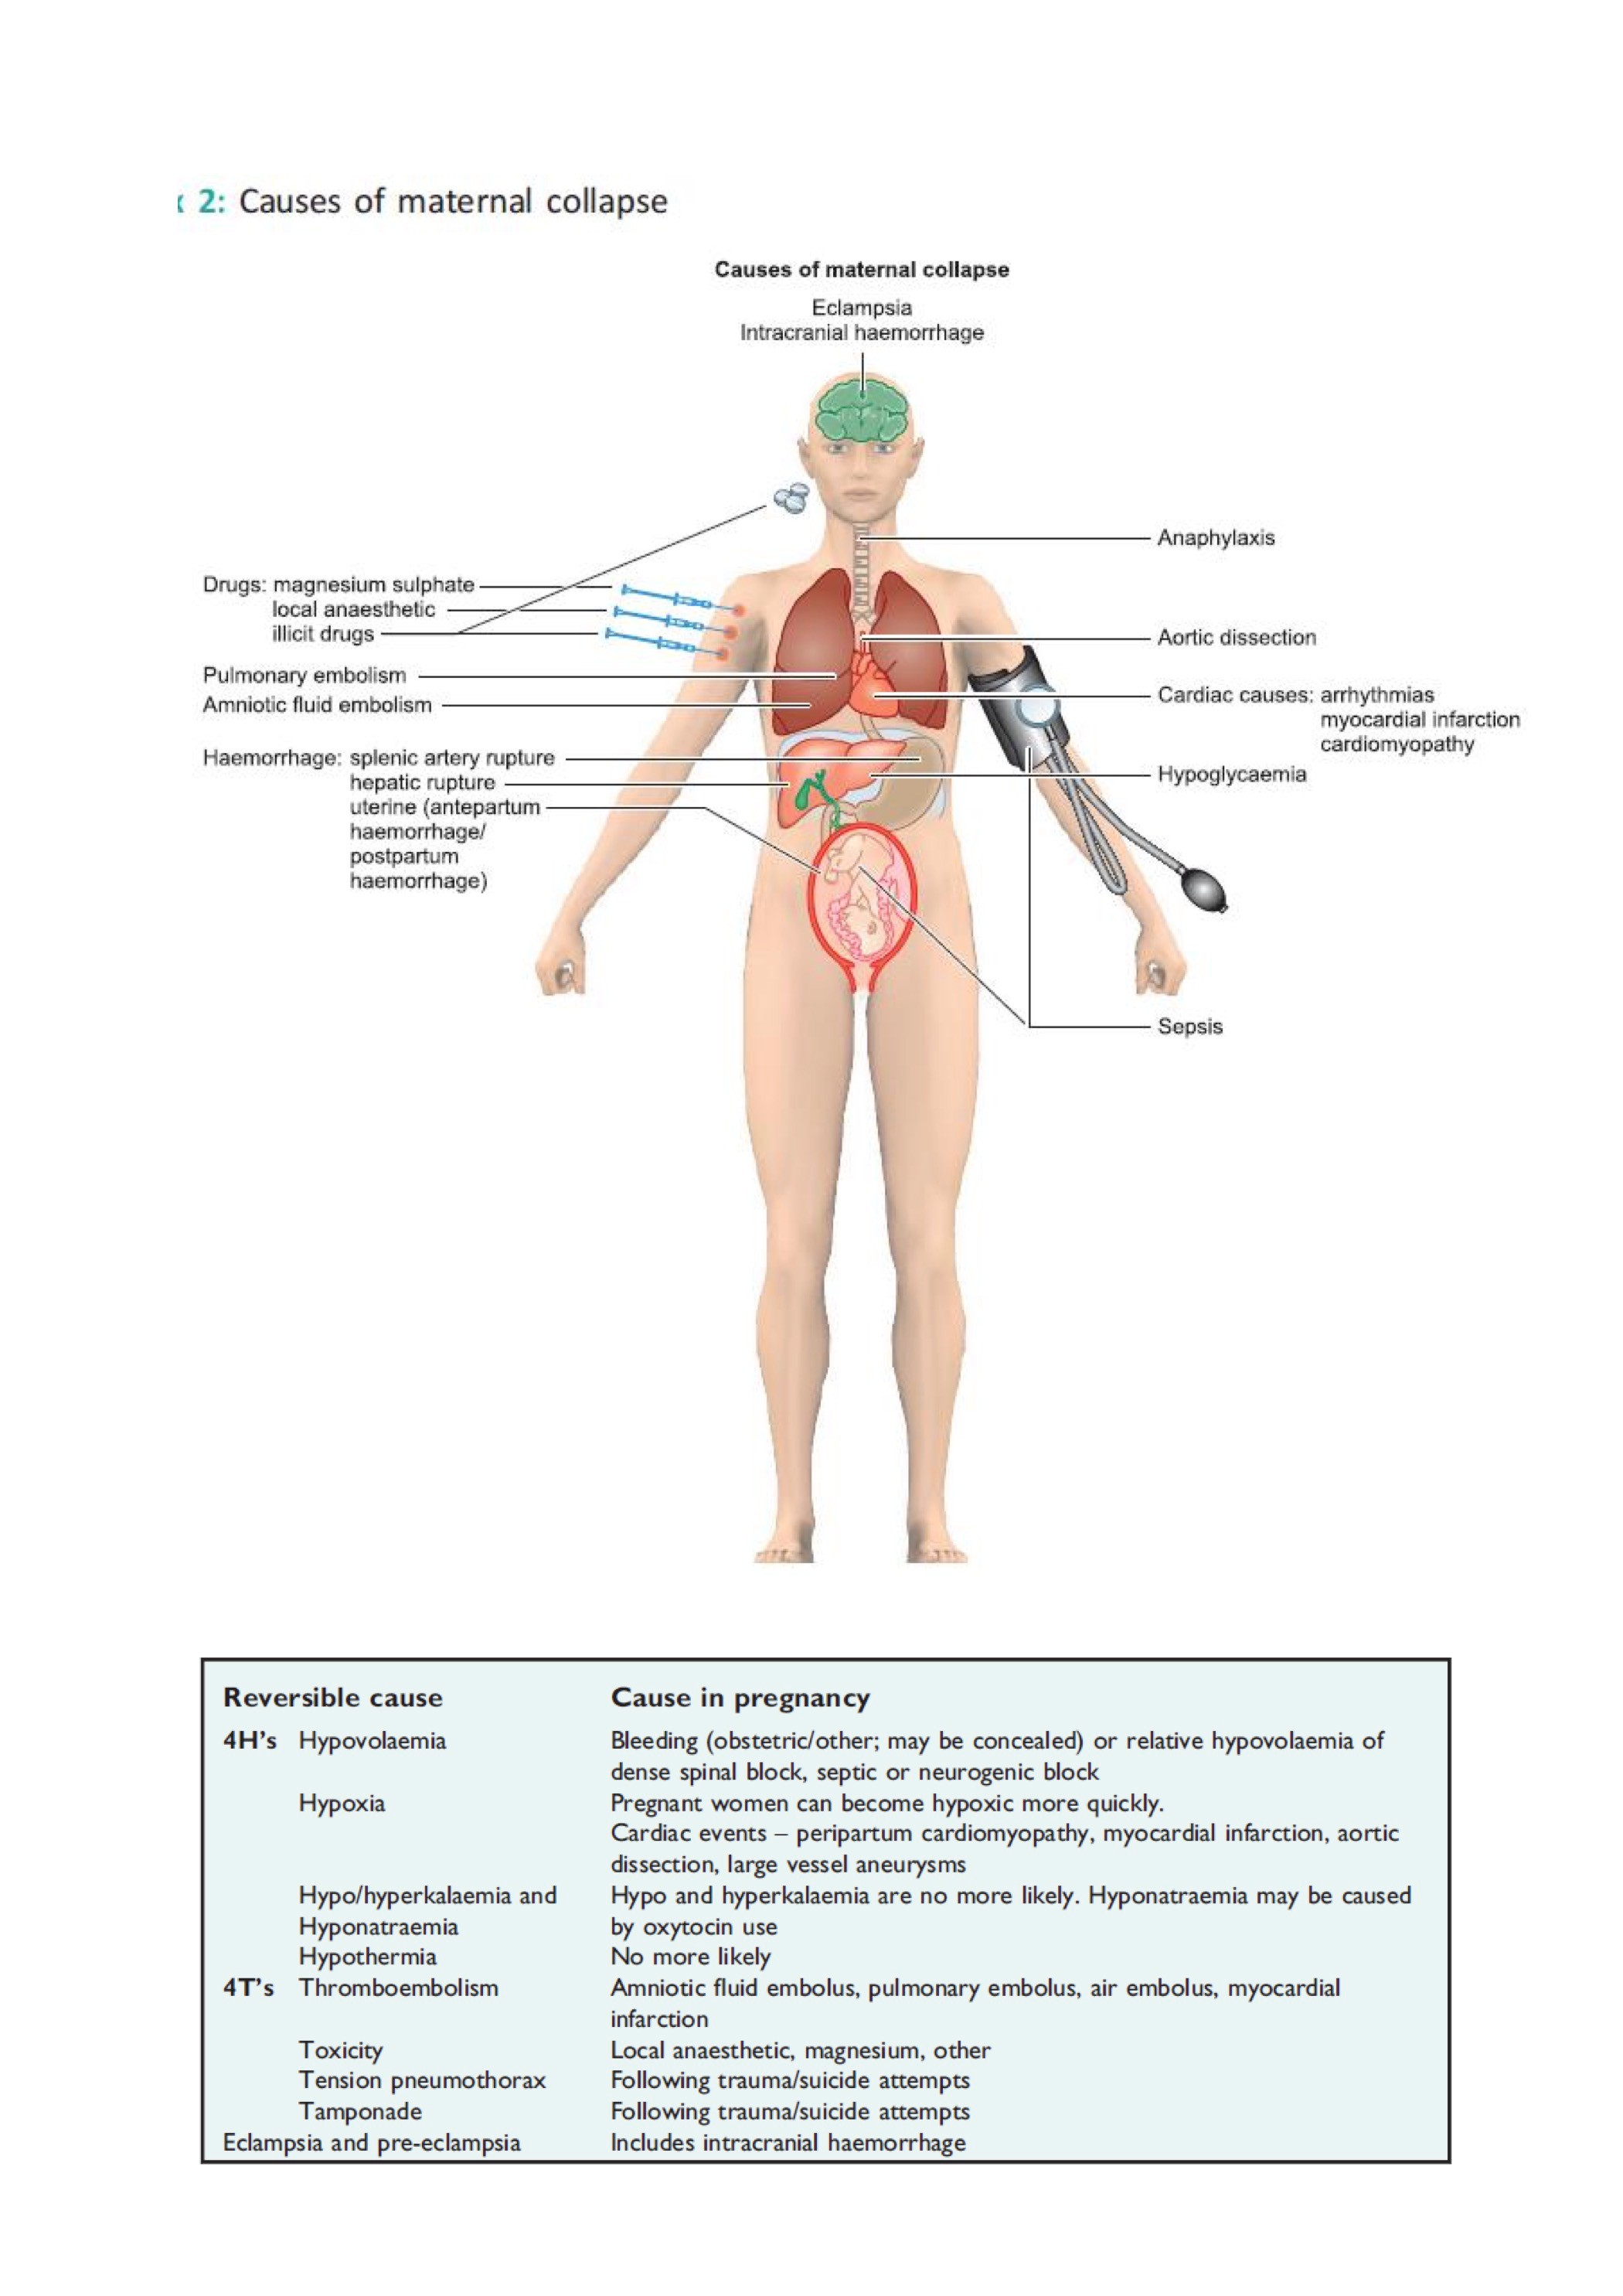

Slide 7
Reversible causes of Maternal Collpase
Cause | Pregnancy related situations
Hypovolaemia | Bleeding
 | Relaive hypovolaemia | Dense spinal block
 |  | Septic shock
 |  | Neurohgenic shock
Hypoxia | Cardiac events | Peripartum cardiomyopathy
 |  | Myocardial infarction
 |  | Aortic dissection
 |  | Large vessel aneurysm
Hypo/hyperkalemia Hyponatraemia | Oxytocin use
Hypothermia and hypoglycaemia

Slide 8
Reversible causes of Maternal Collpase continued…..
Cause | Pregnancy related situations
Thromboembolism | Amniotic fluid embolism
 | Pulmonary embolism
 | Air embolism
 | Myocardial infarction
Toxicity | Local anaesthetic agents
 | Magnesium sulphate
Tension pneumothorax | Trauma
 | Suicide attempts
Tamponade | Trauma
 | Suicide attempts
Others | Eclampsia and pre-eclampsia
 | ICH

Slide 9
Anatomical and physiological changes in pregnancy and its implications

Slide 10
Cardiovascular system
Component | Changes | ImplicationsPlasma
Plasma volume | ↑ 𝑢𝑝𝑡𝑜 50% | Dilutional anaemia and ↓ O₂ carrying capacity
Heart rate | ↑ 𝑏𝑦 15 − 20 𝑏𝑝𝑚 | ↑ circulatory demand at CPR
Cardiac output | ↑ 40% | ↑ circulatory demand at CPR
Uterine blood flow | 10% 𝑜𝑓 𝑐𝑎𝑟𝑑𝑖𝑎𝑐 𝑜𝑢𝑡𝑝𝑢𝑡 𝑎𝑡 𝑡𝑒𝑟𝑚 | Rapid ,massive haemorrhage
Systemic vascular resistance | ↓ | Blood sequestration with CPR
Arterial blood pressure | ↓ 𝑏𝑦 10 − 15 𝑚𝑚𝐻𝑔 | ↓ reserve
Venous return | ↓ by gravid uterus | ↑ circulatory demand at CPR

Slide 11
Respiratory system
Component | Changes | Implications
Respiratory minute volume | ↑ by increasing tidal volume | ↓ buffering capacity and acidosis
O₂ consumption | ↑ by 20% | Hypoxia develops quickly
Residual capacity | ↓ by 25% | If apnoeic hypoxia develops quickly
Arterial P_{CO2} | ↓ | ↓ reduced buffering capacity
Laryngeal oedema | ↑ | Difficult intubation

Slide 12
Other systems
Component | Changes | Implications
Gastric motility | ↓ | ↑ risk of aspiartion
Lower oesophageal sphincter | Relaxed | ↑ risk of aspiartion
Uterus | Enlarged | Diaphragmatic splintting and ↓ residual capacity Aortocaval compression and ↓ venous return
Weight | ↑ breast size | Interfere with intubation with reduced space

Slide 13
Management

Slide 14
Optimal Initial Management
Resuscitation
Community setting
Basic life support→ Advanced life support by paramedics
Hospital setting
Look for Signs of life
If present →ABCDE approach
If absent → CPR/Call upon cardiac arrest team/Summon consultant obstetrician/consultant anaesthetist/neonatology team

Slide 15
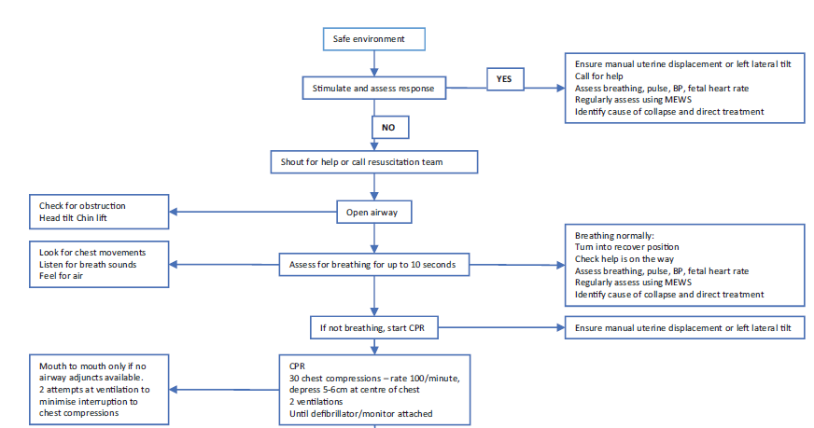

Slide 24
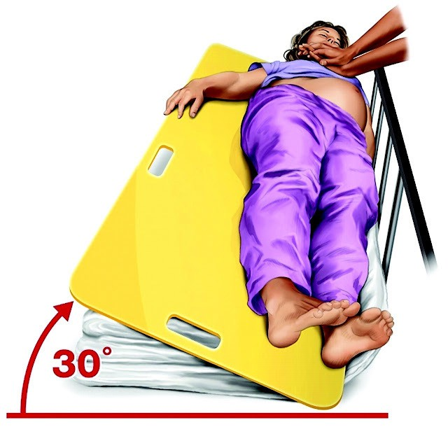
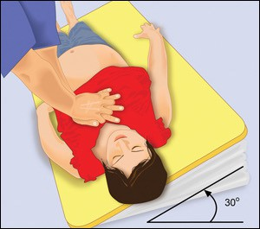
Relieve aortocaval compression after 20 weeks
Manual displacement of the uterus to left side of the abdomen Head to toe left tilt at an angle of 15-30 ⁰
►
►
This Photo by Unknown Author is licensed under CC BY-NC-ND

Slide 26
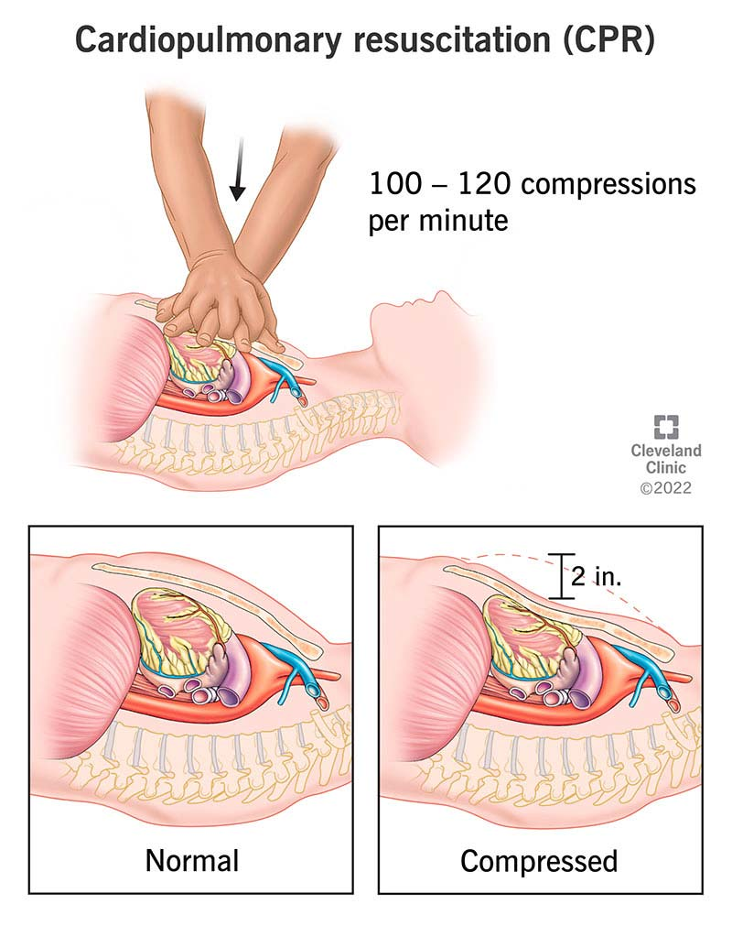
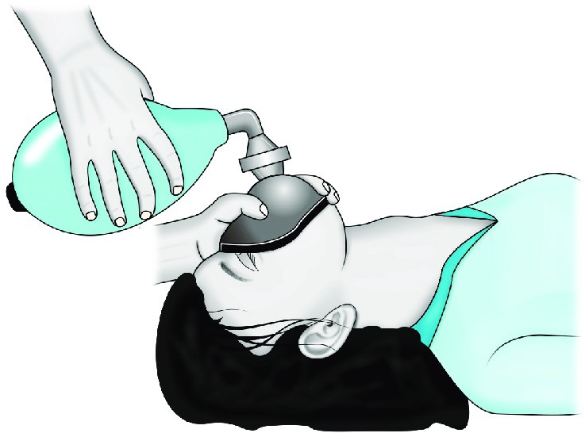

Slide 27
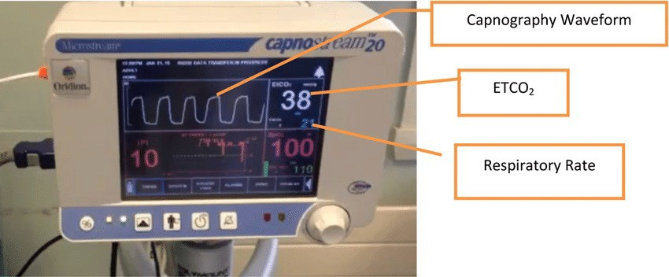
Airway management
If unconscious intubte immediately with cuffed endotracheal tube
If intubation fails
Call for help Maintain oxygenation
Supraglottic airway insertion Front of the neck access
Use wavefoorm capnography

Slide 28
Circulation
Airway clear and if no breathing present start chest compressions
2 wide bore cannulae insertion
Aggressive approach to volume replacement
Abdominal USS to detect concealed bleeding
If defibrillation needed use same energy levels as in non – pregnant patients
After 20 weeks of gestation if chest compressions seems to be ineffective early recourse to delivery

Slide 29
Disability assessment

Slide 30
Exposure
Trauma
Rash
Oedema

Slide 31
Other steps in initial management
Assess the fetus
Consider reversible causes for collapse
Continue resuscitation
Consider perimortem caesarean section

Slide 32
Ongoing Management
Depends on the cause of maternal collpase
Involvement of the senior staff
Supervised transfer to HDU/ICU

Slide 33
Main Causes for Maternal Collapse
Haemorrhage
Embolism
Sepsis
Cardiac Diseases
Drug Overdose and Toxicity
Eclampsia
Anaphylaxis

Slide 34
Haemorrhage
APH- prompt delivery of the placenta and fetus
PPH- IV tranexamic acid reduce mortality
Ruptured ectopic pregnancy-excision of ectopic pregnancy
Hepatic rupture or splenic artery rupture

Slide 35
Embolism
VTE- use thrombolysis and anti-coagulation
Amniotic Fluid Embolism- supportive therapy

Slide 36
Sepsis
Care bundle according to “ Surviving Sepsis Guideline”
Measure serum lactate level
Blood cultures and swabs for cultures
Broad spectrum antibiotics within 1st hour of recognition
Fluid therapy and maintain MAP>65mmHg
Maitain saturation and maintain Hb>7g/dL

Slide 37
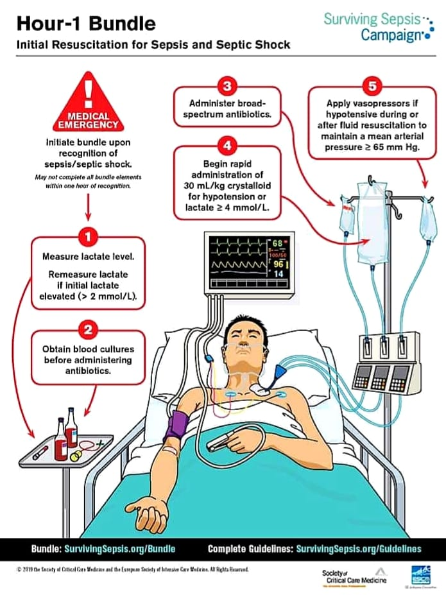

Slide 38
Cardiac disease
Myocardial infarction
Sudden arrhythmias
Prosthetic cardiac valves
Cardiomyopathy
LVF and pulmonary oedema
Infective endocarditis

Slide 39
Drug ovedose and toxicity
MgSO₄- 10% Calcium gluconate 10ml over 10 min
Local anaesthetic agents- Lipid rescue/manage arrhythmias/consider cardio- pulmonary bypass

Slide 40
Eclampsia
Control seizures with MgSO₄
Definitive management- Delivery of fetus and placenta

Slide 41
Anaphylaxis
Rmove potential agent
ABCDE approach
1:1000 adrenaline 0.5mg IM
Adjuvant therapy- IV/IM Chlophenamine and Hydrocortisone

Slide 42
Outcome
Depends on:
Cause
Access to emergency care
Gestational age

Slide 43
Team management
Senior obstetrician
Senior obstetrics anaesthetist
Neonatal team if gestational age> 22 weeks
Senior midwife
Intensivist

Slide 44
Clinical Governance
Accurate documentation
Incident reporting
Training on resuscitation
Debriefing

Slide 45
Thank you!

