Slide 1
Newborn Resuscitation
Sri Lanka College of Obstetricians & Gynaecologists
Scientific Activities & Research Committee

Slide 2
Objectives
Sri Lanka College of Obstetricians & Gynaecologists
Scientific Activities & Research Committee
Understand the physiology of asphyxia
Initiating resuscitation at birth and first 20 minutes in a competent manner
Skills
# airway management and lung inflation
# chest compression

Slide 3
Sri Lanka College of Obstetricians & Gynaecologists
Scientific Activities & Research Committee
Adults
Babies
Primarily cardiac
Needs CPR
Primarily respiratory
Needs airway MX
No fluid in the lungs
Fluid in the lungs
Chest compressions circulation to brain
Chest compressions circulation to heart

Slide 4
Physiology of neonatal hypoxia
Sri Lanka College of Obstetricians & Gynaecologists
Scientific Activities & Research Committee

Slide 5
Sri Lanka College of Obstetricians & Gynaecologists
Scientific Activities & Research Committee

Slide 6
Strategy for resuscitation
Sri Lanka College of Obstetricians & Gynaecologists
Scientific Activities & Research Committee
Difficult to decide whether in primary or secondary apnoea
Therefore graded approach which will be effective in either situation
Start the clock/Note the time of birth

Slide 7
Preparation
Sri Lanka College of Obstetricians & Gynaecologists
Scientific Activities & Research Committee

Slide 8
Sri Lanka College of Obstetricians & Gynaecologists
Scientific Activities & Research Committee
Risk Factor/anticipation
Check the equipment

Slide 9
Dry and cover the baby
Sri Lanka College of Obstetricians & Gynaecologists
Scientific Activities & Research Committee
Use 3 prewarmed towels
Dry the baby quickly
Remove the wet towel and wrap in a fresh dry warm towel

Slide 10
Asses the situation
Sri Lanka College of Obstetricians & Gynaecologists
Scientific Activities & Research Committee
Colour ?
Tone ?
Heart rate ?
Breathing ?

Slide 11
Do you need help ? Don’t be proud Always ask for help if you encounter any difficulty
Sri Lanka College of Obstetricians & Gynaecologists
Scientific Activities & Research Committee

Slide 12
Airway management key elements
Sri Lanka College of Obstetricians & Gynaecologists
Scientific Activities & Research Committee
Opening the airway
Inflating the lungs

Slide 13
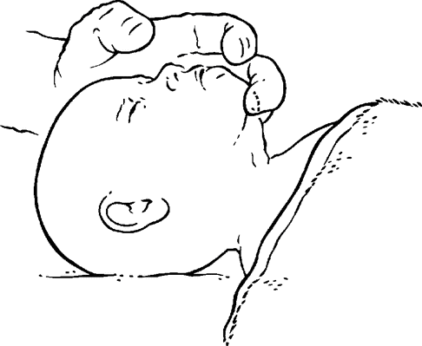
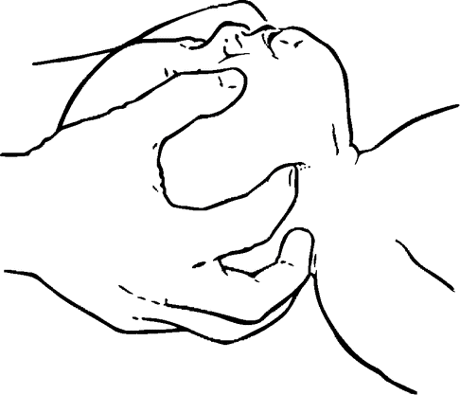
Opening the airway
Sri Lanka College of Obstetricians & Gynaecologists
Scientific Activities & Research Committee
Neutral position
Chin lift
Jaw thrust

Slide 14
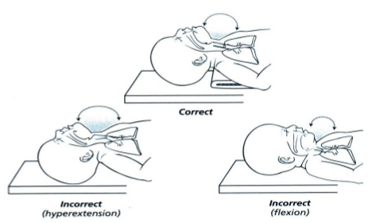
Sri Lanka College of Obstetricians & Gynaecologists
Scientific Activities & Research Committee

Slide 15
AMBU - MASK INFLATION IS OF NO USE UNLESS THE AIRWAY IS OPEN
Sri Lanka College of Obstetricians & Gynaecologists
Scientific Activities & Research Committee

Slide 16
Inflating the lungs
Sri Lanka College of Obstetricians & Gynaecologists
Scientific Activities & Research Committee

Slide 17
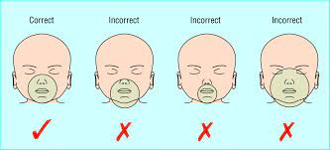
Sri Lanka College of Obstetricians & Gynaecologists
Scientific Activities & Research Committee

Slide 18
Sri Lanka College of Obstetricians & Gynaecologists
Scientific Activities & Research Committee
INFLATE THE LUNGS WITH
FIVE INFLATION BREATHS

Slide 19
Inflation breaths
Sri Lanka College of Obstetricians & Gynaecologists
Scientific Activities & Research Committee

Slide 20
Sri Lanka College of Obstetricians & Gynaecologists
Scientific Activities & Research Committee
After five inflation breaths
Check for a response
Did I achieve chest expansion?
Did the HR improve?

Slide 21
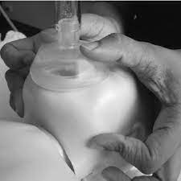
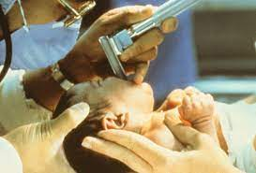
If the inflation breaths were not delivered properly
Sri Lanka College of Obstetricians & Gynaecologists
Scientific Activities & Research Committee
Reposition the air way
Double handed jaw thrust
Directly visualise the vocal cords and suck out secretions, if present
No blind suctioning

Slide 22
Re assess
Sri Lanka College of Obstetricians & Gynaecologists
Scientific Activities & Research Committee
NO IMPROVEMENT
C
T
B
T
Start ventilation breaths

Slide 23
Providing ventilation breaths
Sri Lanka College of Obstetricians & Gynaecologists
Scientific Activities & Research Committee

Slide 24
Re assess CTBH
Sri Lanka College of Obstetricians & Gynaecologists
Scientific Activities & Research Committee
IMPROVEMENT IN HR
NO IMPROVEMENT IN BREATHING
NO IMPROVEMENT
IN BOTH B & H
VENTILATION BREATHS
START CEHST COMPRESSIONS WITH VENTILATION

Slide 25
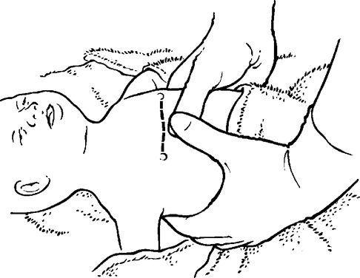
CARDIAC COMPRESSIONS On the sternum just below an imaginary line joining the nipples
Sri Lanka College of Obstetricians & Gynaecologists
Scientific Activities & Research Committee

Slide 26
Sri Lanka College of Obstetricians & Gynaecologists
Scientific Activities & Research Committee

Slide 27
Sri Lanka College of Obstetricians & Gynaecologists
Scientific Activities & Research Committee

Slide 28
Sri Lanka College of Obstetricians & Gynaecologists
Scientific Activities & Research Committee
3:1 synchrony

Slide 29
Sri Lanka College of Obstetricians & Gynaecologists
Scientific Activities & Research Committee

Slide 30
Drugs drugs needed – only rarely.
Sri Lanka College of Obstetricians & Gynaecologists
Scientific Activities & Research Committee
What drugs ?
sodium bicarbonate
Adrenaline
Dextrose
Volume expander

Slide 31
DO NOT INJECT TO THE UMBILICAL CORD OR PERIPHERAL VEIN
Sri Lanka College of Obstetricians & Gynaecologists
Scientific Activities & Research Committee

Slide 32
Endotracheal intubation
Sri Lanka College of Obstetricians & Gynaecologists
Scientific Activities & Research Committee
When is it necessary ?

Slide 33
Sri Lanka College of Obstetricians & Gynaecologists
Scientific Activities & Research Committee
It should be achieved within 30 seconds. If you fail to do so, revert to mask inflation before trying again

Slide 34
Lets practice inflation breaths!!
Sri Lanka College of Obstetricians & Gynaecologists
Scientific Activities & Research Committee

