Slide 1




Postpartum Haemorrhage

Slide 2

Post Partum Hemorrhage
Sri Lanka College of Obstetricians & Gynaecologists
Scientific Activities & Research Committee
Each year, about 14 million women experience PPH resulting in about 70,000 maternal deaths globally(WHO 2023)
Primary – more than 500ml within 24 hrs of delivery
Secondary – Any significant blood loss between 24 hrs to 12 weeks of delivery
PPH can be minor (500–1000 ml) or major (more than 1000 ml). Major could be divided to moderate (1000–2000 ml) or severe (more than 2000 ml)

Slide 3
A WOMAN Dies Every 4 minutes from PPH
Sri Lanka College of Obstetricians & Gynaecologists
Scientific Activities & Research Committee
Why ???
Too Little
Too Late
(Golden Hour)

Slide 4
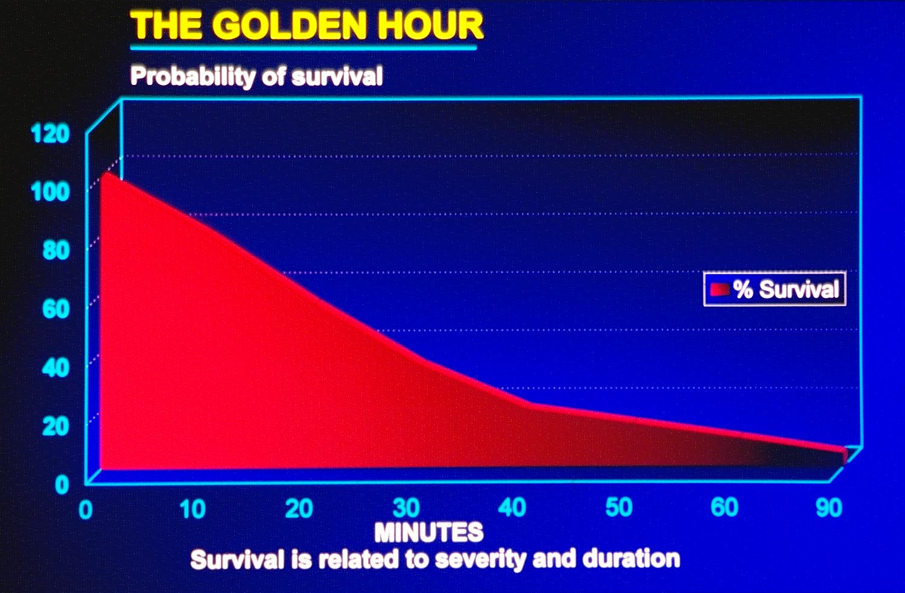
Sri Lanka College of Obstetricians & Gynaecologists
Scientific Activities & Research Committee

Slide 5
Sri Lanka College of Obstetricians & Gynaecologists
Scientific Activities & Research Committee
Tone
Trauma
Tissue
Thrombin
4Ts

Slide 6
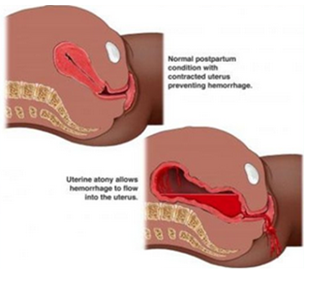
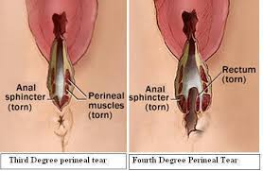
Causes
Sri Lanka College of Obstetricians & Gynaecologists
Scientific Activities & Research Committee
T = TONE
4 T’s
T = TRAUMA

Slide 7
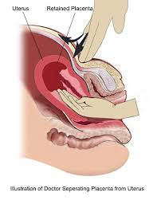
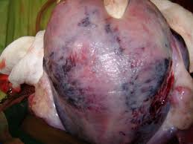
Causes Cont…
Sri Lanka College of Obstetricians & Gynaecologists
Scientific Activities & Research Committee
T = TISSUE
4 T’s
T = THROMBINE

Slide 8
Post Partum Hemorrhage
Sri Lanka College of Obstetricians & Gynaecologists
Scientific Activities & Research Committee
Risk Factors
Previous PPH -Tone
Multiple pregnancy -Tone
Fetal macrosomia -Tone
Failure to progress in second stage -Tone
Prolonged third stage of labour -Tone
General anaesthesia -Tone
Retained placenta -Tissue
Placenta accreta -Tissue
Episiotomy -Trauma
Perineal laceration -Trauma
Pre-eclampsia -Thrombin

Slide 9
Initial Assessment
Sri Lanka College of Obstetricians & Gynaecologists
Scientific Activities & Research Committee
Check Airway, breathing , circulation
· “Mrs X , how are you?”
(If Mrs X repsonds airway intact)
· Look listen and feel for breathing
· Check her pulse and blood pressure / attach to cardiac monitor
Capillary refill time and pallor
Assess blood loss

Slide 10
Pictogram
Sri Lanka College of Obstetricians & Gynaecologists
Scientific Activities & Research Committee

Slide 11
Shock index = HR/SBP (normal <0.9)
Sri Lanka College of Obstetricians & Gynaecologists
Scientific Activities & Research Committee

Slide 12
Initial Management
Sri Lanka College of Obstetricians & Gynaecologists
Scientific Activities & Research Committee
O2 via face mask 12-15L/min
· Ensure she has good IV access (large bore cannula 14G or 16G) and insert foley catheter to monitor UOP
· Send blood (full blood count , PT/INR, APTT, Grouping & cross match, LFT, RFT)
· Start IV fluids (IV Ringer’s lactate / 0.9% saline 2.5L)
· Get down blood from the blood bank. Until blood arrives IV fluids

Slide 13
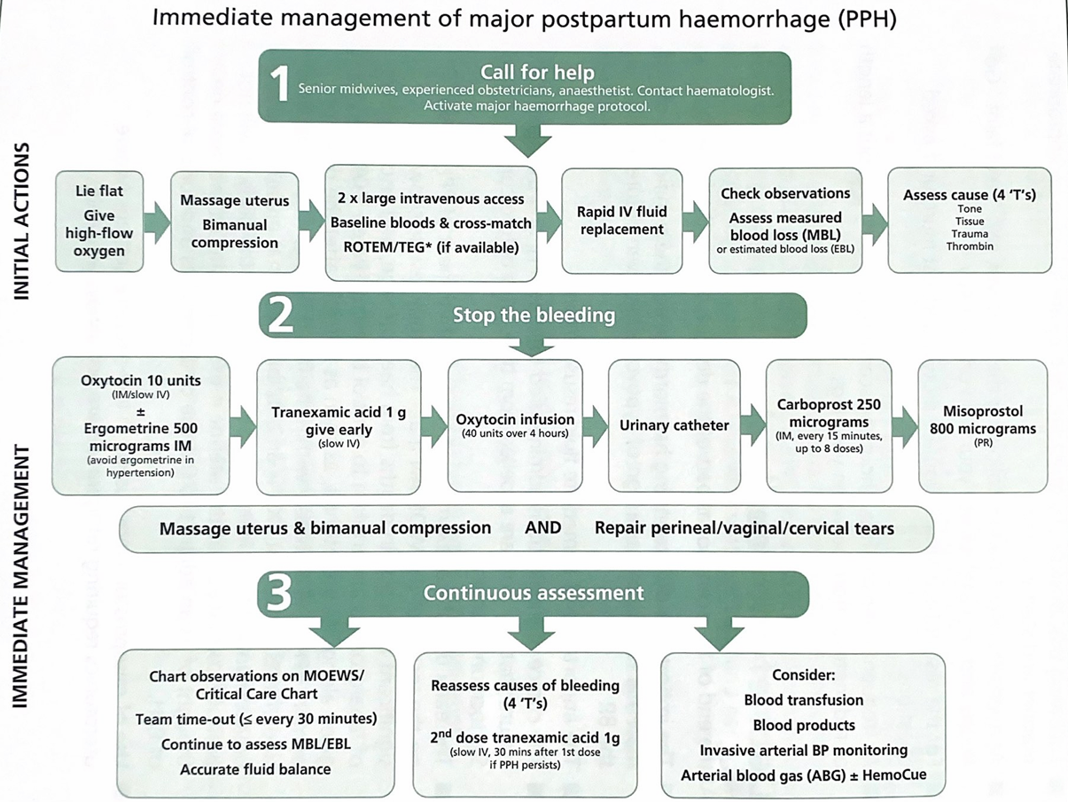
Sri Lanka College of Obstetricians & Gynaecologists
Scientific Activities & Research Committee

Slide 14
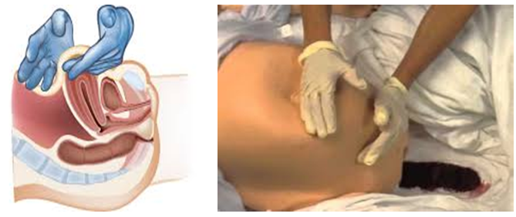
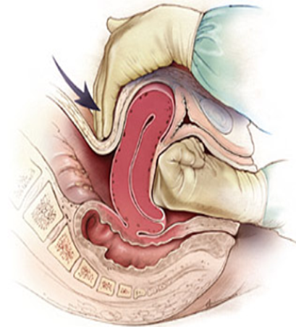
Management Cont…
Sri Lanka College of Obstetricians & Gynaecologists
Scientific Activities & Research Committee
Uterine Massage
Bimanual Compression

Slide 15
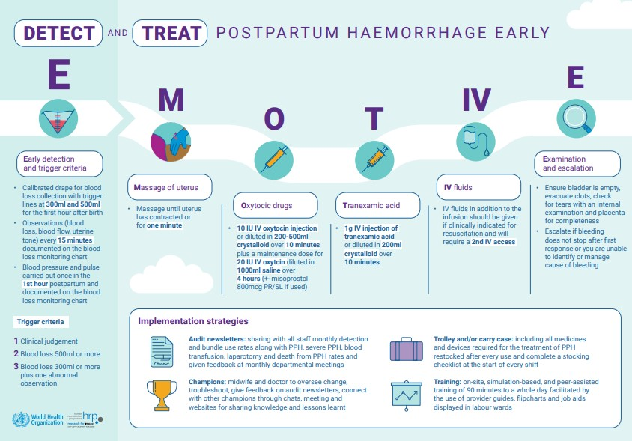

Slide 16
Sequential Medical Mx
Oxytocin 10 units IV bolus
Oxytocin 20 units in 1000 ml N/S over 4 hours (5 u/hr)
Ergometrine 0.5 mg IV or IM (Ask for C/I)
After each step 5 to 10 min.s given depending on the situation;
Reassessed and moved to the next step
Rpt Ergometrine 0.5 mg IV
Misoprostol 800 mcg PR
Carboprost 0.25mg intramyometrial/ Intramuscular. Repeated every 15mins, Up to max of 8 doses

Slide 17
Post Partum Hemorrhage
Sri Lanka College of Obstetricians & Gynaecologists
Scientific Activities & Research Committee
Surgical managements
Explore under good light
Repair / Pack
Tamponade – Condom catheter, Bakri catheter
Surgical options – B lynch, De-vascularization, Hysterectomy

Slide 18
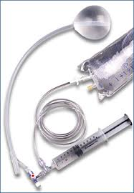
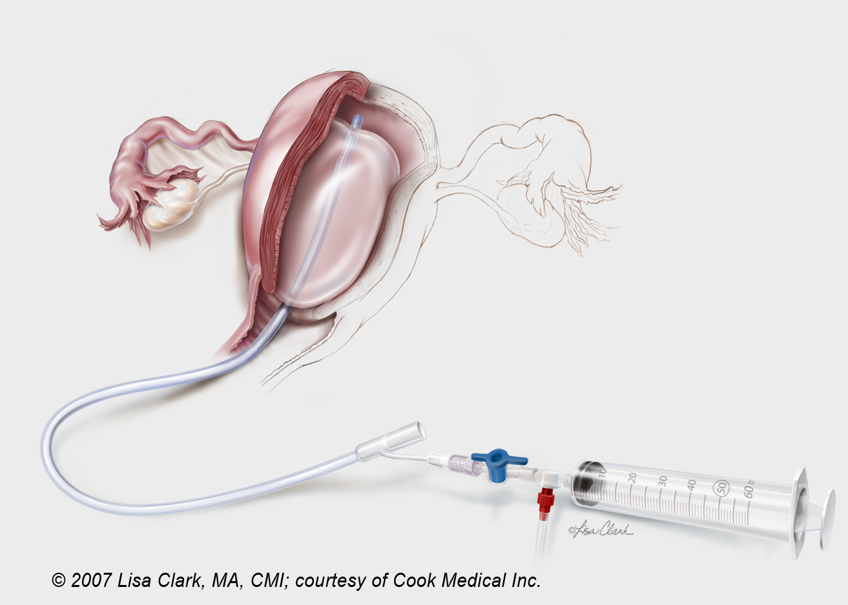
Sri Lanka College of Obstetricians & Gynaecologists
Scientific Activities & Research Committee
Balloon Tamponade
Tamponade; Bakri Catheter

Slide 19
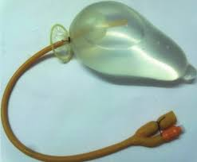
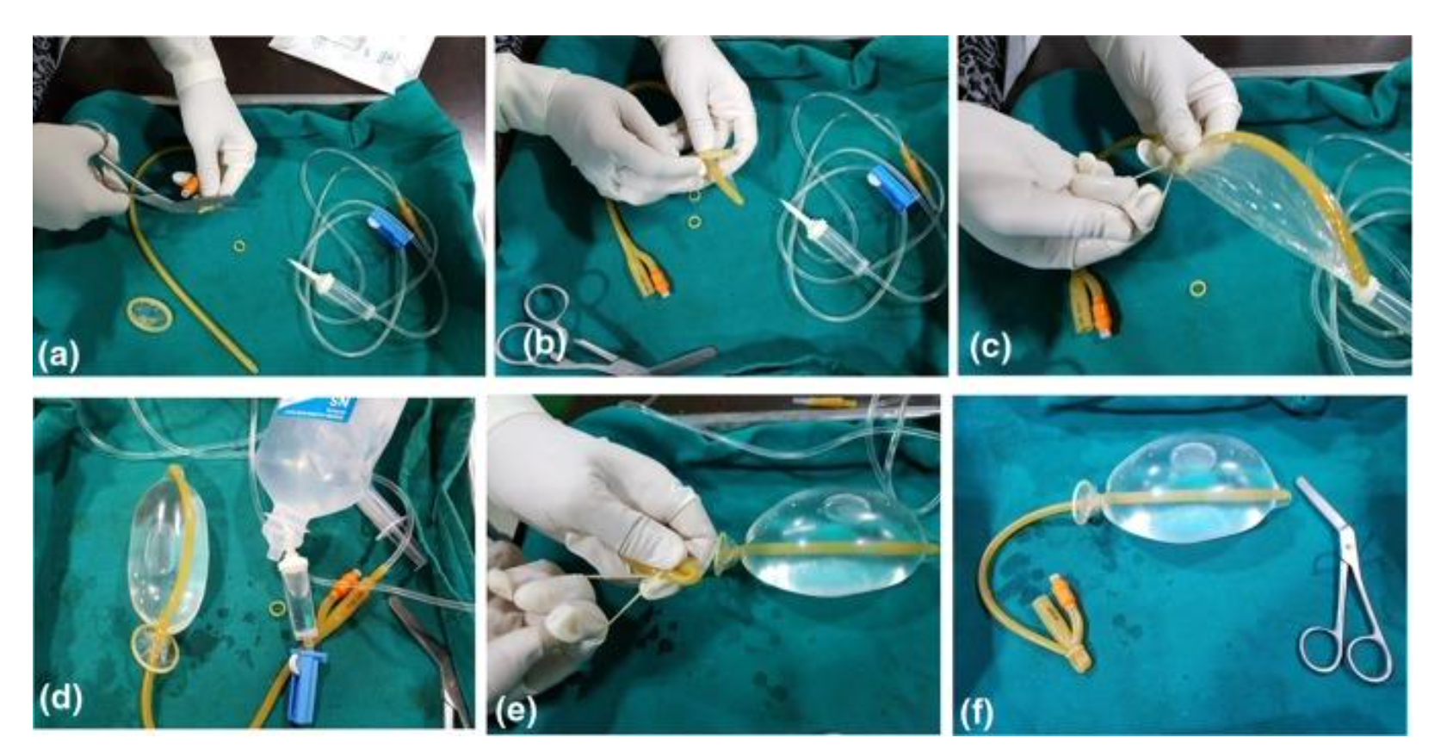
Sri Lanka College of Obstetricians & Gynaecologists
Scientific Activities & Research Committee
Balloon Tamponade
Tamponade; Condom Catheter

Slide 20
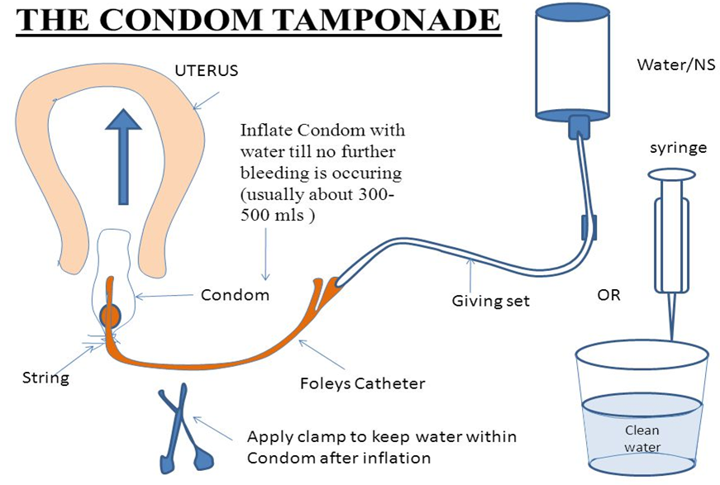

Slide 21
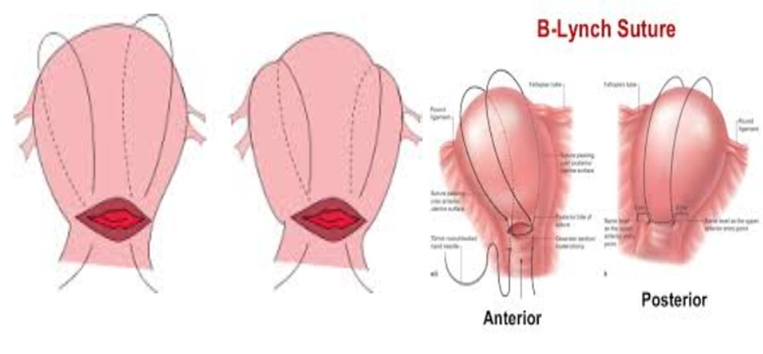
Sri Lanka College of Obstetricians & Gynaecologists
Scientific Activities & Research Committee
Surgical Mx Cont…
Compression Structures;

Slide 22
Post partum care
Sri Lanka College of Obstetricians & Gynaecologists
Scientific Activities & Research Committee
MEOWS chart monitoring
HDU / ICU setup
Be extra vigilant
Documentation
Debrief the team & mother, relatives
Incident reporting

Slide 23
Thank you…
Sri Lanka College of Obstetricians & Gynaecologists
Scientific Activities & Research Committee

