Slide 1
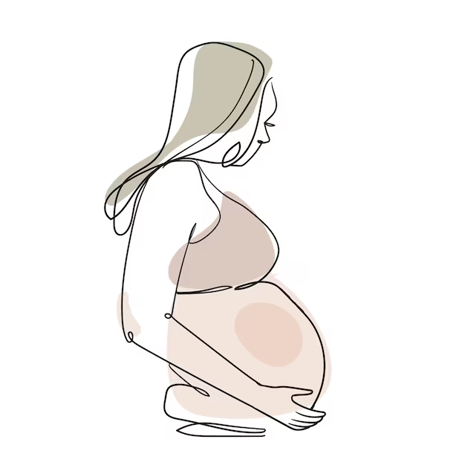
Maintaining the partogram
Sri Lanka College of Obstetricians & Gynaecologists
Scientific Activities & Research Committee

Slide 2
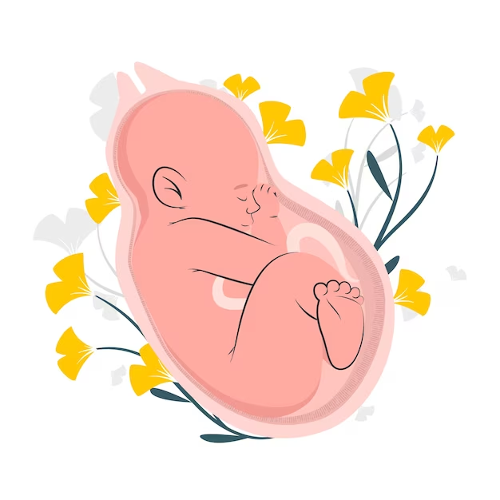
Partogram:
Is a graphic representation of the events of labour
All the observations made on the mother and the fetus are plotted in one sheet
Helps in early recognition of abnormal labour and fetal distress.
Now let us look at the partogram in detail.

Slide 3
When should the partogram be started?
If the frequency of uterine contractions is 2 or more per 10 minutes
or
At induction of labour with oxytocin or by amniotomy

Slide 4
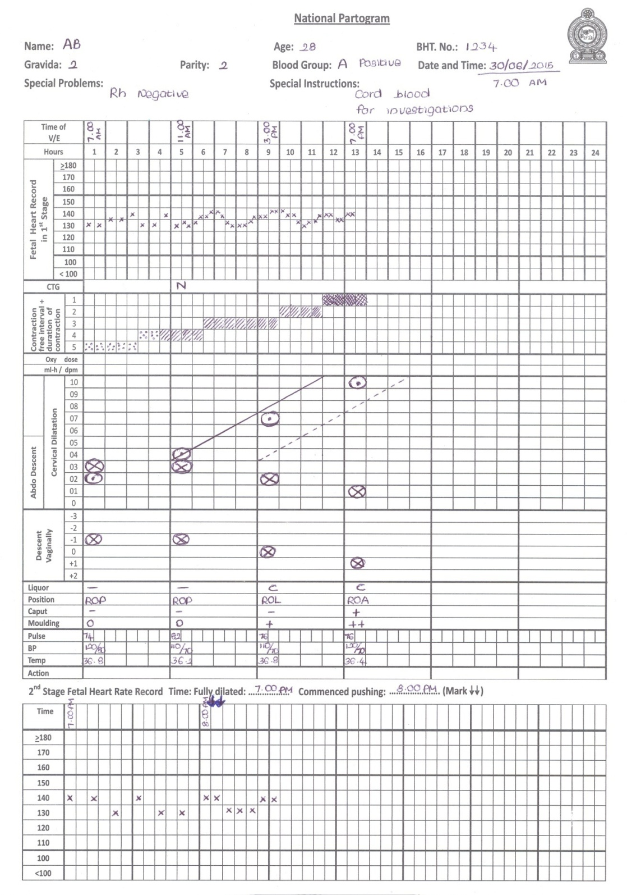
Information of the mother
Name
Age
BHT number
POG
Gravidity
Parity
Blood group
Date & Time
Special problems
Special instructions
Time of Vaginal Examination

Slide 5
First stage of labour
FHR - latent phase every 30 min
active phase every 15 min
CTG information- N / S / P
Duration of a contraction and contraction free interval
Dose and rate of oxytocin infusion (drops/min or ml/min)

Slide 6
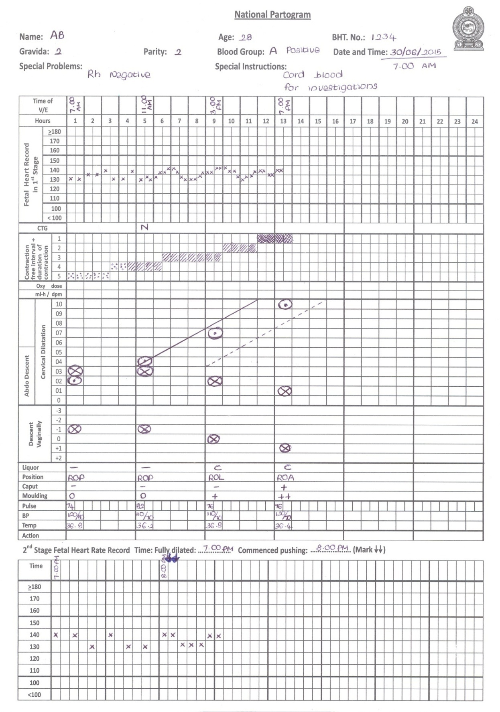
Abdominal descent of fetal presenting part
Cervical dilation ⊙
Digital vaginal examination
Cervical descent
Liquor - C/M/B/Ab
Membranes intact - I
Position
Caput
Moulding - 0 / + /++ / +++

Slide 7
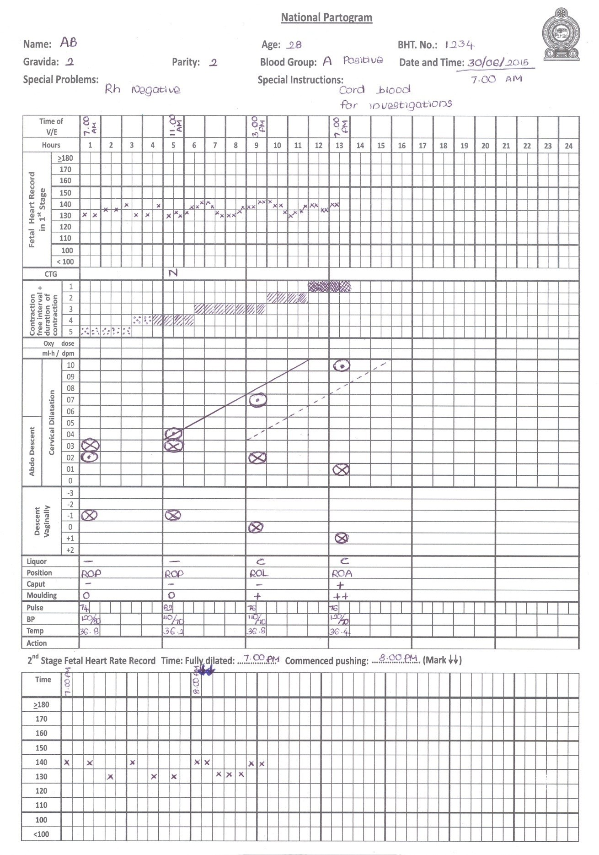
Mother’s observations
Pulse rate
Blood pressure
Temperature
Actions taken

Slide 8
Time at full cervical dilation and commencement of pushing
Second stage of labour
Fetal heart rate
passive phase every 10 min expulsive phase every 5min

Slide 9
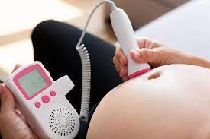
Frequency of recording the fetal heart rate
From onset of labour to cervical dilation of 4cm
every 30 minutes
From cervical dilation of 4cm to 10cm
every 15 minutes
From cervical dilation of 10cm to onset of pushing (during the passive phase of the second stage)
every 10 minutes
From the onset of pushing to delivery of the baby (active phase of the second stage)
every 5 minutes

Slide 10
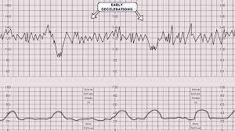
example of a FHR recording If a CTG is carried out, findings to be documented as; N (normal) S (suspicious) P (pathological)
Commencement of the active phase of the second stage

Slide 11
Documenting Labour Contractions
This needs to be done every 30 minutes
Document the sum of the ‘duration of a contraction and the interval between two consecutive contractions’
<
Duration less than 20 S
between 20-40 S
between 40-60 S
Duration of a contraction
Interval between two consecutive contractions

Slide 12
Duration of a contraction = < 20 s
Contraction free interval = 5mins
Duration of a contraction = 20 s – 40 s
Contraction free interval = 3mins
Duration of a contraction = 40 s – 60s
Contraction free interval = 1min

Slide 13
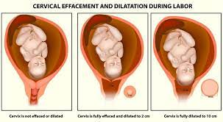
Documentation of cervical dilation
Alert line - to be drawn (1 cm per hour) from the first detection of a cervical dilatation of 4 cm or more
Action line - to be drawn (1cm per hour) 4 hours to the right of the alert line

Slide 14
In this example, partogram was started when cervical dilation was 5cm. Look how the alert line was drawn from the point where cervical dilation was more than 4cm for the first time.
 |  | 10
 |  | 9
 |  | 8
 |  | 7
 |  | 6
 |  | 5
 |  | 4
 |  | 3
 |  | 2
 |  | 1
 |  | 0
Cervical dilation
Cervical dilation
Alert line
Action line
abdominal descent
4 hours
Abdominal descent

Slide 15
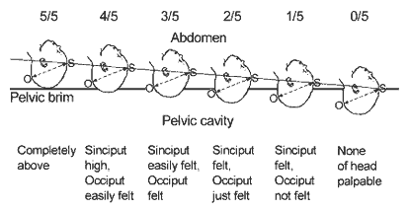
Descent of the fetal head on abdominal palpation

Slide 16
Documentation about the colour of liquor
I (Intact membranes)
C (Clear)
M (Meconium)
B (Bloodstained)
A (Absent)
Degree of moulding to be documented as:
0 Bones separated, and suture lines felt easily.
+ Bones just touching each other
++ Bones overlapping
+++ Bones overlapping severely
suTURES

Slide 17
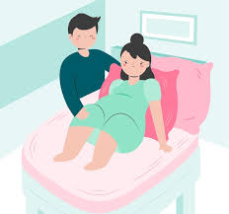
Maintaining the partogram during the second stage of labour

Slide 18
Section to be used in the second stage
Time of commencement of pushing
Time of full dilation
Time of full dilatation & Time of commencement of pushing ( ) should be recorded

Slide 19
The second stage of labour
During the intrapartum period (during both the first and second stages) document the observations of the mother as follows ,
Pulse rate – every 30 minutes
Blood pressure and temperature – every 4hrs

Slide 20
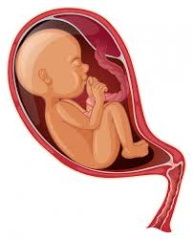
Monitoring the mother during the third stage of labour

Slide 21
Use the chart on the reverse side of the partogram to document the third stage

Slide 22
details of the delivery
Restless or drowsy?
Alert & oriented?
Respiratory rate
Pulse rate
Systolic Blood pressure
Diastolic Blood pressure

Slide 23
Urine output
Consistency of the uterus
Level of fundus
Bleeding PV
Bladder dilation
PV & PR findings if done
Neonatal condition

Slide 24
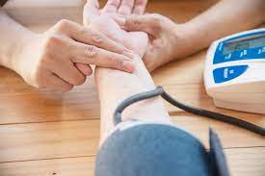
Monitor & document
maternal pulse rate at 15-minute intervals
BP and RR at 30-minute intervals.
Palpate the uterus for tone and level of fundus and document at 15-minute intervals.
High-risk (PIH, cardiac diseases, PPH) mothers may need more frequent monitoring.
Can mark the level of fundus on the mother’s abdomen with a marker pen, any degree of rising of the level needs urgent attention - 30-minute

Slide 25
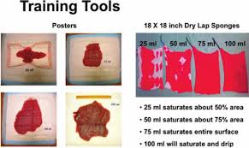
Visual estimation of blood loss should be
recorded
Examine for a distended bladder & monitor urine output hourly if the mother is catheterized
Vaginal and PR examination may be necessary depending on the clinical situation
https://www.google.com/url?sa=i&url=https%3A%2F%2Fonlinelibrary.wiley.com%2Fdoi%2Fpdf%2F10.1111%2Fj.15526909.2012.01375.x&psig=AOvVaw2ENxWaNWgKNn7kigM4_U0O&ust=1707988676900000&source=images&cd=vfe&opi=89978449&ved=2ahUKEwj8pJrkv6qEAxU6jWMGHSD1D6sQr4kDegUIARCNAQ

Slide 26
Inform MO/Senior MO if any parameter is recorded in one dark grey box or in two or more light grey boxes
Close observation needed if any parameter is recorded in a light grey box
If the observations are recorded only in the white boxes usual frequency of observation could be continued

Slide 27
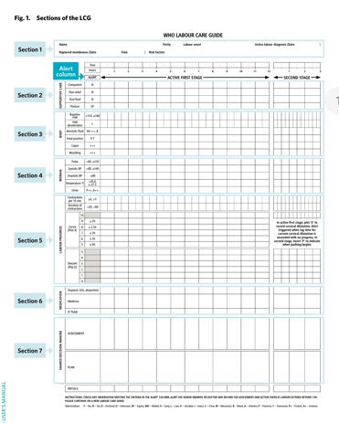
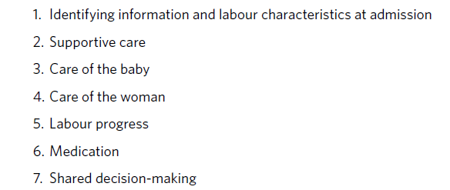
WHO Labour Care Guide

Slide 29
Section 1: Identifying information and labour characteristics at admission

Slide 30
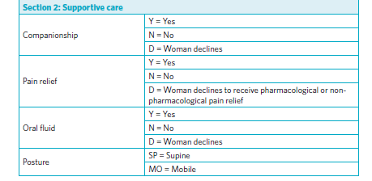
Section 2: Supportive care

Slide 31
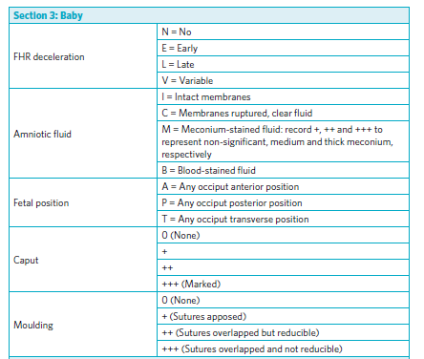
Section 3: Care of the baby

Slide 32
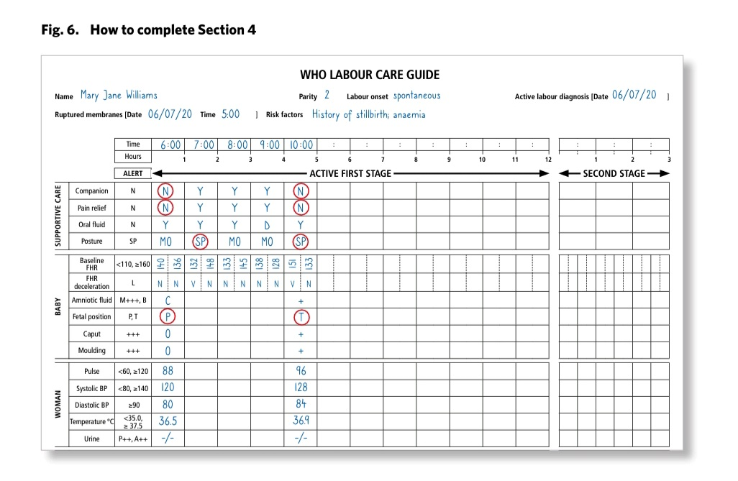
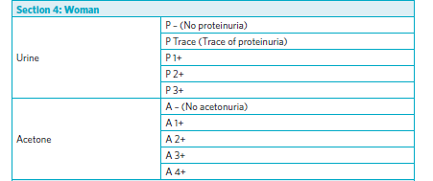
Section 4: Care of the woman

Slide 33
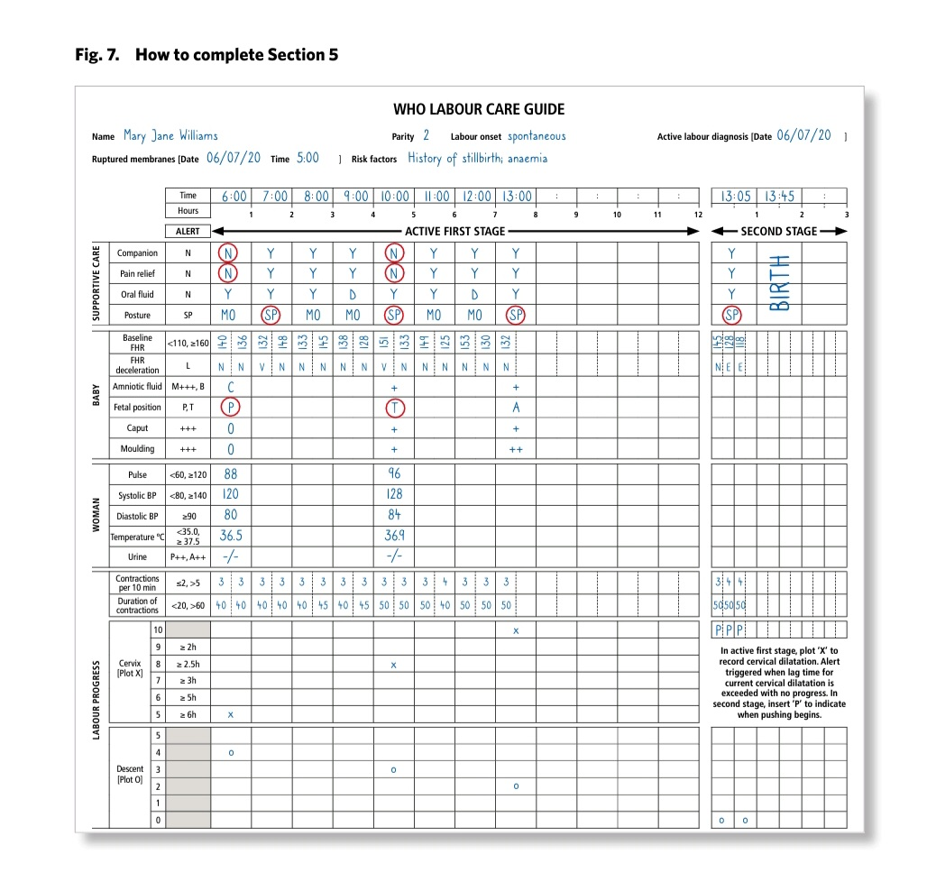
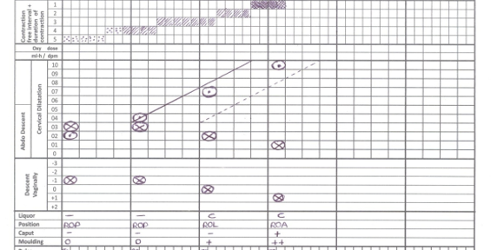
Section 5: Labour progress

Slide 34
Section 6/7: Medication/ Shared decision-making

Slide 35
Changes from Previous Guideline

Slide 36
Changes from Previous Guideline

Slide 37
Changes from Previous Guideline

Slide 38
Thank You!
Special Acknowledgement for compiling Presentation
Dr Chinthaka Banagala
Dr Nisansala Perera

