Slide 1
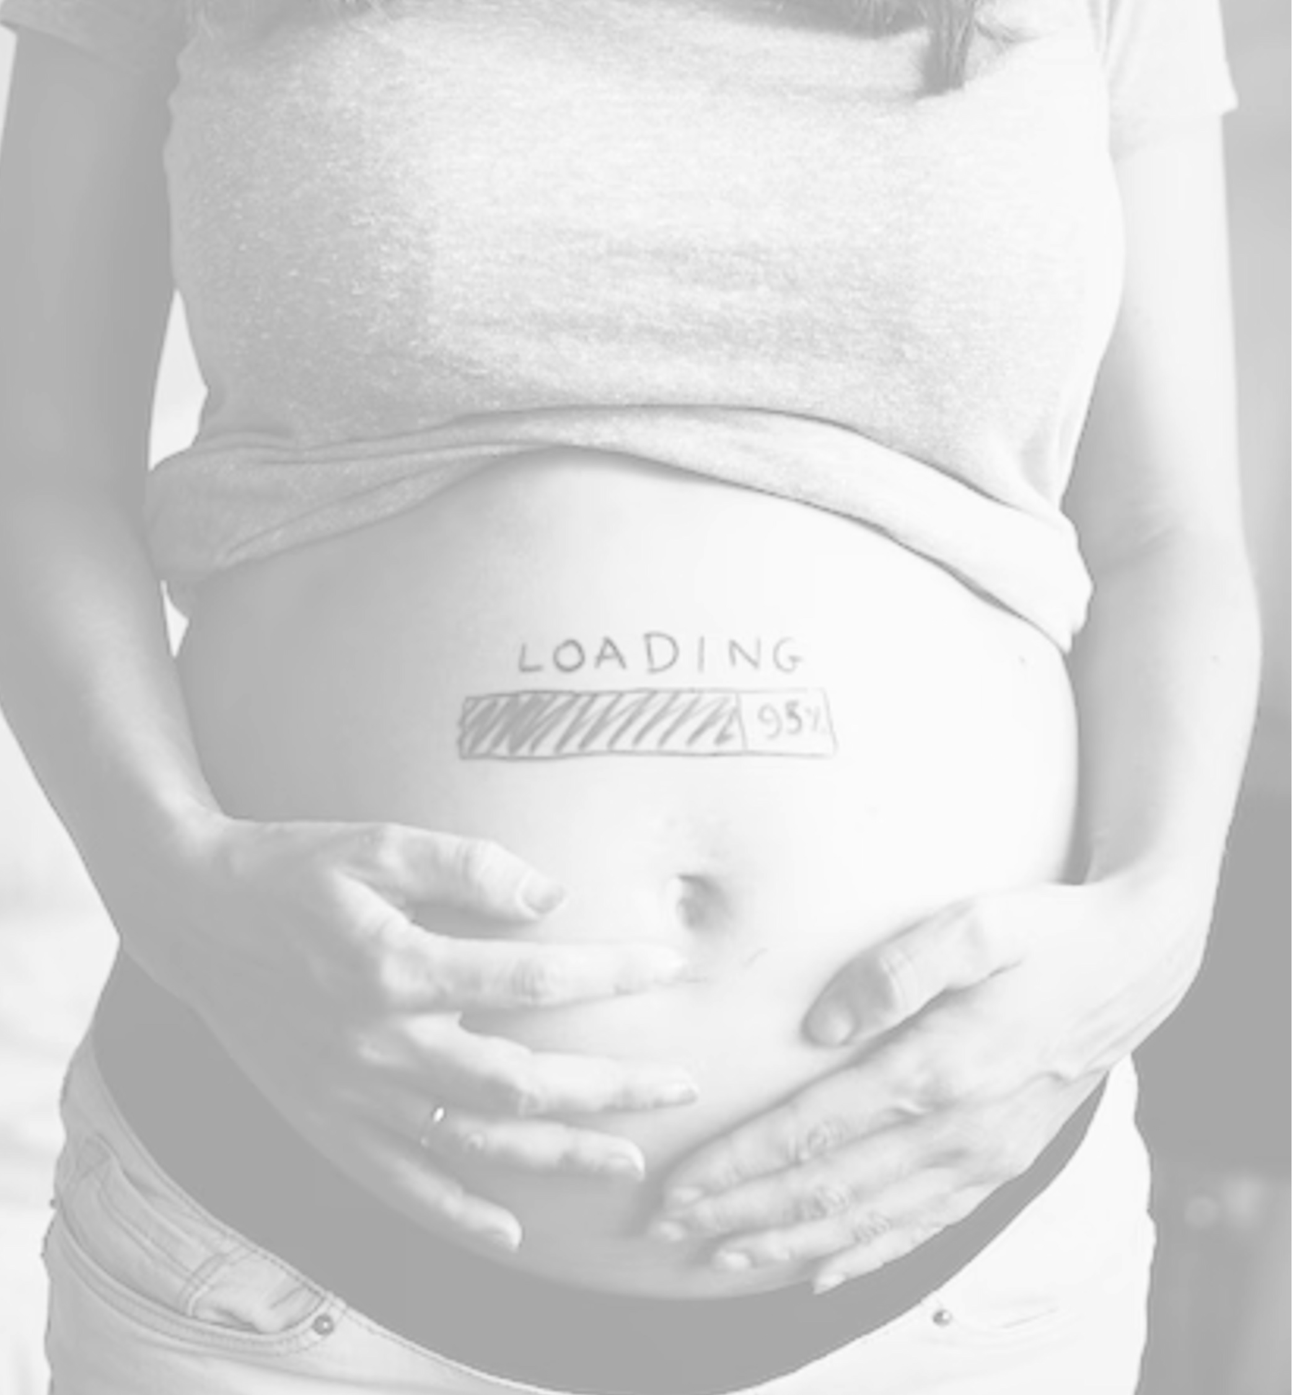
Sri Lanka College of Obstetricians & Gynaecologists Scientific Activities & Research Committee
Intrapartum
Cardiotocography
Interpretation of Cardiotocographs

Slide 2
INTRODUCTION
CTG was introduced to clinical practice in late 1960s
First recognized guideline on CTG interpretation published in 1979(ACOG)
First international guideline on CTG interpretation published by FIGO 1987.
HOW EVER currently there are more than 20 Guidelines available

Slide 3
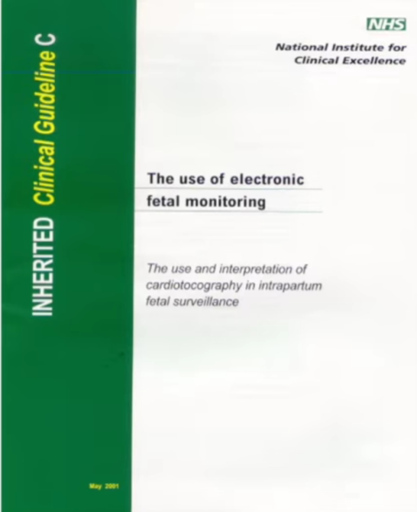
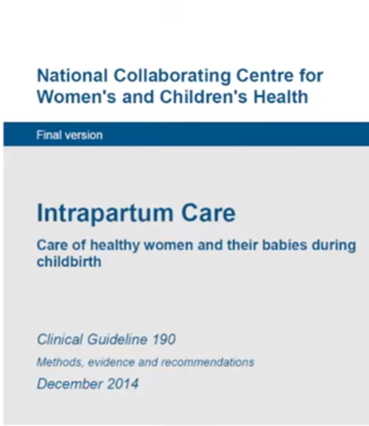
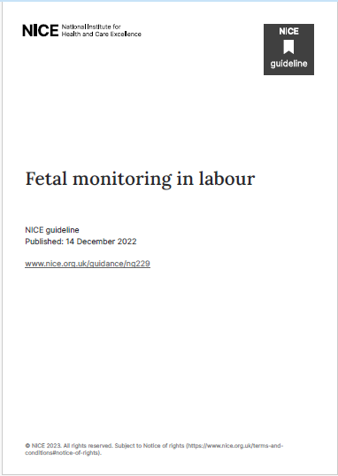
NICE 2001
NICE 2006
NICE 2014
NICE 2022

Slide 4
CTG interpretation: What is the problem?
CTG was introduced to clinical practice without proper randomized controlled trials.
It has high sensitivity with HIGH FALS POSITIVE rate nearly 60 to 90% with pattern recognition
Until you learn the fetal physiology, DECELERATIONS causes ‘panicking’ situation leading to increase operative interventions
33% of intrapartum related perinatal deaths and severe hypoxic ischaemic injuries in the UK were due to CTG misinterpretation (Each Baby Counts Reports in the UK from 2016-2021 )
30% inter and intra-observer variability in conventional pattern recognition CTG reading

Slide 5
CTG during labour is associated with reduced rates of neonatal seizures, but no clear differences in cerebral palsy, infant mortality or other standard measures of neonatal wellbeing. However, continuous CTG was associated with an increase in caesarean sections and instrumental vaginal births.

Slide 7
What is a Cardiotocograph?
A graphical record of fetal heart rate and uterine contractions through an ultrasound device placed on maternal abdomen or through fetal scalp electrode.
There are two types of cardiotocographs. Antenatal cardiotocographs Intrapartum cardiotocographs

Slide 8
Aims of intra-partum CTG monitoring
To avoid intra-partum hypoxia related HIE with its long-term sequelae ( CP and learning difficulties)
To avoid perinatal deaths
While avoiding unnecessary operative interventions to the mother

Slide 9
Interpretation of CTG
Features used for this purpose
Baseline heart rate
Baseline variability
Accelerations
Decelerations
Cycling
Contraction frequency and number between contractions

Slide 10
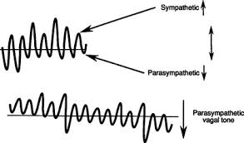
Control of fetal heart: physiology
Fetal heart rate is controlled by Autonomic nerves system and somatic nerves system
Autonomic –Sympathetic/ parasympathetic control FHR and variability
Somatic- control body movement /skeletal muscles hence accelerations

Slide 11
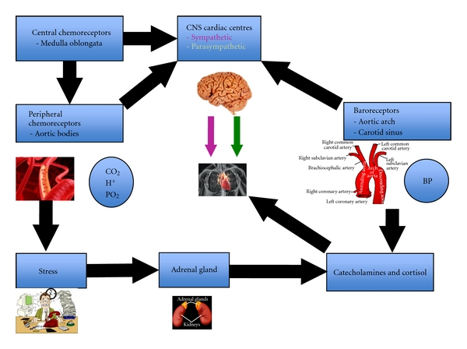
Control of fetal heart is is complex

Slide 12
1. Baseline Heart Rate
Baseline heart rate is the average heart rate in a 10-minute segment after excluding accelerations and decelerations.
The mean level of the most horizontal and less oscillatory fetal heart rate segments are taken.
Normal baseline heart rate will be 110-160 beats per minute in a term fetus.
Preterm fetuses may tend to have a higher rate of normal range while post-term fetuses tend to have a lower limit of this range.
It is important to review the previous segments if the trace shows unstable fetal heart rate signals.

Slide 13
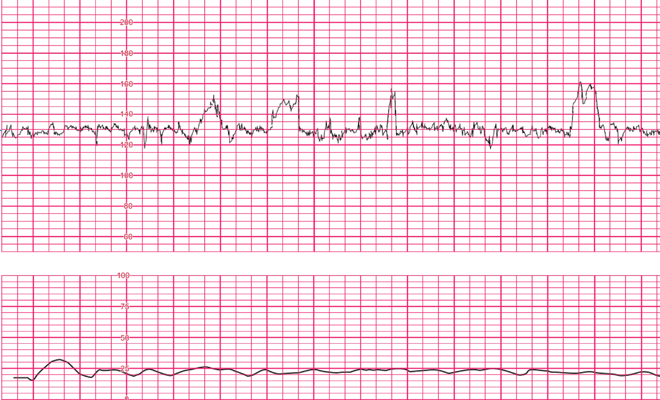

Slide 14
Fetal Tachycardia
A baseline heart rate remaining higher than 160 bpm for more than 10 minutes is defined as fetal tachycardia.
This can be due to
Maternal fever Chorioamnionitis
Drugs (Sympathomimetics, parasympathetic blockers) Fetal compromise
Epidural analgesia

Slide 15
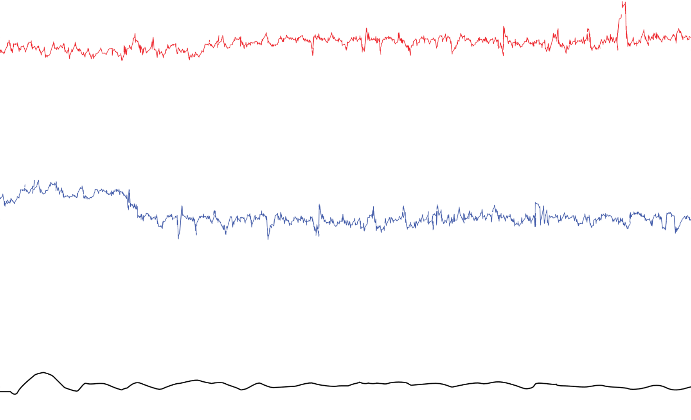

Slide 16
Fetal Bradycardia
A baseline heart rate below 110 bpm lasting for more than 10 minutes is defined as fetal bradycardia.
Postdate fetuses can have a heart rate between 90 bpm and 110 bpm. But categorizing this as a normal feature should be done by a senior.
Maternal hypothermia, administration of beta-blockers, and fetal arrhythmias such as atrioventricular block are other possible causes

Slide 17
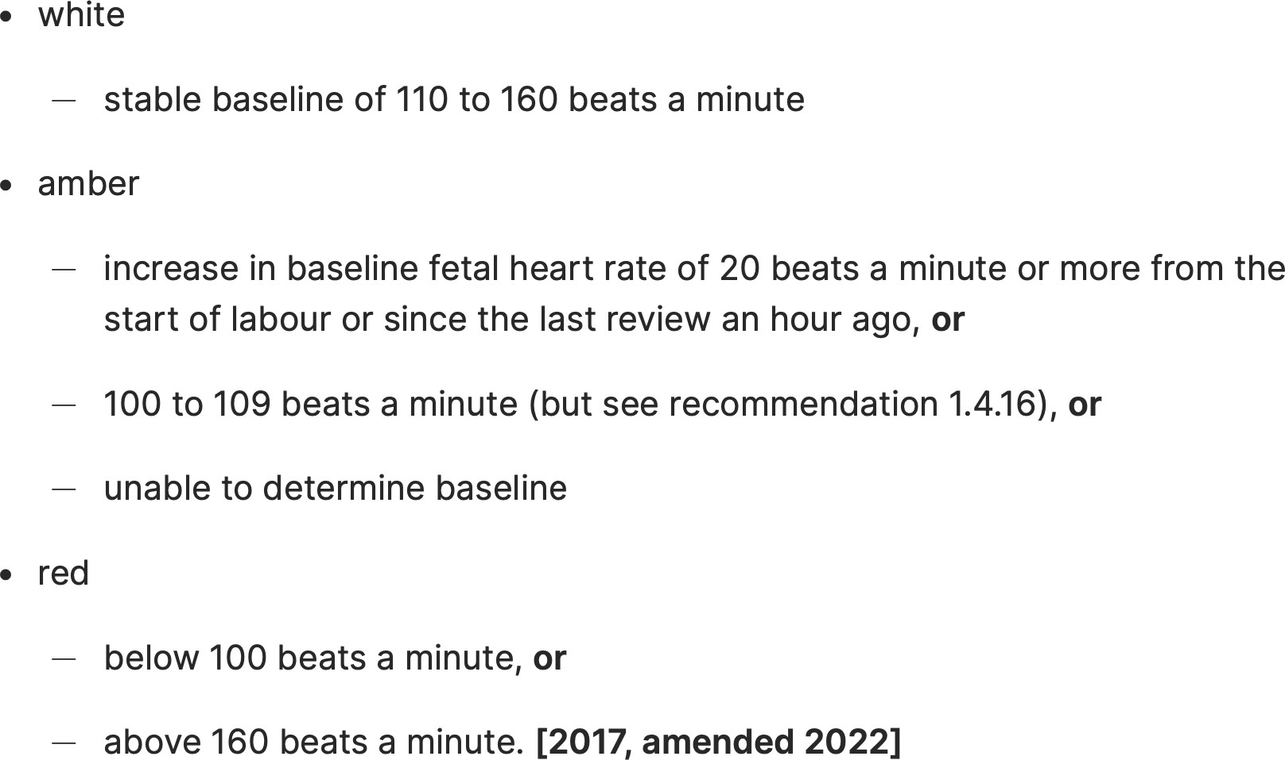
BHR-according to NICE 2022 classification

Slide 18
2. Baseline Variability
This refers to the fluctuations seen in the trace i.e. the variation of fetal heart rate from one beat to the next.
This is measured from peak to trough in the traces. By looking at how much these peaks and troughs deviate from the baseline.
In normal healthy fetuses, the baseline variability lies within a range of 5-25 bpm.
Normal variability reflects the integrity of the neurological system in the fetus.

Slide 19
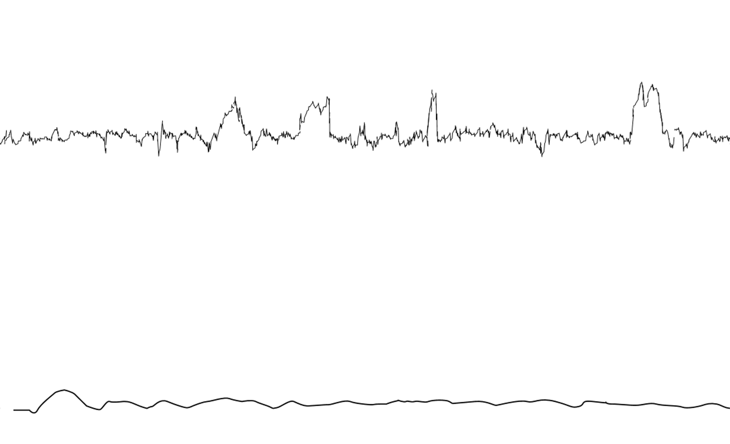

Slide 20
Variability-according to NICE 2022 classification

Slide 21
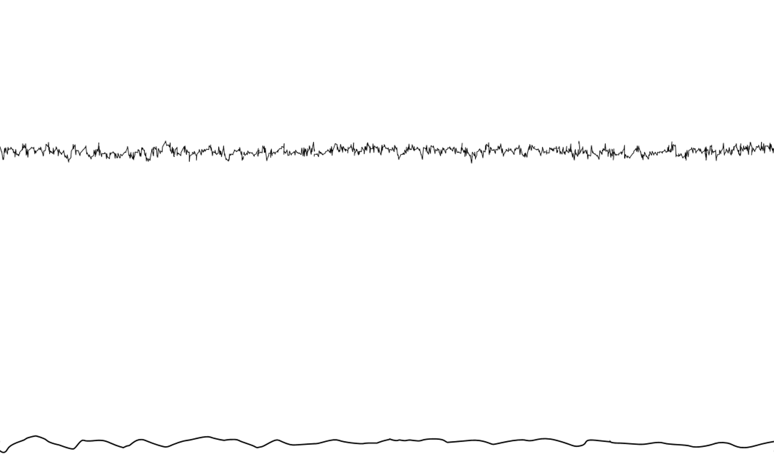

Slide 22
Reduced amplitude below 5 bpm lasting more than 50 minutes or seen lasting more than 3 minutes during decelerations is defined as reduced variability.
Reduced variability can occur due to
Fetal deep sleep (most common cause) – this should last no longer than 40 minutes
Central nervous system hypoxia/acidosis and resulting decreased sympathetic and parasympathetic activity
Previous cerebral injury
Infection
Administration of central nervous system depressants or parasympathetic blockers.
Prematurity – variability is reduced at earlier gestation (<28 weeks)
Congenital heart abnormalities

Slide 23
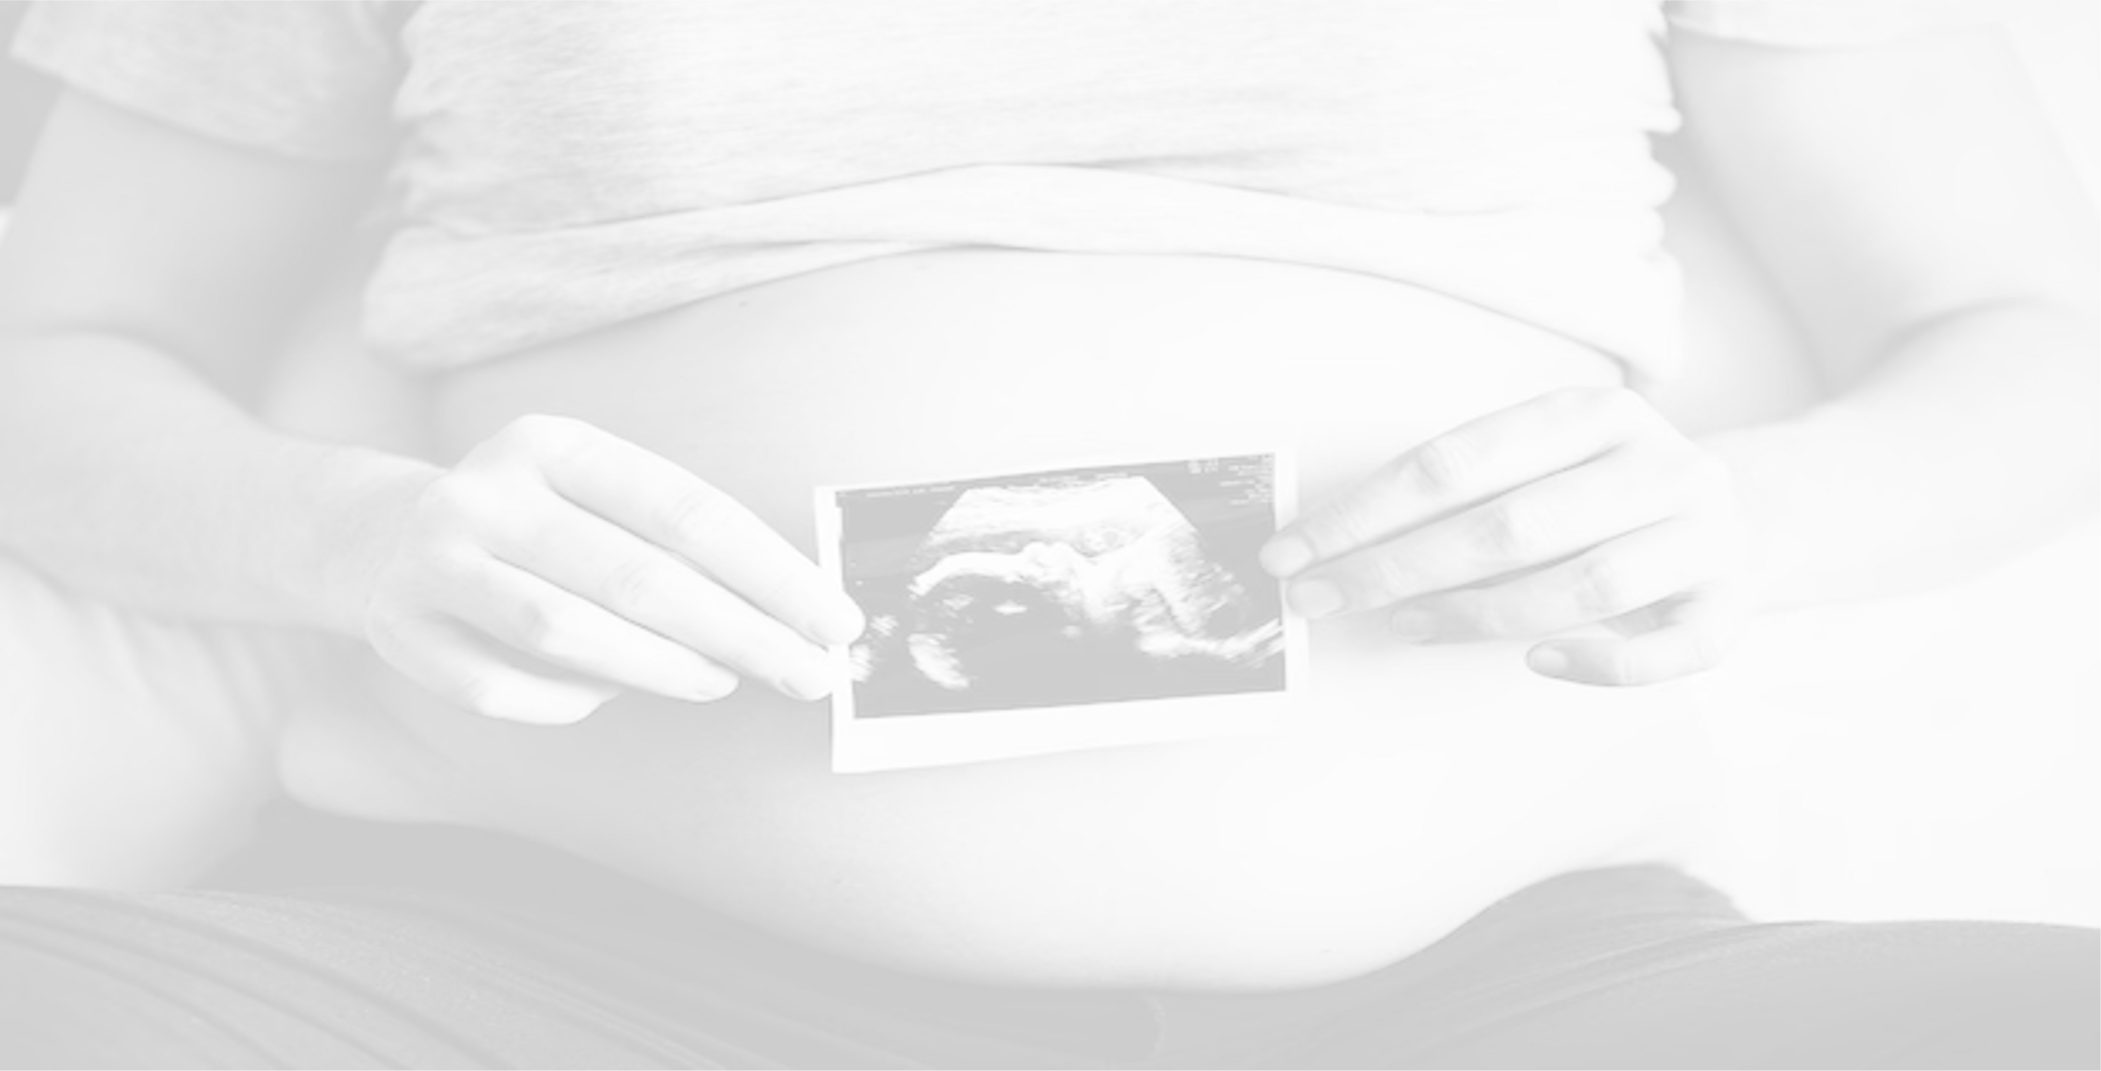
Undetectable amplitude range with or without deceleration is called absent variability or flat trace. This can be due to hypoxia.
(Macones 2008 )

Slide 25
Increased Variability - Saltatory Pattern
When the bandwidth value increases in a trace for more than 30 minutes it is said to show increased variability.
This feature is considered pathological requiring immediate intervention.
This is presumed to happen due to instability or hyperactivity of nervous system of the neonate.

Slide 26
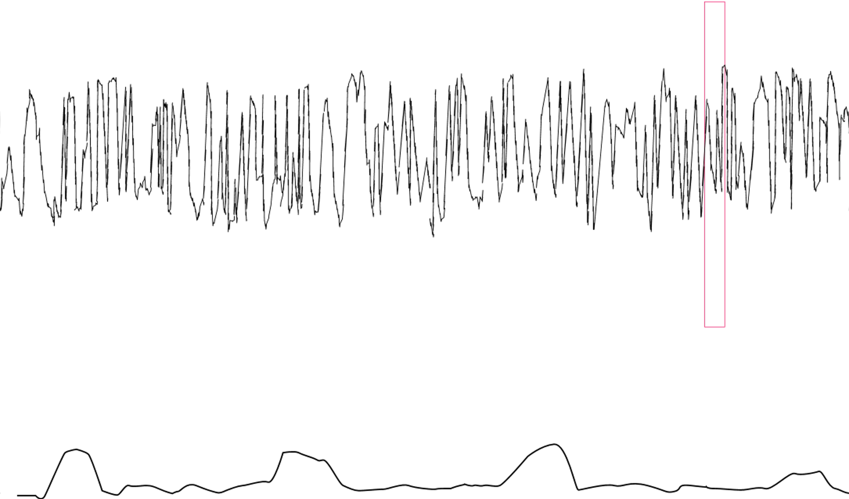

Slide 27
Sinusoidal pattern
A smooth regular waveform-like pattern with no accelerations and a stable baseline around 120-160 bpm, a frequency of 3-5 cycles per minute, and no beat-to-beat variability lasting more than 30 minutes.
The pathophysiology of this mechanism is not well understood and it is rare.

Slide 28
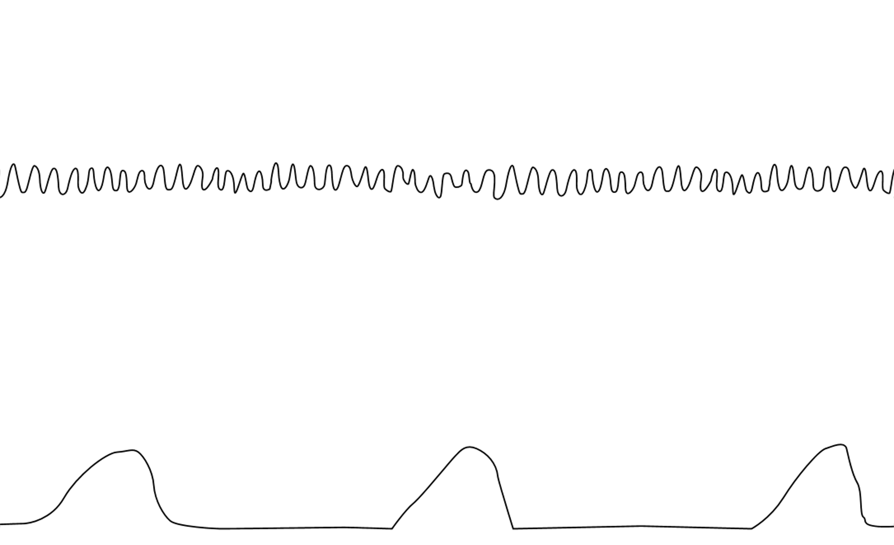

Slide 29
When it occurs, it is usually associated with
Severe fetal anaemia as is found in anti-D allo-immunization Feto-maternal haemorrhage
Twin-to-twin transfusion syndrome Ruptured vasa praevia
It has also been described in cases of acute fetal hypoxia, infection, cardiac malformations, hydrocephalus, and gastroschisis.

Slide 30
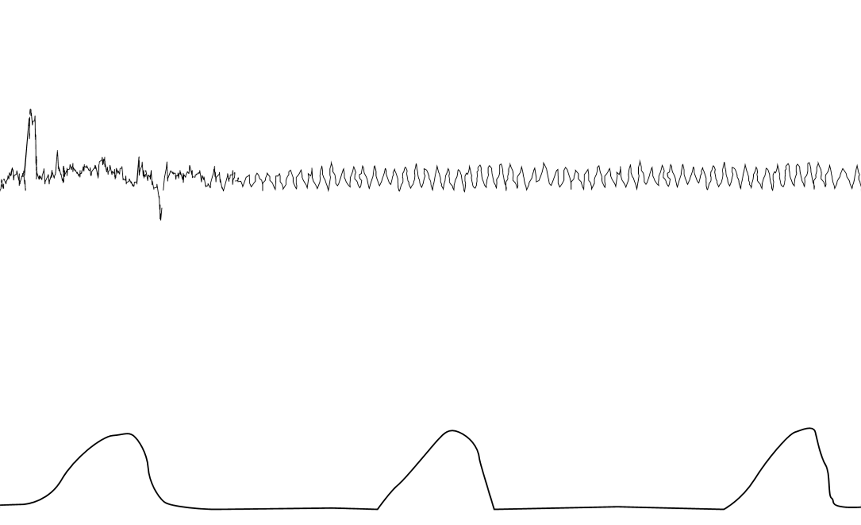

Slide 31
Pseudo Sinusoidal Pattern
This has a similar pattern to the sinusoidal pattern, but with a more jagged “saw-tooth” appearance, without the smooth waveform as in the sinusoidal trace.
Its duration rarely exceeds 30 minutes, and it is characterized by normal patterns before and after.
This pattern has been described
After analgesic administration to the mother
During periods of fetal sucking and other mouth movements

Slide 32
A trace of this nature should be informed to a consultant as there is a school of thought that this can be observed in fetal hypotension occurring secondary to acute feto-maternal haemorrhage and conditions such as ruptured vasa praevia.

Slide 33
3. Accelerations
Abrupt increases in the fetal heart rate above the baseline more than 15 bpm in amplitude and lasting more than 15 seconds but less than 10 minutes.
An acceleration must start from and return to a stable baseline.
Accelerations coincide with fetal movements and are a sign of a neurologically responsive fetus that does not have hypoxia/acidosis.

Slide 34
Healthy if:
🠶 Seen antenatally
🠶 Seen in early labour
🠶 Seen in response to stimulation
Significance
🠶 Healthy sign
🠶 Absence of hypoxia
🠶 Fetal movements
🠶 Vaginal exam
🠶 Healthy SNS
Do not be confused
Shoulders are not accelerations
🠶 Overshoots are not accelerations
🠶 If coinciding with contractions, they are not accelerations
🠶 Accelerations are uncommon in 2nd stage

Slide 35
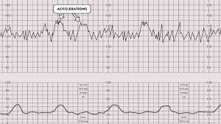
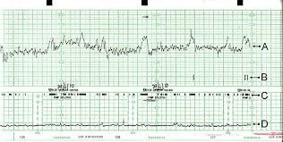

Slide 36
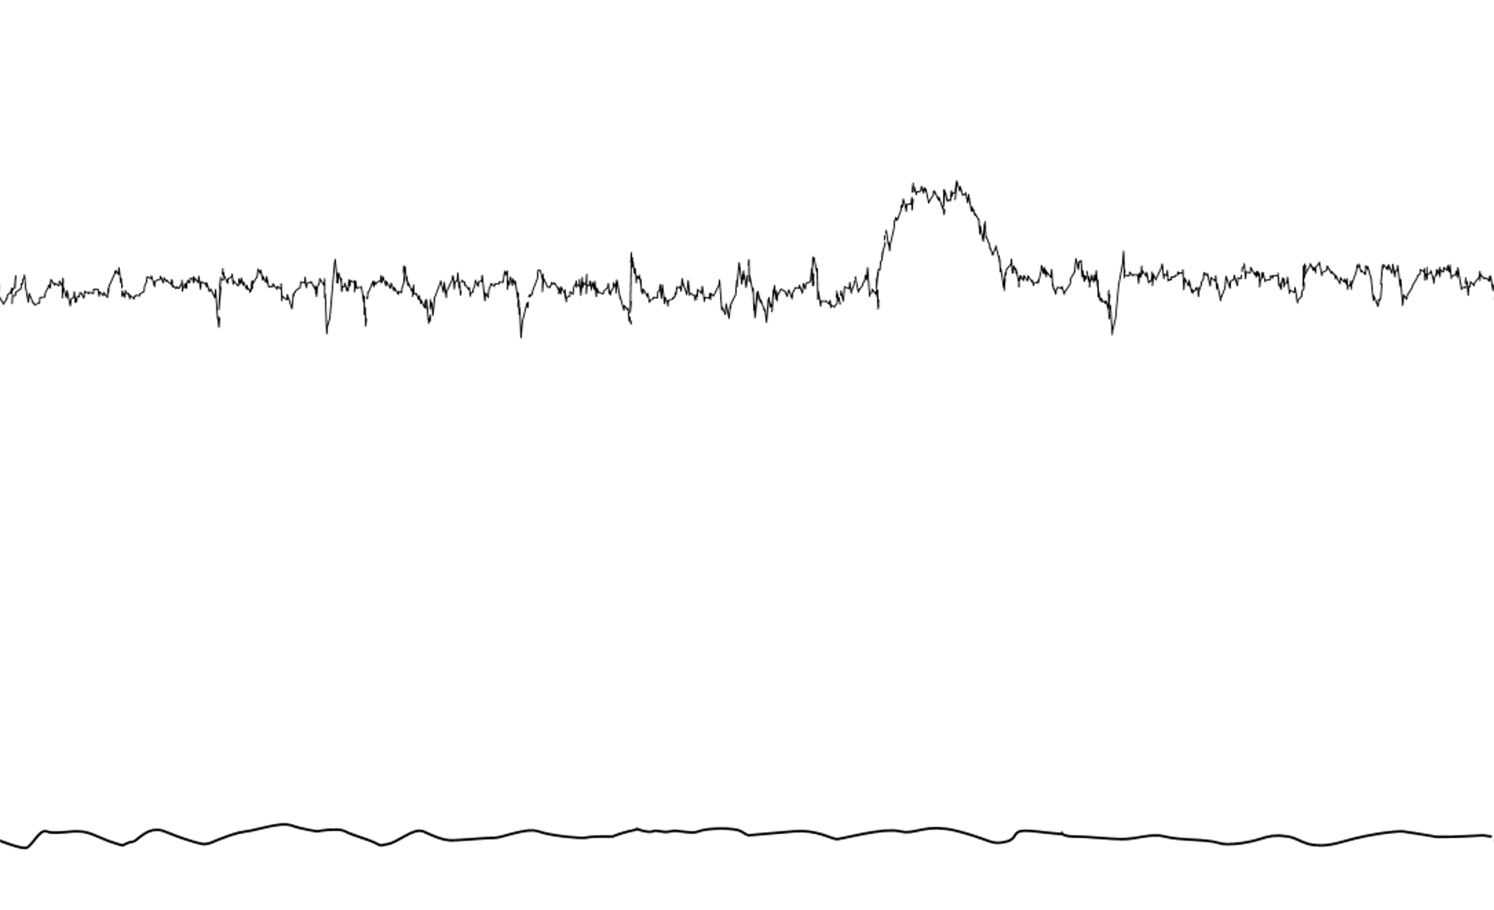

Slide 37
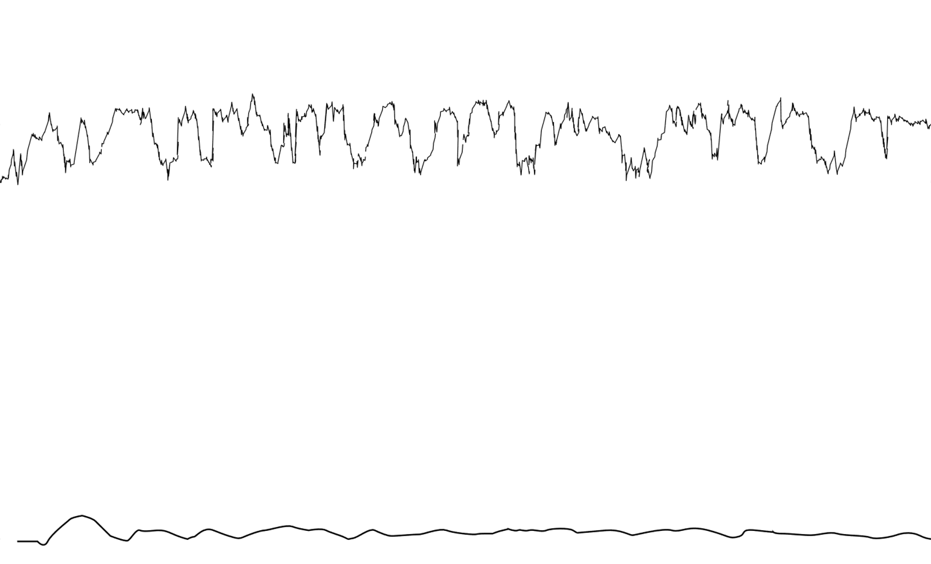

Slide 38
Before 32 weeks, the amplitude and frequency of accelerations can be low.
After 32-34 weeks, the fetus in deep sleep may not even show accelerations up to 50 minutes.
Confluence of accelerations - Sometimes frequent and larger accelerations in a trace make it difficult to estimate the baseline. This is a sign of wakefulness of the fetus and is considered as a good sign. This should not be confused with fetal tachycardia.

Slide 39
Cycling on a trace
It’s a hallmark of fetal wellbeing.
This refers to alternating periods of quiescence and activity in a trace.
During the quiescence period the baseline would be less or borderline with no accelerations and during the active period traces would show a moderate number of accelerations and normal variability.
Cycling is considered an excellent sign of a neurologically intact fetus. ( Edwin, 2012)

Slide 41
4. Decelerations
An abrupt decrease in the fetal heart rate below the baseline more than
15 bpm in amplitude lasting more than 15 seconds is termed a deceleration.
It is believed that decelerations occur to protect the myocardium by reducing the myocardial workload when a fetus is exposed to a hypoxic
or a mechanical stress and this help to maintain an aerobic metabolism within the myocardium.
There are different types of decelerations, each with varying significance.

Slide 43
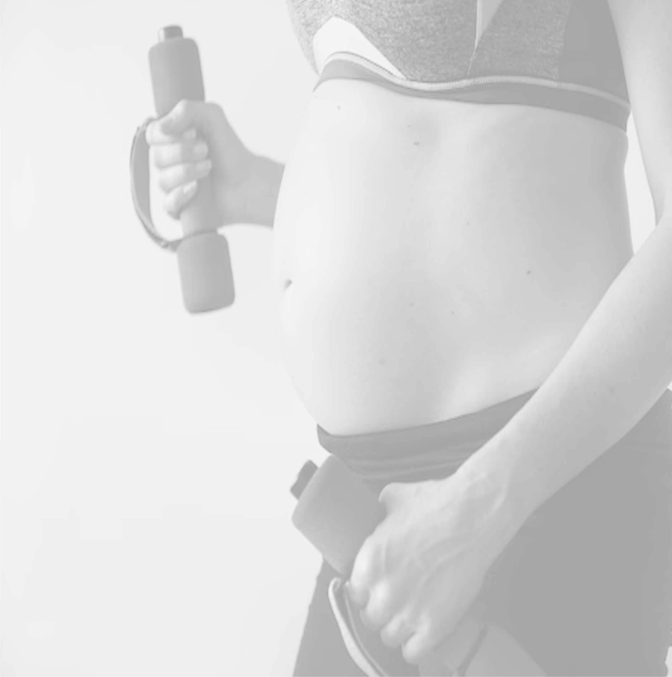
Do all types of decelerations reflect fetal hypoxia?

Slide 44
Early Decelerations/Baroreceptor
These decelerations begin together with the uterine contractions and recover when the contractions stops.
These are shallow, short-lasting, with normal variability within the deceleration and are coincident with contractions.
The onset and return to baseline are gradual.
They are believed to be caused by fetal head compression and do not indicate fetal hypoxia/acidosis.

Slide 45
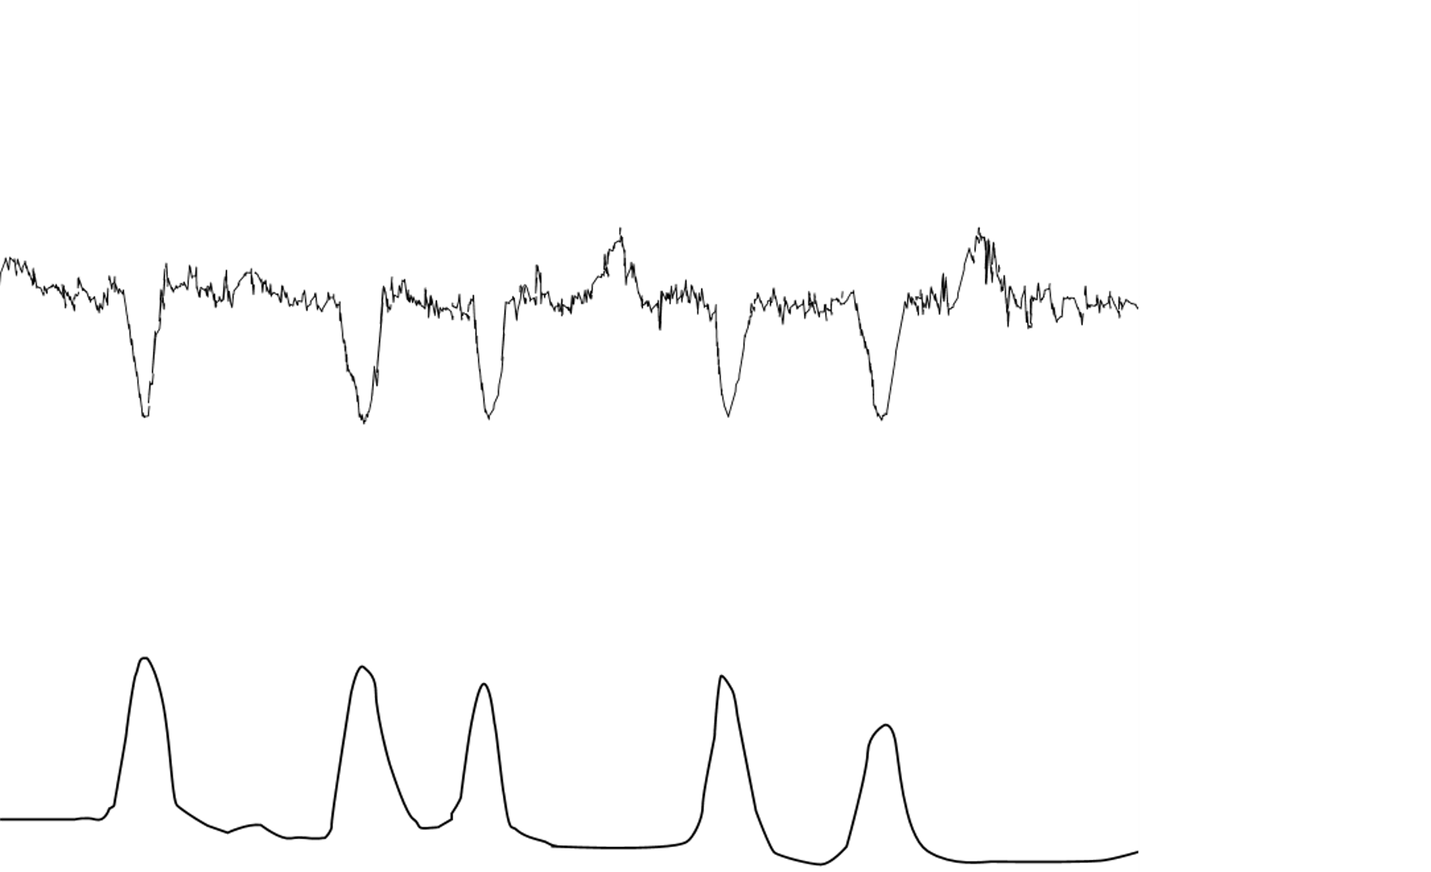

Slide 46
Variable (V-shaped) Decelerations/baroreceptor
Decelerations that exhibit a rapid drop (onset to nadir in less than 30 seconds), good variability within the deceleration, rapid recovery to the baseline, varying size, shape, and may not have any relationship to uterine contractions
Majority of decelerations during labour are variable decelerations and are thought to occur due to a baroreceptor-mediated response to increased arterial pressure when the umbilical cord compression occurs.

Slide 47
They are usually considered physiological.
If the fetal heart rate rises immediately before and after a variable deceleration, it is called shouldering and it is a good sign.

Slide 48
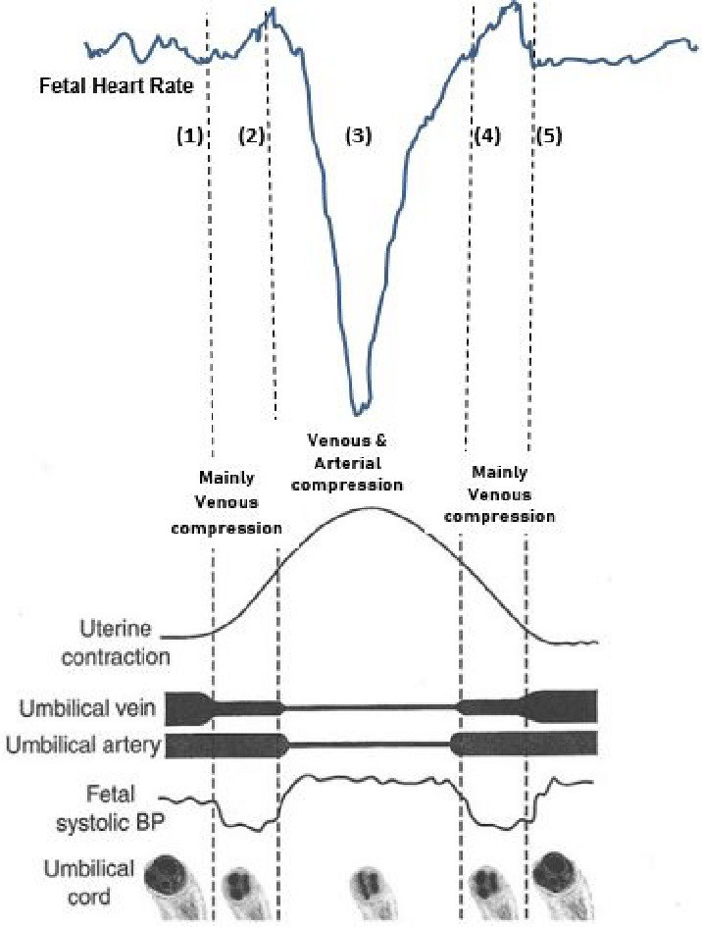
Cord compression

Slide 49
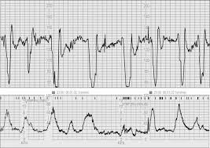
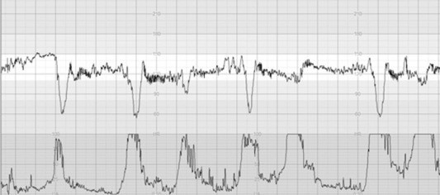
Shouldering is the key fact Due to cord compression alone
If associated with normal Baseline and variability no hypoxia

Slide 50
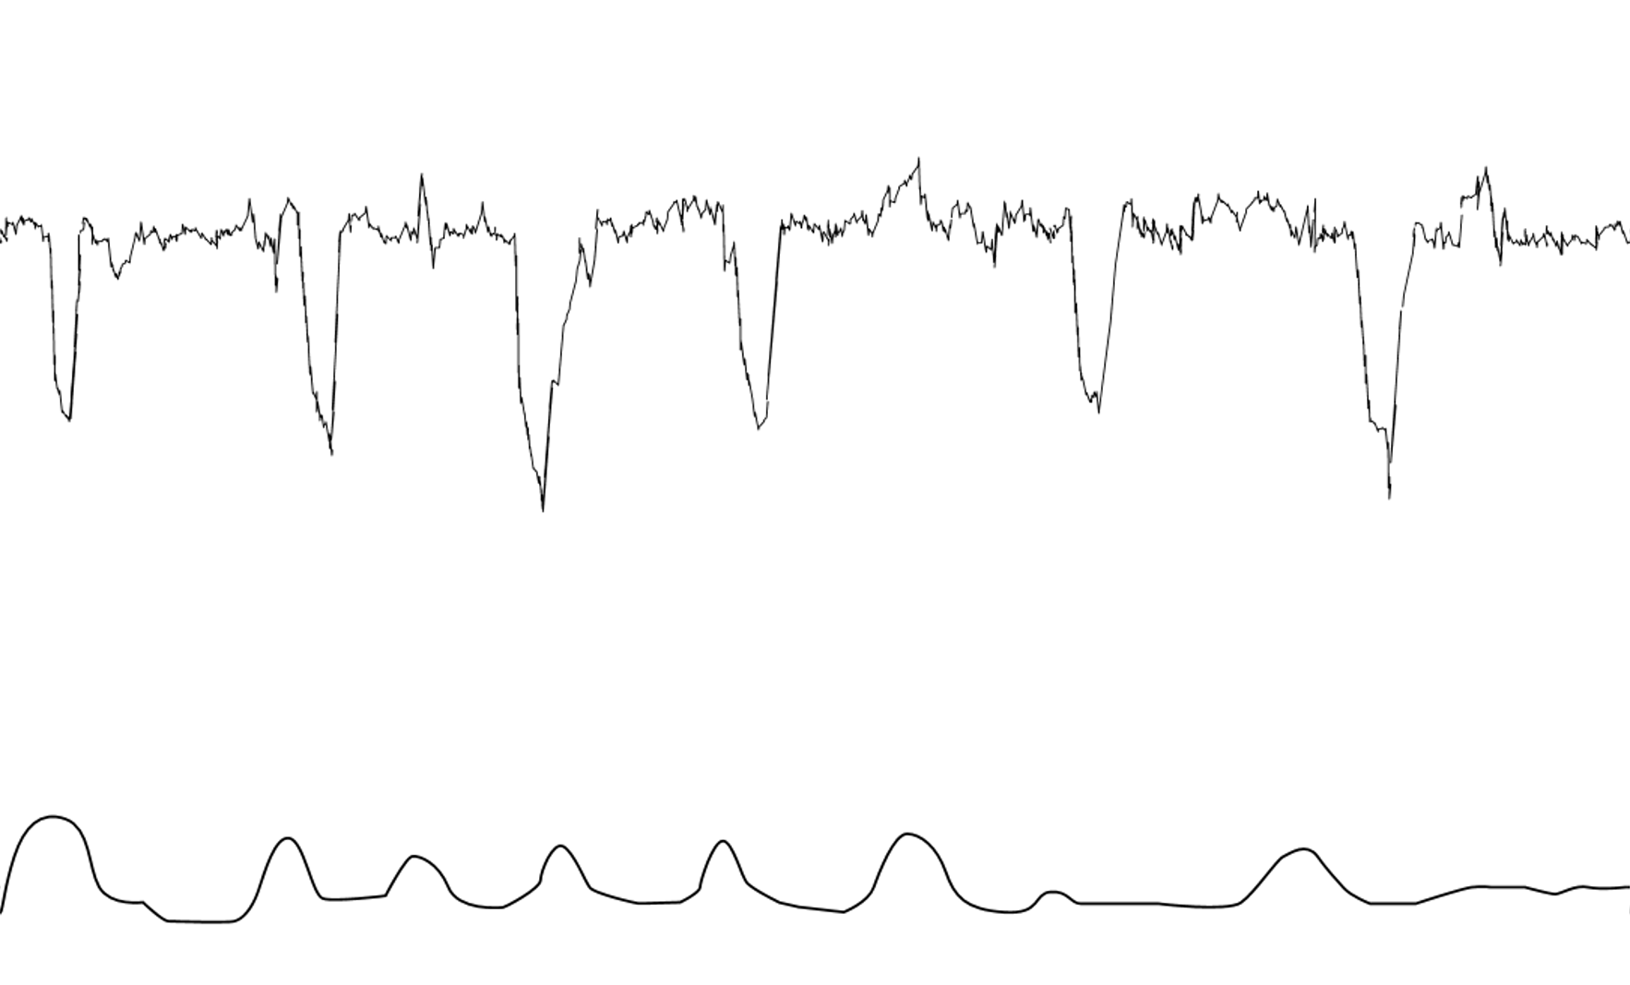

Slide 51
Complicated Variable Decelerations/CHEMORECEPTOR
Variable decelerations can occur with non-reassuring or concerning features and are referred to as ‘complicated variable decelerations.
Being cautious is necessary as these can be due to hypoxia or academia and appear as a result of chemoreceptor-mediated response.
A U-shaped component with a reduced or increased variability within the deceleration ( FIGO,2015)
Reduced variability within the deceleration and/or their individual duration exceeds 3 minutes (FIGO,2015)

Slide 52
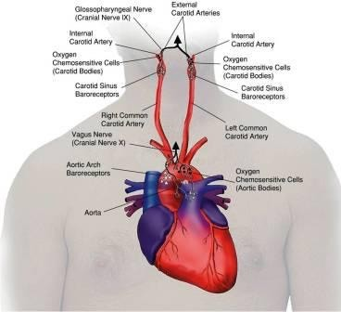
CHEMORECEPTORs
Seen in low SaO₂ and low pH
Could indicate placental insufficiency
On going cord compression
Foetus become decompensated

Slide 53
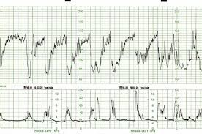
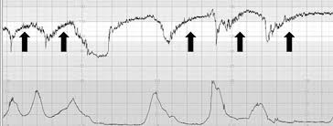

Slide 54
Concerning characteristics of variable decelerations (NICE,2021)
Lasting more than 60 seconds
Failure to return to baseline
Biphasic (W) shape
No shouldering
Slow return to baseline with less variability

Slide 55
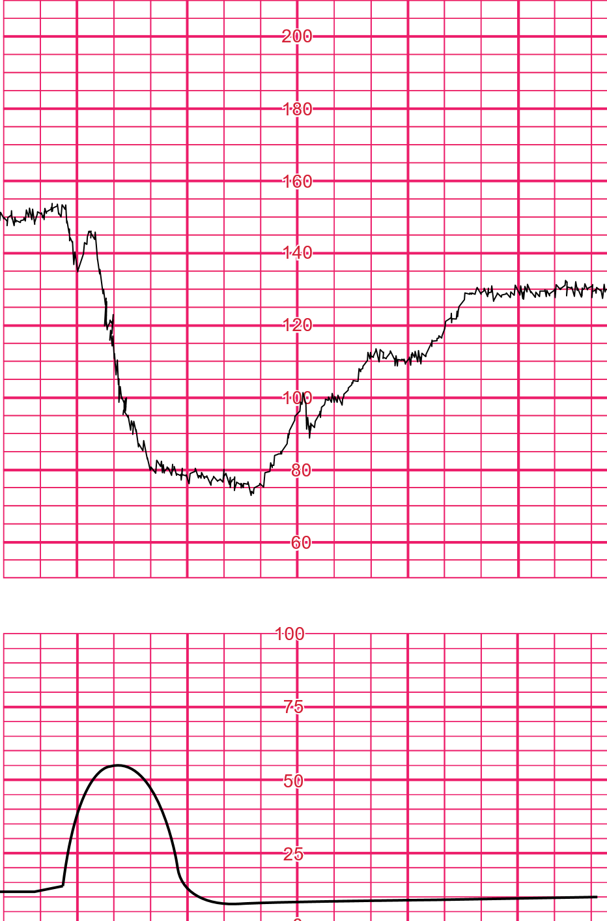

Slide 56
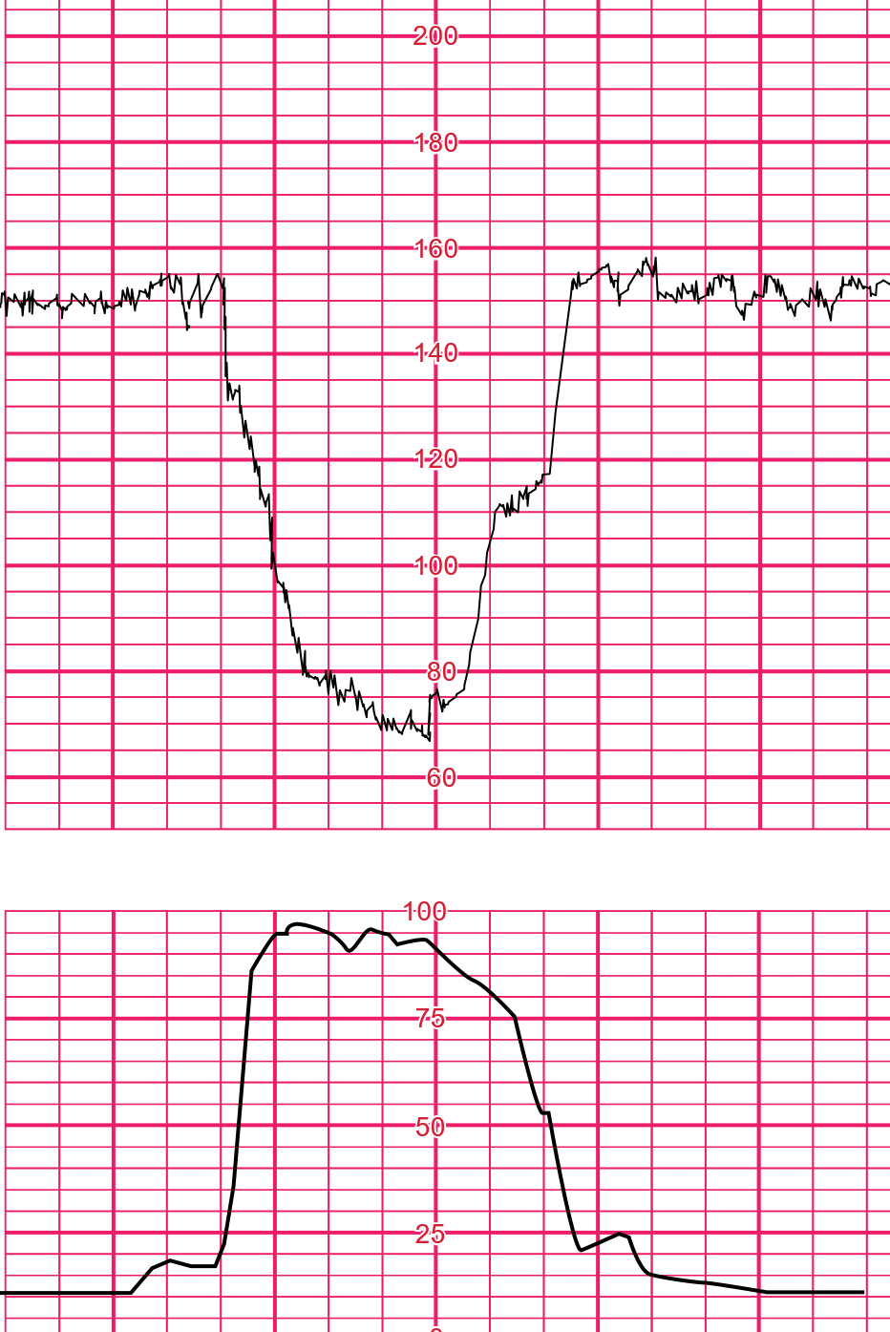
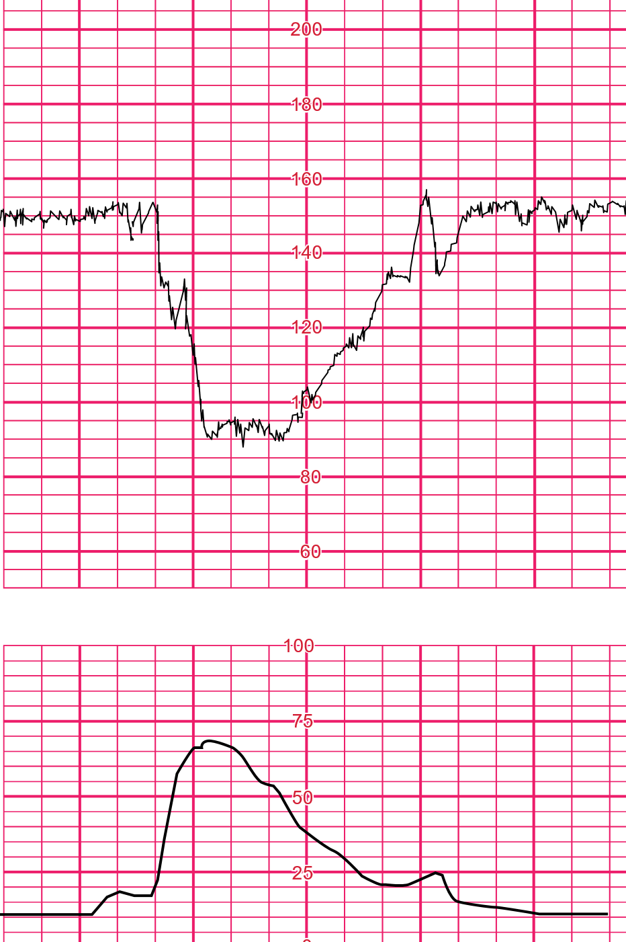

Slide 57
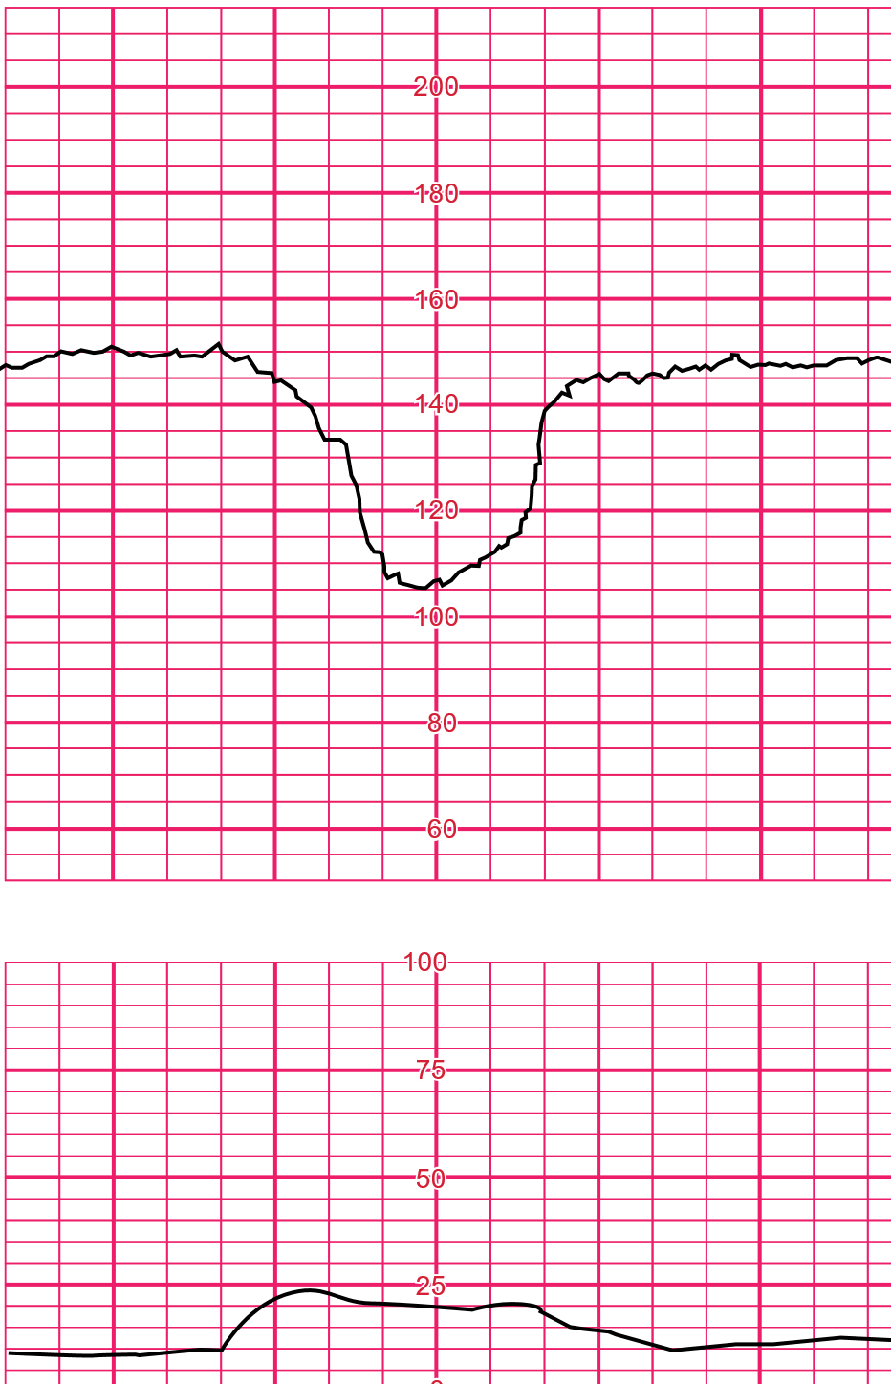
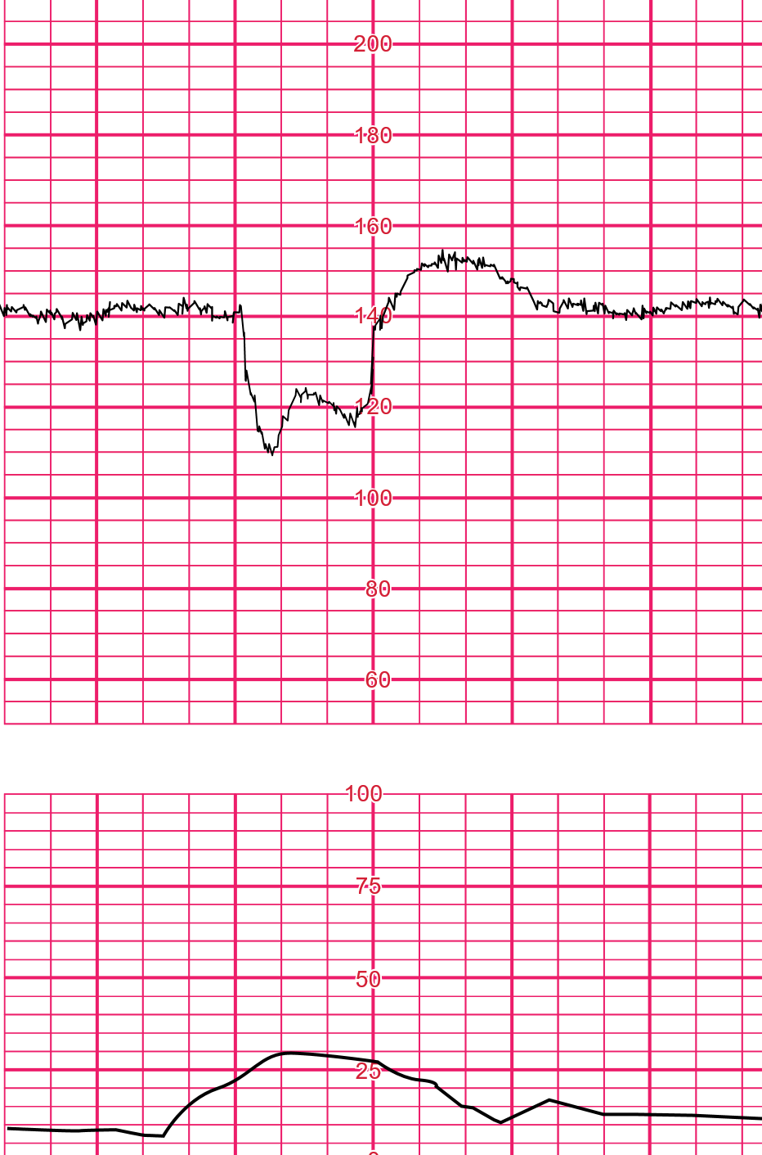

Slide 58
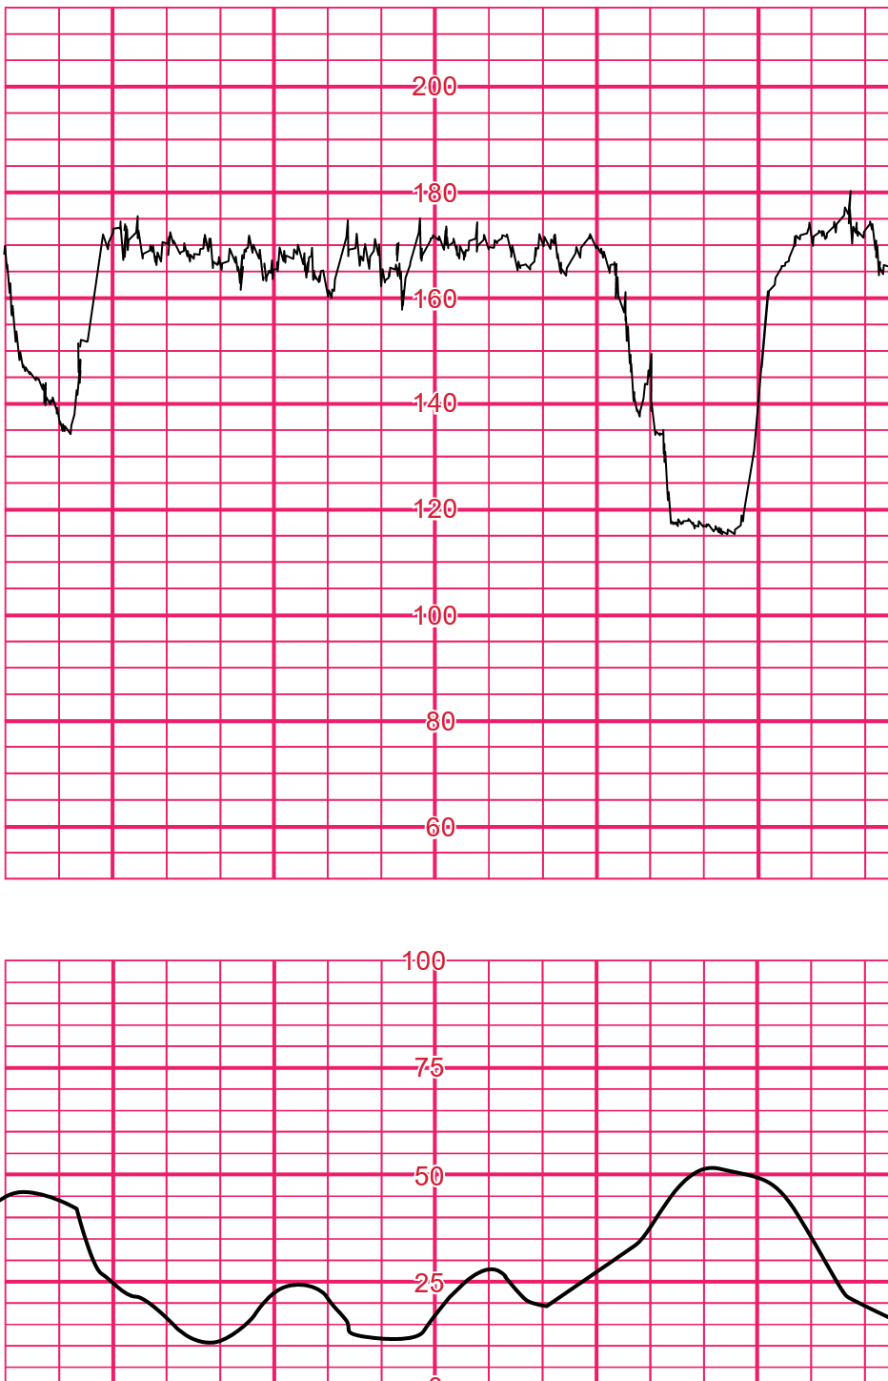

Slide 59
Late Decelerations
Late decelerations are U-shaped and/or with reduced variability.
When contractions are adequately monitored, late decelerations start more than 20 seconds after the onset of a contraction, have a nadir after the acme, and return to the baseline after the end of the contraction.
These are decelerations with a gradual onset and/or a gradual return to the baseline and/or reduced variability within the deceleration.

Slide 60
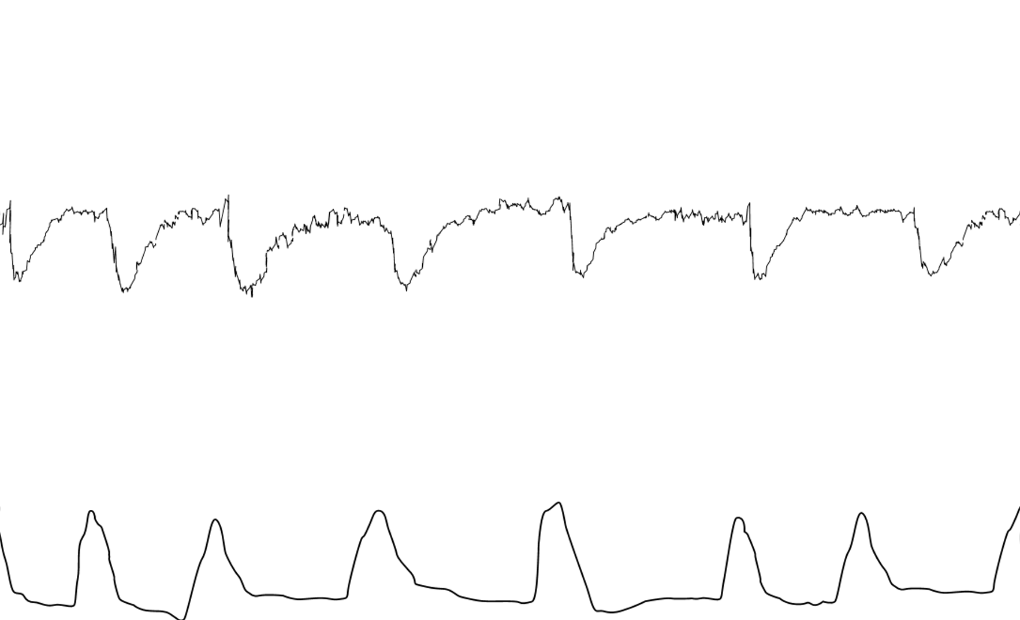

Slide 61
Prolonged Decelerations
These are decelerations lasting for more than 3 minutes.
These are likely to include a chemoreceptor-mediated component and thus to indicate hypoxemia.
Decelerations exceeding 5 minutes, with fetal heart rate maintained at less than 80 bpm and reduced variability within the deceleration, are frequently associated with acute fetal hypoxia/acidosis and require urgent intervention.

Slide 62
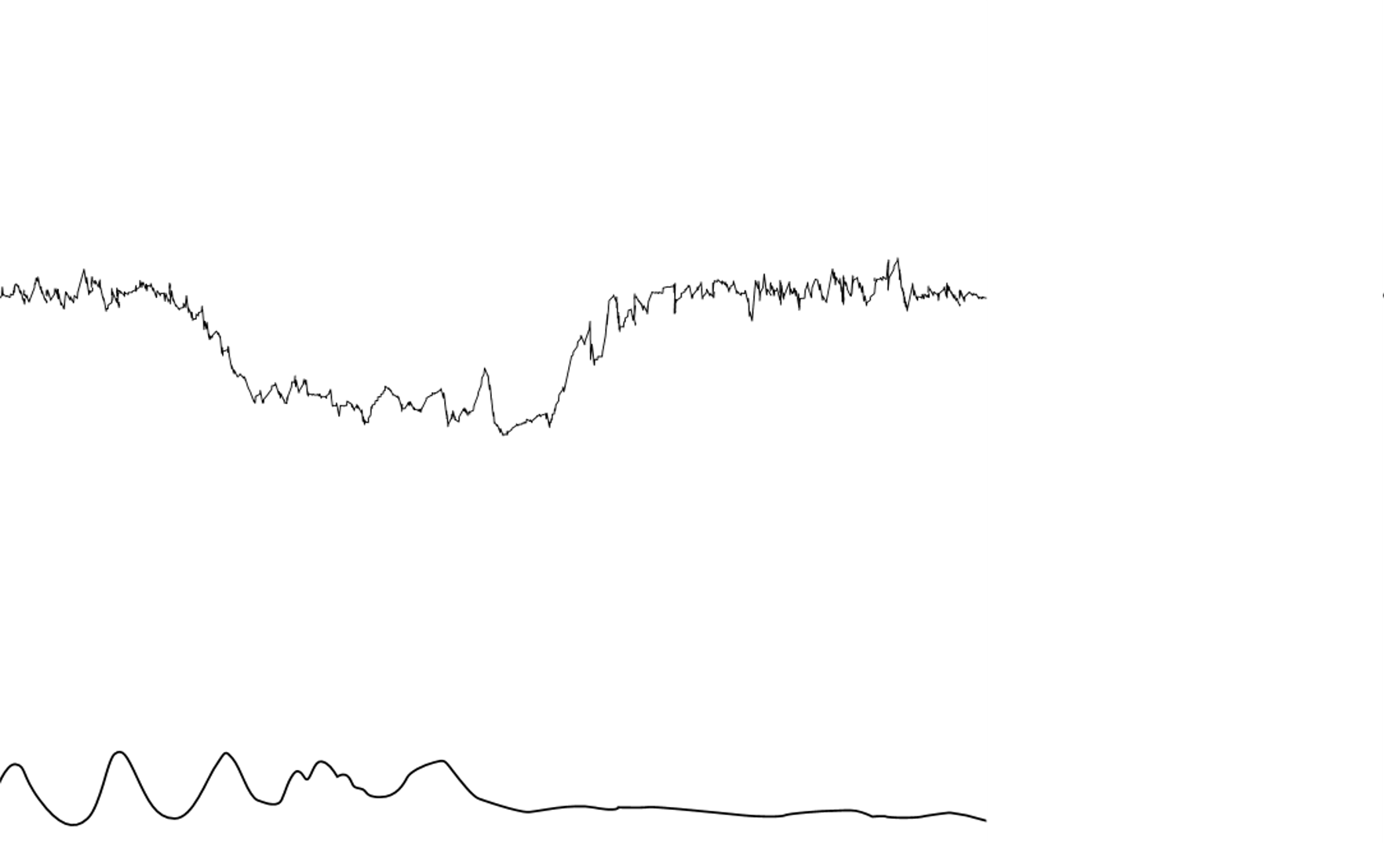

Slide 63
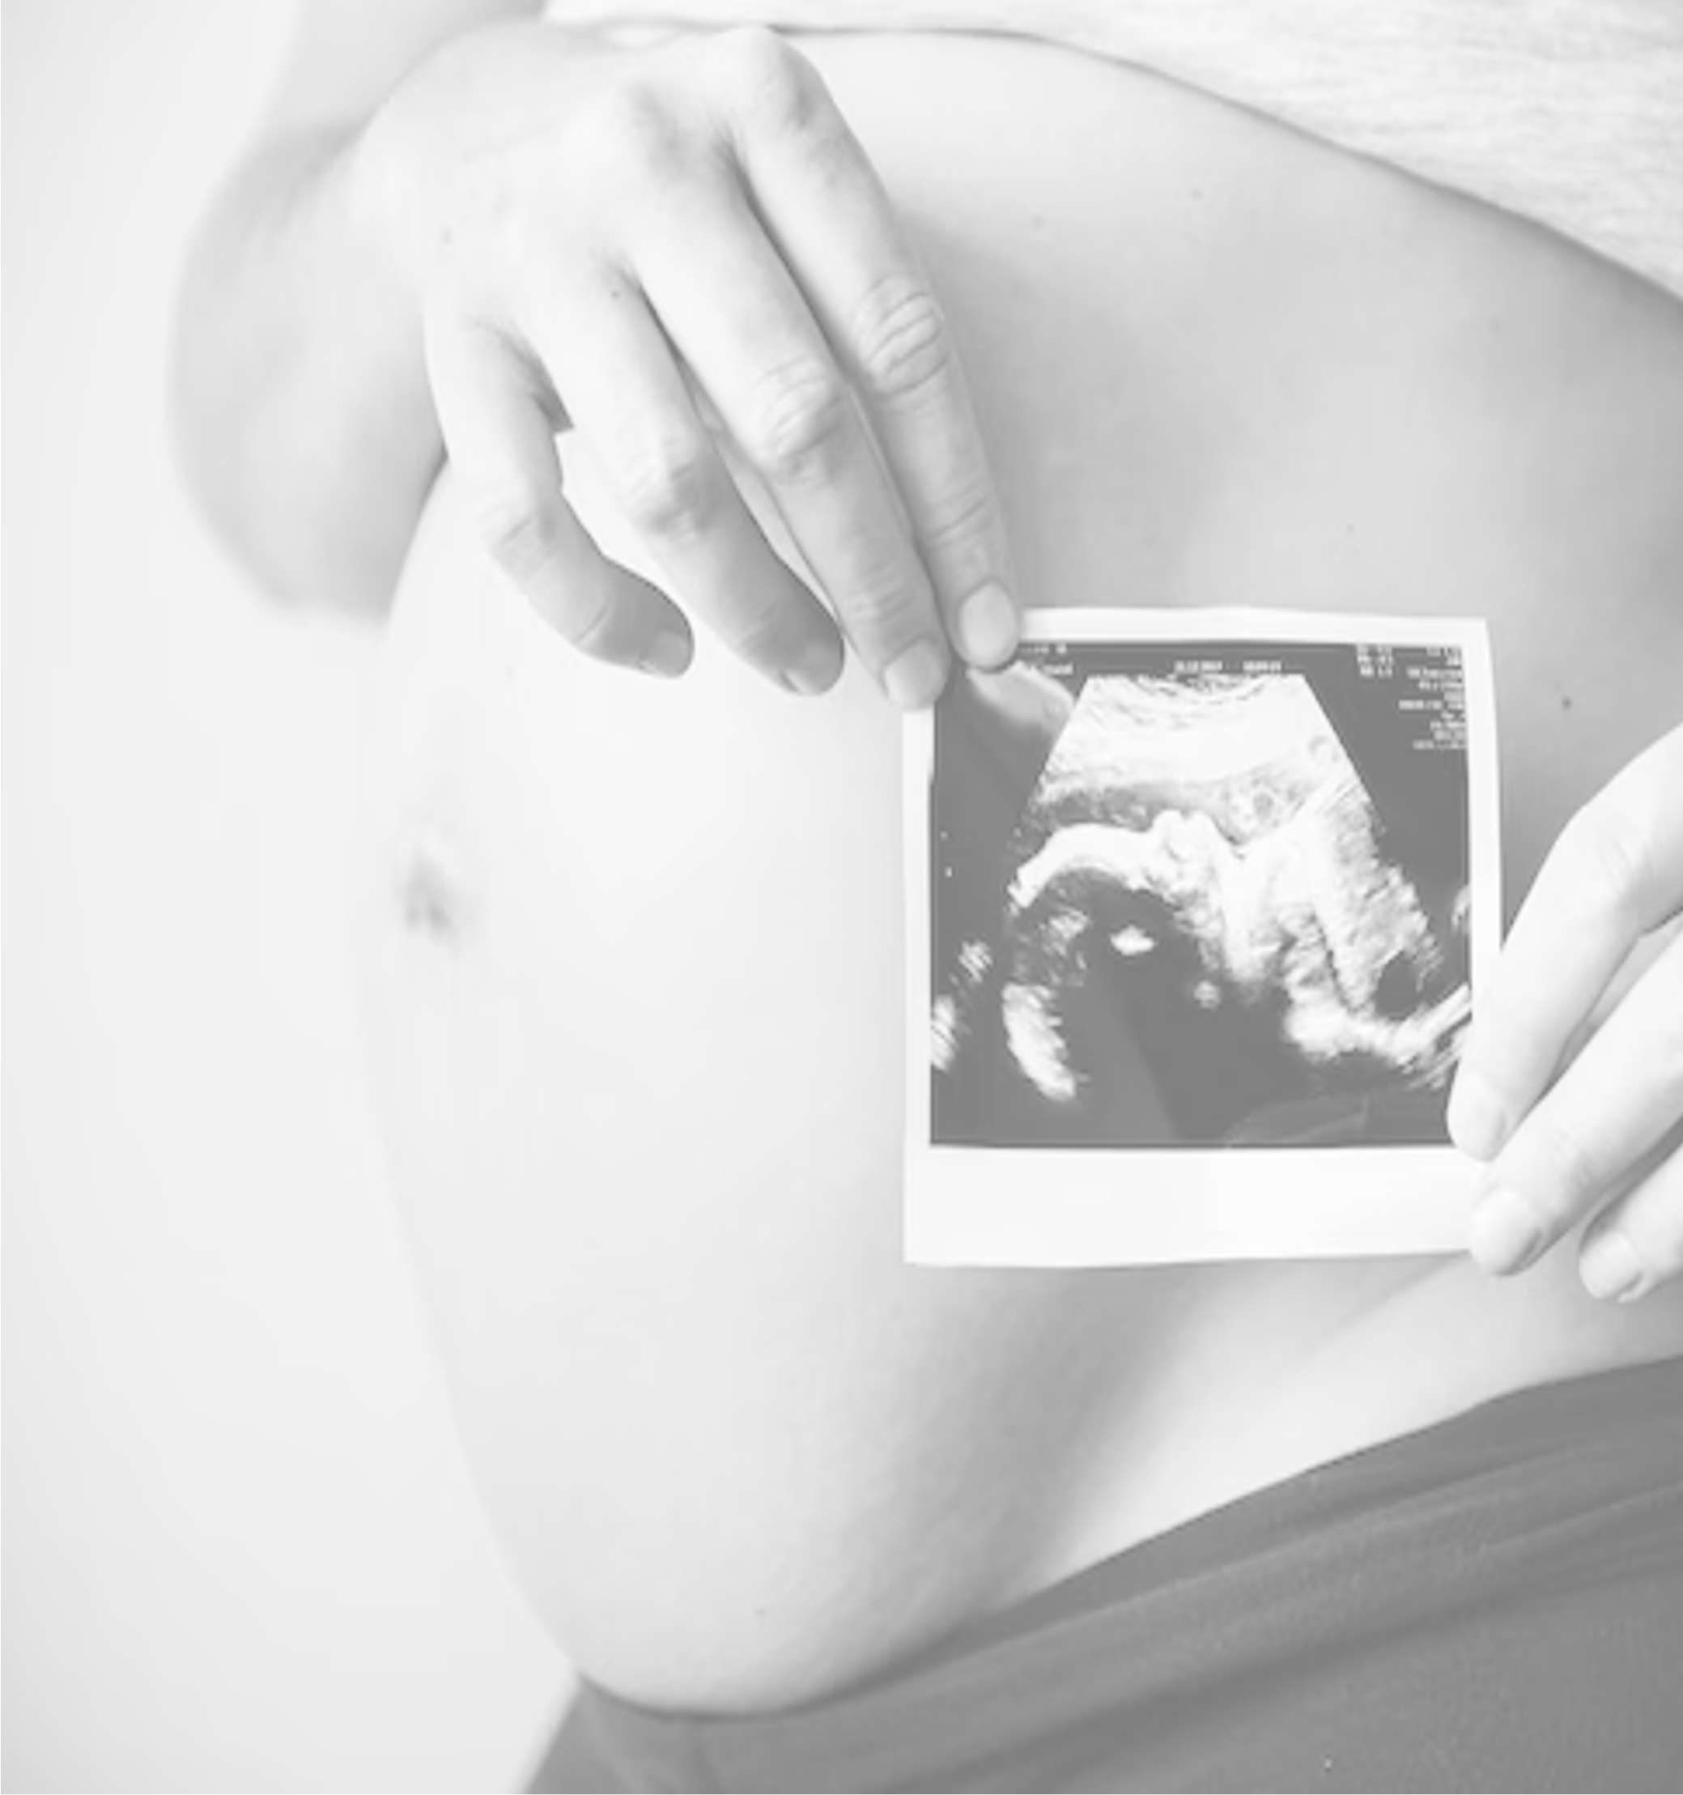
The target of CTG interpretation is to categorize it as Normal
Suspicious Pathological
While individual components will be recognized as Reassuring
Non-reassuring Abnormal

Slide 64
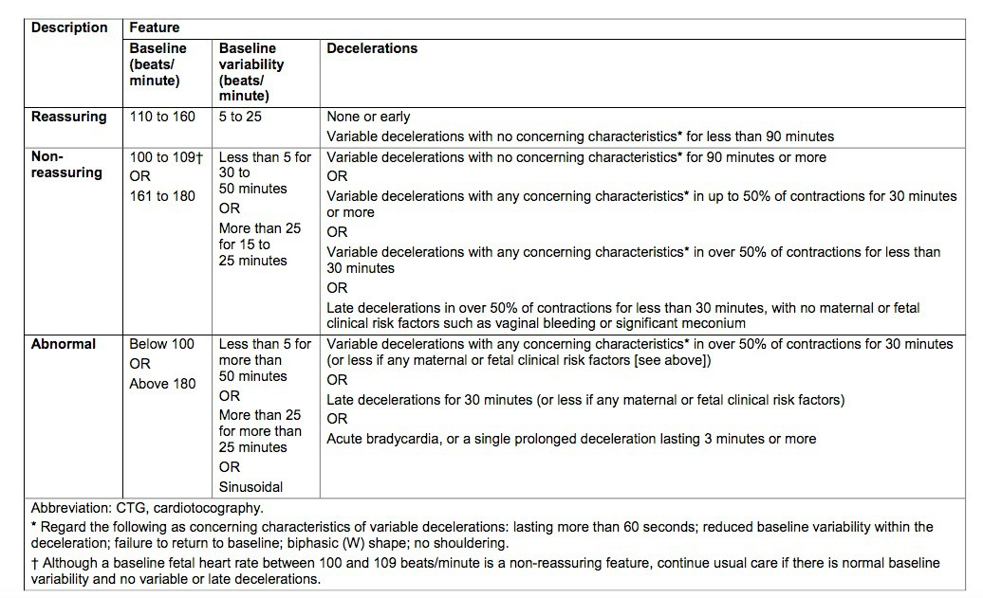

Slide 65
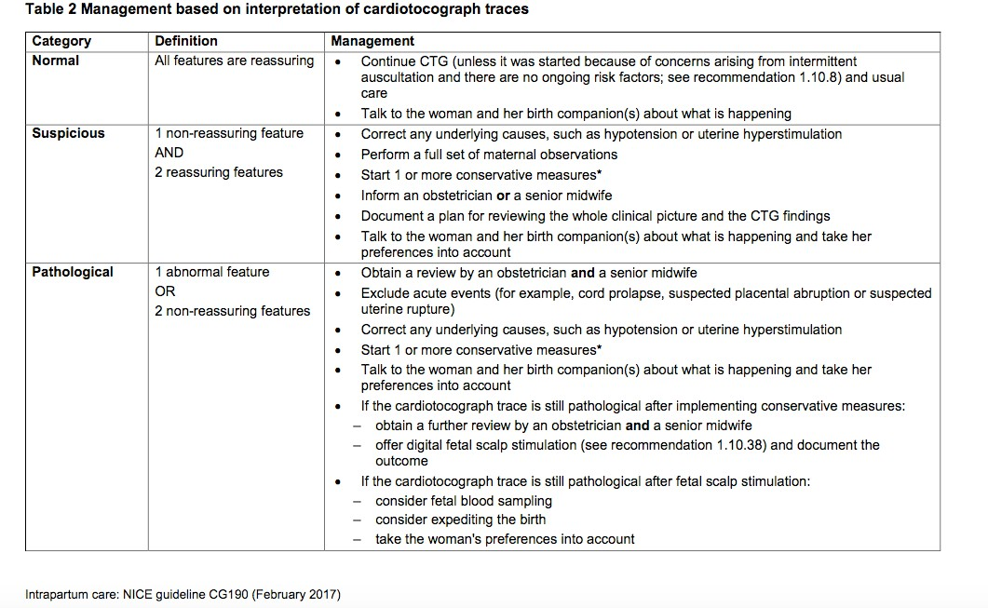

Slide 66
Contractions
External monitoring of uterine contractions using a tocodynamometer evaluates the increase in myometrial tension measured through the abdominal wall.
This is recorded as a bell-shaped uterine activity signal.
The only information obtained from this is the frequency of contractions by recording the number of contractions present in a 10- minute period.

Slide 67
Each big square on the CTG trace is equal to one minute, so look at how many contractions (bell shaped peaks) have occurred within 10 big squares.
It is not possible to get reliable information regarding the intensity, duration of contractions or the basal uterine tone.

Slide 68
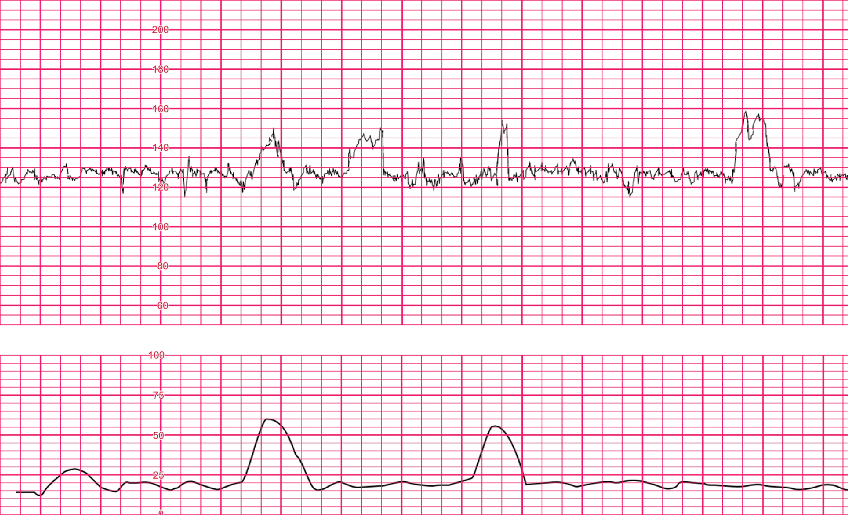

Slide 69
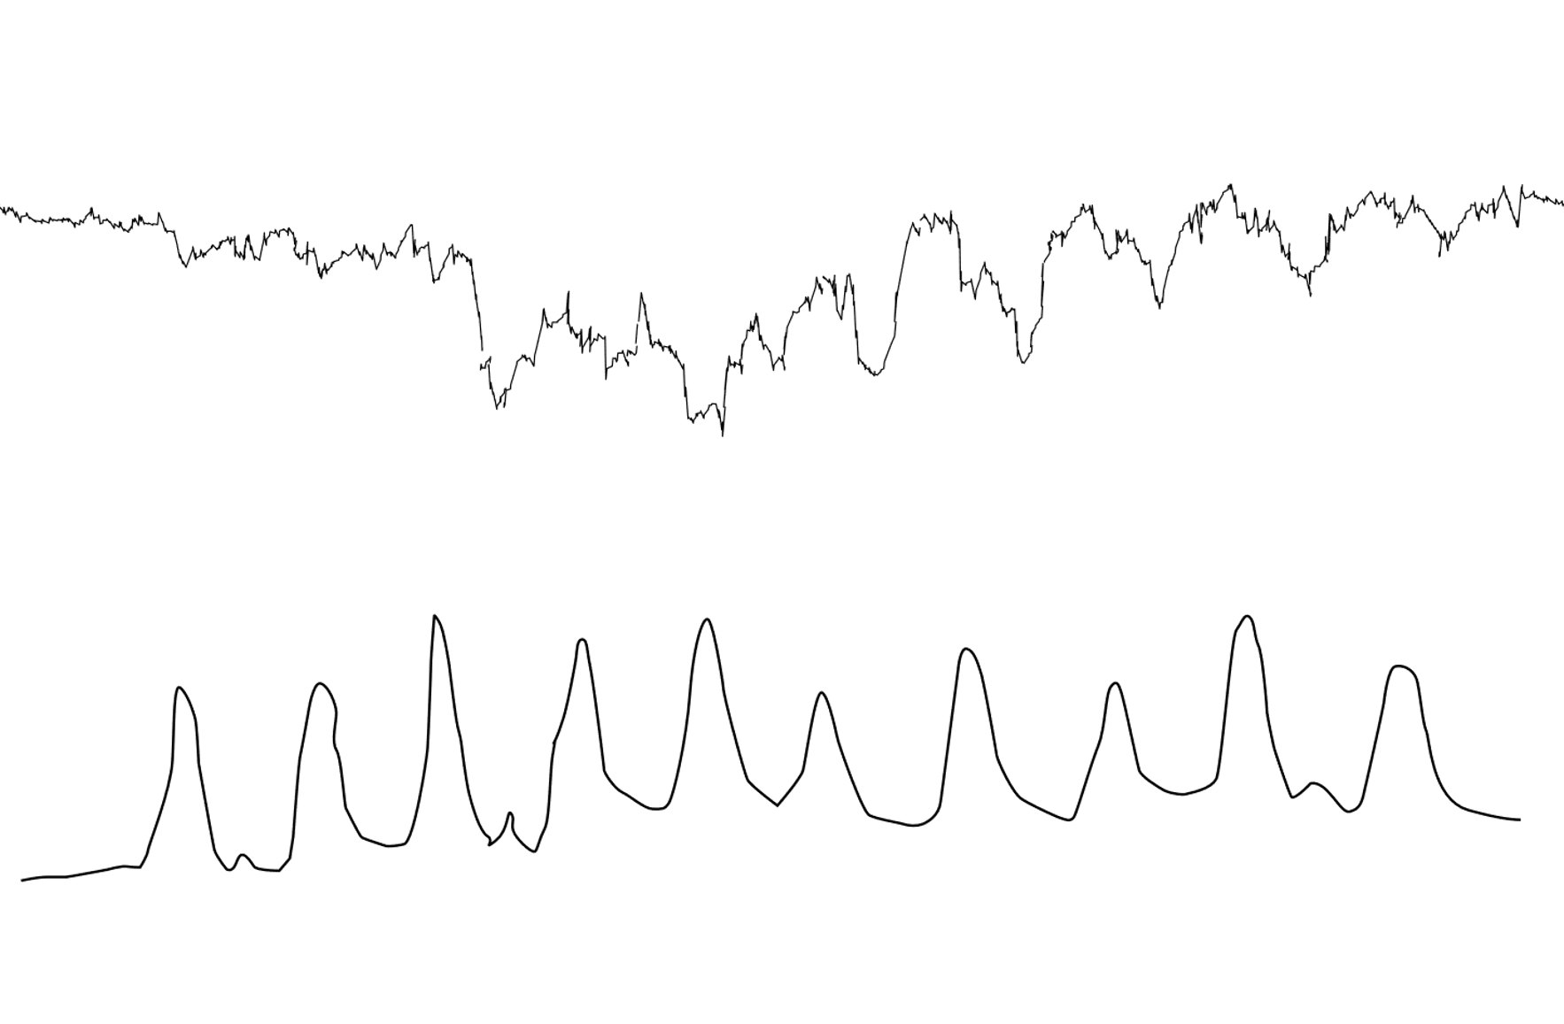

Slide 70
Hyperstimulation
This can be defined either as
Tachysystole – More than five contractions in 10 minutes over a period of at least 20 minutes. This is not associated with changes in
the fetal heart trace. (Peebles et al 1994) or
Hypertonus - A contraction lasting for more than 2 minutes in association with changes in the fetal heart trace. (Strat OG, RCOG)
According to some authorities, any increased uterine activity (frequency, duration or strength) associated with CTG changes should be considered as uterine hyperstimulation. (Edwin Guideline 2018)

Slide 71
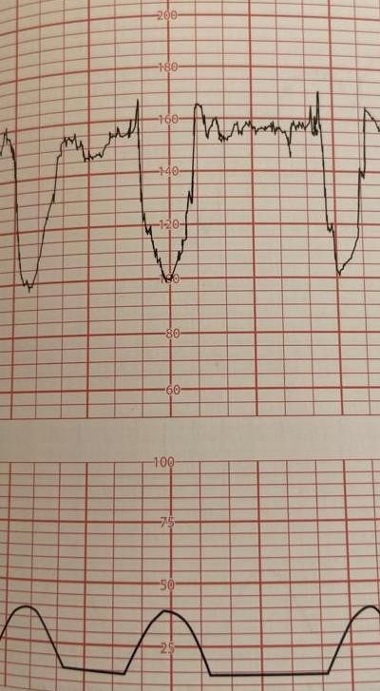
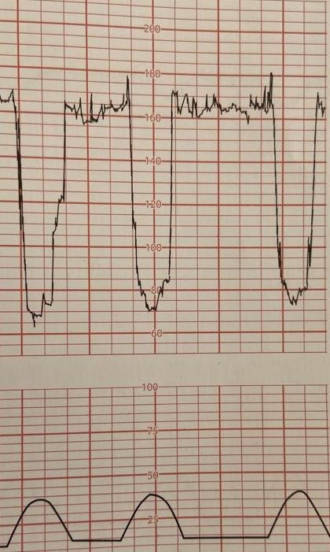

Slide 72
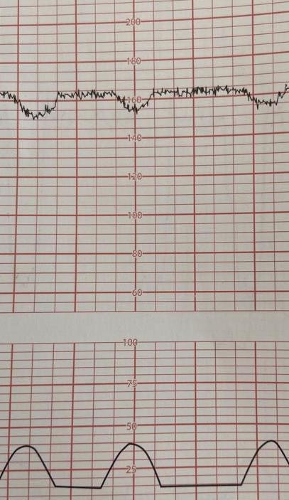
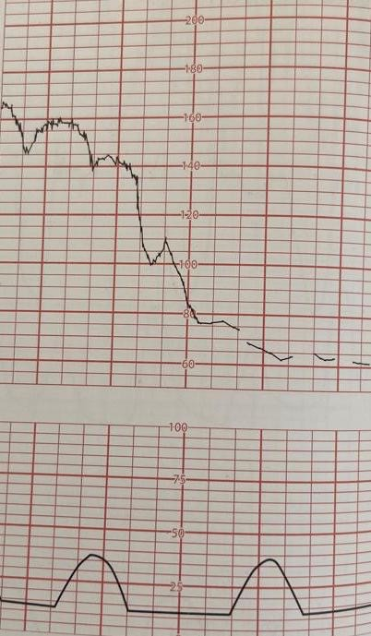

Slide 73
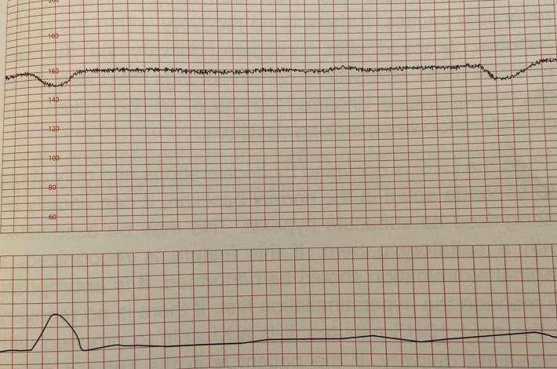

Slide 74
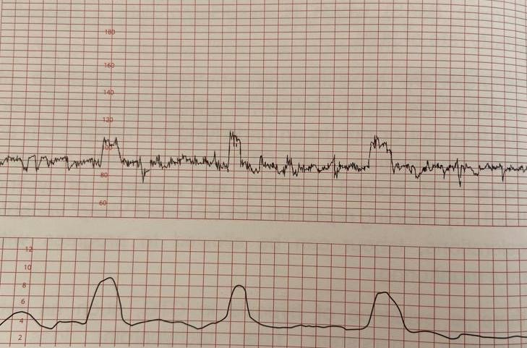

Slide 75
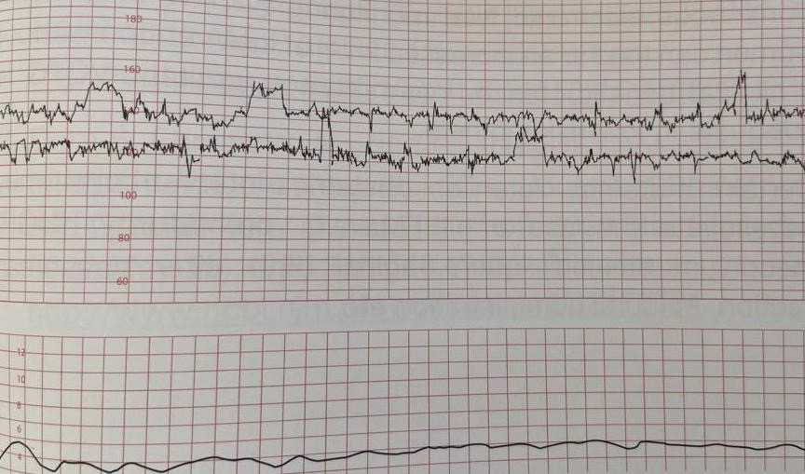

Slide 76
Actions to be taken in cases of suspicious or pathological CTGs
If excessive uterine activity is detected either in the CTG or by palpation of the uterus, the oxytocin infusion should be immediately stopped.
If she has been administered PGE2, it should be removed and the vagina
can be washed if needed. If available, administer an acute tocolytic agent after consulting your consultant.
Changing the maternal position is important. If the woman is in the
supine position, this can lead to reduced fetal perfusion due to aorto- caval compression.
Furthermore, changing the position can reverse the temporary cord compression.

Slide 77
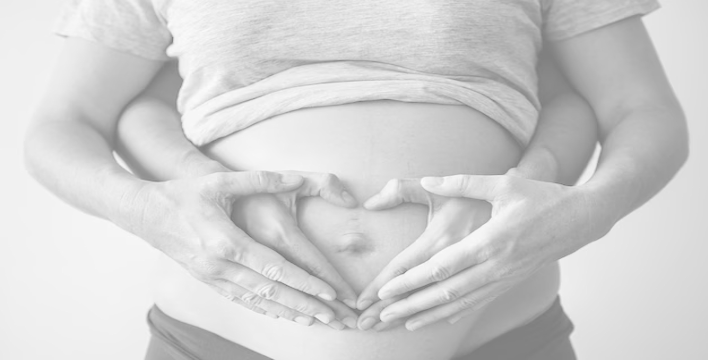
If there is a sudden hypotension due to epidural analgesia, IV fluids should be given to reverse the situation.
Giving oxygen to mothers via mask or IV fluids to normotensive women has not been proven to be an effective method.
When a suspicious or worsening CTG pattern is suspected, the underlying cause should be identified if possible before a pathological tracing develops.

Slide 78
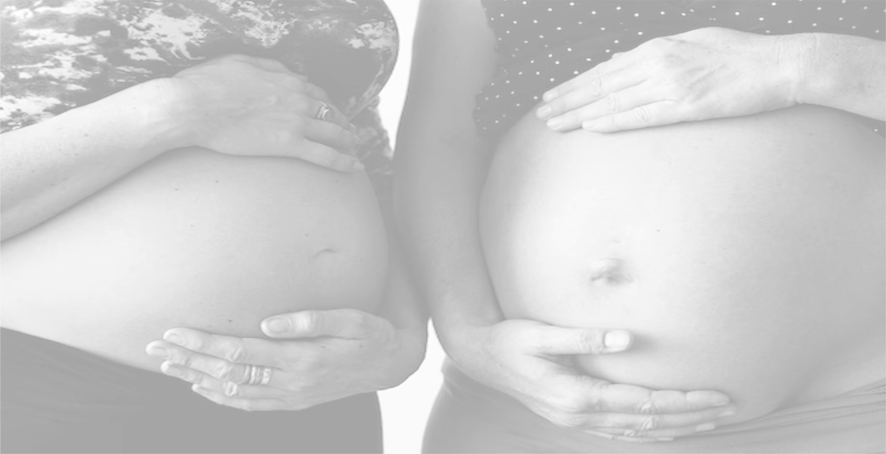
If the CTG is suspicious or pathological, repeating CTGs without the guidance of a senior can lead to serious consequences.
If the woman is in the second stage, the worsening of hypoxia can be minimized by discontinuing maternal push and expediting the delivery.
If there is any doubt about the CTG or suspect contact loss, do not hesitate to seek help from seniors.
If there is maternal tachycardia/maternal pyrexia, this should be addressed immediately.
Maternal dehydration should be corrected without delay.

Slide 79
Your aim is to identify hypoxia in labour
Acute hypoxia
Sub acute hypoxia Gradually evolving hypoxia
Chronic hypoxia

Slide 80
Next

