Slide 1
Mother-Friendly Practices
Safe Motherhood – SLCOG
Dr PGCM Jayasundara
Act Consultant Obstetrician and Gynarcologist

Slide 2
WHO recommendations: Intrapartum care for a positive childbirth experience
Transforming care of women and babies for improved health and well-being

Slide 3
Respective Maternity Care
COMPONENTS
Care organized and provided to all women
in a manner that maintains their dignity, privacy, and confidentiality
ensures freedom from harm and mistreatment
enables informed choice and continuous support
During labor and childbirth

Slide 4
Respectful maternity care (RMC) is a universal human right for every childbearing woman in every health system around the world

Slide 5
What is Respectful Maternity Care?
RESPECT FOR A WOMAN’S RIGHTS, CHOICES AND DIGNITY
Care that “does no harm”
Care that promotes positive parenting and improves birth outcomes
Care that is culturally sensitive and valued by the woman and her community

Slide 6
RMC for Everyone!!
Regardless of
Risk status of labour - High risk or low risk
Birth setting
Cadre of health care providers
Country in income level - High, middle or low

Slide 7
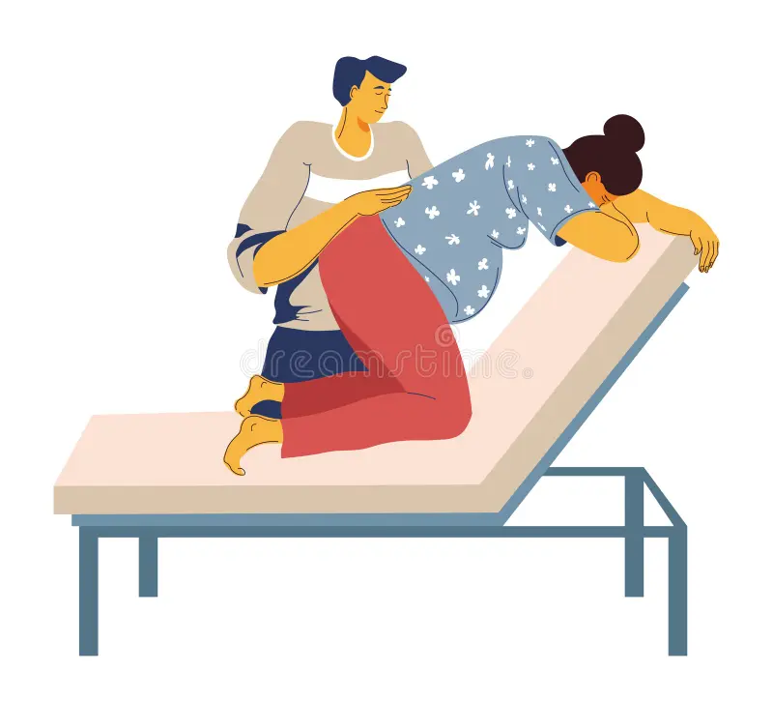
Labour Companion
Person chosen by the woman to provide her with continuous support during labour
Spouse/partner
A female friend or relative
community member
Doula
The presence of a birth companion improves birth outcomes and the overall birth experience

Slide 8
Clinically Significant benefits;
Shorter labour time
Greater rates of spontaneous vaginal birth
Decreased caesarean section
Intrapartum analgesia
Increased satisfaction with childbirth experiences
Dubey et al.(2023)

Slide 9
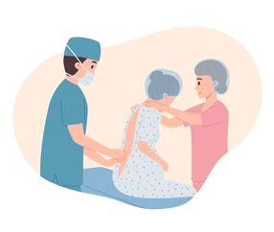
Analgesia
Relaxation techniques
Progressive muscle relaxation, Breathing, Music, Mindfulness yoga techniques etc
Manual techniques
Massage, Application of warm packs etc
Epidural
Opioids
Fentanyl, Diamorphine, Pethidine

Slide 10
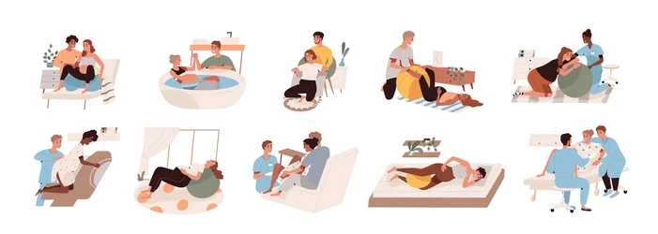
Choice of the position for labour and birth encourages a woman’s sense of control and reduces need for analgesia
Does your workplace allow for choice for different positions?

Slide 11
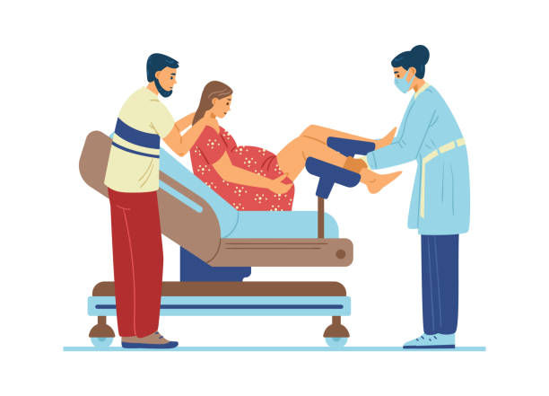

Slide 12
Common Practices that may be Harmful
Restricting ambulation/different positions during labor and choice of birth position
Lack of companion/family during labour
Over-use of anesthesia/analgesia
Administration of oxytocin at any time before delivery in such a way that the effect cannot be controlled
Restricting food and fluids
Separation of mother and baby
Early cord clamping
Routine episiotomy

Slide 13
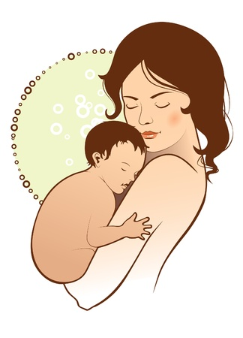
Keeping mother and baby together
Promote warming with ‘skin-to-skin’ after birth
Promote early and exclusive baby-led breastfeeding
Ensure mother counselled on danger signs

Slide 14
Challenges
Space limitations
Inadequate privacy
Higher patient load
Limited staff

Slide 15
How to overcome the challenges
Conduct Proper staff training programmes
Orientation session on supportive labour companionship techniques, refresher courses
Provide an adequate number of staff
Provide supplies and equipment
Enhance physical environment – measures to support privacy and confidentiality (Private physical space for the woman and her companion at the time of birth)
Supportive supervision of monitoring

Slide 17
Accountability for our practices
Take responsibility for your own actions
Provide care that is evidence-based and is beneficial
Do no harm
Record and report
Communicate
Be the woman’s advocate
Everyone has a role in ensuring maternity care is respectful

Slide 19
Thank You

