Slide 1
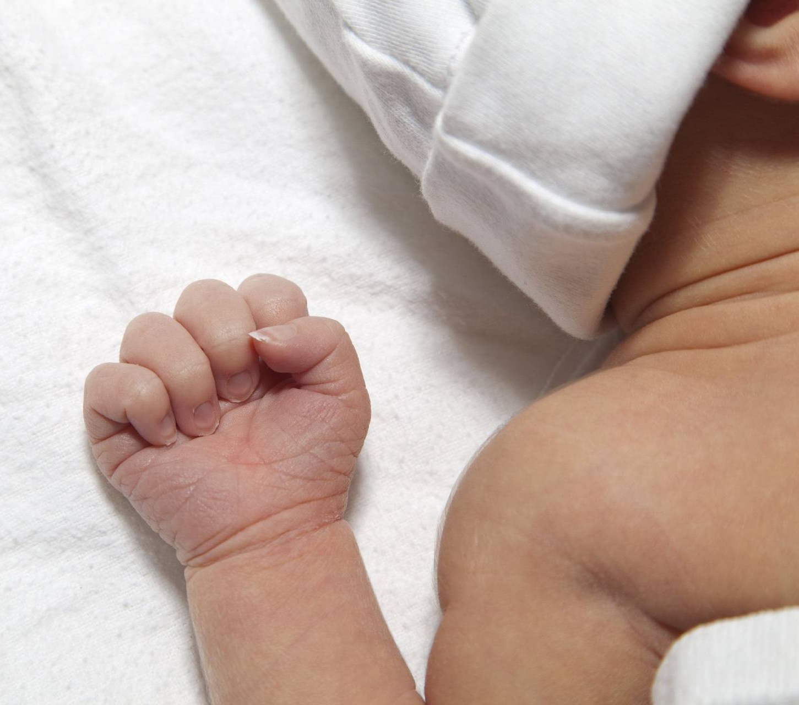
Shoulder Dystocia
Sri Lanka College of Obstetricians & Gynaecologists
Scientific Activities & Research Committee

Slide 2
Sri Lanka College of Obstetricians & Gynaecologists
Scientific Activities & Research Committee
Shoulder dystocia is an Obstetric emergency
It must be recognized and treated as soon as possible to avoid significant morbidity and even mortality.
100% awareness need among health care workers.
Neonatal BPI is the most common cause for litigation related to shoulder dystocia and the third most litigated obstetric-related complication in the UK

Slide 3
Shoulder dystocia - Definition
Sri Lanka College of Obstetricians & Gynaecologists
Scientific Activities & Research Committee
A vaginal cephalic delivery that requires additional obstetric manoeuvres to deliver the fetus after the head has delivered and gentle traction has failed.
An objective diagnosis of a prolongation of head-to-body delivery time of more than 60 seconds has also been proposed
Incidence 0.58% - 0.70%.

Slide 4
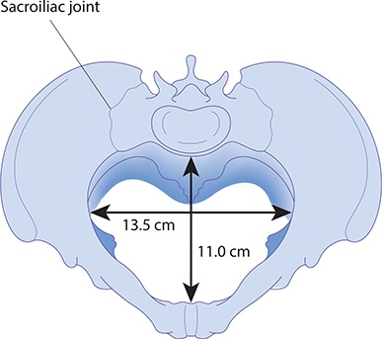
Pathophysiology
Sri Lanka College of Obstetricians & Gynaecologists
Scientific Activities & Research Committee
Shoulder dystocia occurs when the
Anterior fetal shoulder impacts on maternal symphysis pubis.
Posterior shoulder impacts on sacral promontory
Both shoulders
In majority of women AP diameter of pelvic inlet is narrower than transverse or oblique diameter.
Fetal shoulder usually enter the pelvis in oblique diameter.

Slide 5
Sri Lanka College of Obstetricians & Gynaecologists
Scientific Activities & Research Committee
If the fetal biacromial diameter is large and the fetal shoulders attempt to enter the pelvis in the narrower AP diameter, the anterior fetal shoulder will become impacted on the maternal symphysis pubis.
On extremely rare occasions both shoulders may remain above the pelvic brim causing bilateral shoulder dystocia.

Slide 6
Risk factors
Sri Lanka College of Obstetricians & Gynaecologists
Scientific Activities & Research Committee

Slide 7
Maternal diabetes mellitus
Sri Lanka College of Obstetricians & Gynaecologists
Scientific Activities & Research Committee
Infants of diabetic mothers have a 2 to 4 fold increased risk of shoulder dystocia compared to infants of non diabetic mothers for the same birth weight.
These infants tend to have a higher shoulder to head circumference ratio, because the tissues that contribute to shoulder girth are insulin sensitive and respond to hyperglycaemia and hyperinsulinism.

Slide 8
Fetal weight and Shoulder dystocia
Sri Lanka College of Obstetricians & Gynaecologists
Scientific Activities & Research Committee
Infants weighing over 4000g are significantly more likely to suffer shoulder dystocia compared to those weighing less than 4000g. (11.1% and 0.6% respectively)
However, macrosomia remains a weak predictor of shoulder dystocia.
Beacause;
Fetal weight is difficult to determine accurately
The large majority of infants with a birth weight of greater than 4500g do not develop SD and up to 48% of cases shoulder dystocia occurs in infants with a birth weight less than 4000g.

Slide 9
Sri Lanka College of Obstetricians & Gynaecologists
Scientific Activities & Research Committee
ALWAYS ANTICIPATE
SHOULDER DYSTOCIA
IF YOU DETECT RISK FACTORS

Slide 10
Complications
Sri Lanka College of Obstetricians & Gynaecologists
Scientific Activities & Research Committee
Maternal
Neonatal
Maternal morbidity is increased
PPH -11%
third and fourth-degree perineal tears - 3.8%
Brachial plexus injury (BPI) - 2.3% to 16%
most cases of BPI resolve without permanent disability
Less than 10% resulting in permanent neurological dysfunction.
Hypoxia and acidosis
Soft tissue injury
Fractures (Humerus, Clavicle)

Slide 11
Prevention of shoulder dystocia
Sri Lanka College of Obstetricians & Gynaecologists
Scientific Activities & Research Committee
IOL doesn't prevent shoulder dystocia in non diabetic macrosomia
IOL at term can reduce shoulder dystocia in GDM
Elective LSCS is recommended in GDM or pre gestational DM if EFW>4.5kg
Recurrence rate can be low as 1% to high as 25%
Next pregnancy MOD is individualized decision

Slide 12
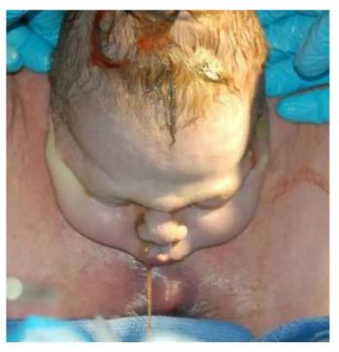
Diagnosis
Sri Lanka College of Obstetricians & Gynaecologists
Scientific Activities & Research Committee
Difficulty of delivering face and chin
Head remaining tightly applied to the vulva (Turtle neck sign)
Failure of restitution
Failure of shoulders to descend and failure to deliver the anterior shoulder even after application of routine axial traction

Slide 13
Immediate measures to take after diagnosis
Sri Lanka College of Obstetricians & Gynaecologists
Scientific Activities & Research Committee
Declare Obstetrics emergency
State clearly shoulder dystocia
Call for help
establish a chain of communication up to most experience obstetrician, neonatologist, anaesthetist,
Communicate with the mother; get her support, Get her to the edge of the bed
Stop maternal pushing.
Remove pillows.
Avoid fundal pressure.

Slide 14
Management
Sri Lanka College of Obstetricians & Gynaecologists
Scientific Activities & Research Committee
With each maneuver gentle axial traction is applied
All maneuvers can be tried for 30 seconds in a cycle
If time permits can go back on the cycle

Slide 15
Sri Lanka College of Obstetricians & Gynaecologists
Scientific Activities & Research Committee
1st line - McRoberts’ position + suprapubic pressure
2nd line – rotational maneuvers or delivery of posterior arm
3rd line - cleidotomy , symphysiotomy, and the Zavanelli manoeuvre.

Slide 16
The McRoberts’ maneuver
Sri Lanka College of Obstetricians & Gynaecologists
Scientific Activities & Research Committee
Flexion and abduction of the maternal hips
Positioning the maternal thighs on her abdomen.
It straightens the lumbosacral angle, rotates the maternal pelvis towards the mother’s head and increases the relative anterior-posterior diameter of the pelvis.
Reported success rates is high as 90%.
It has a low rate of complication and is one of the least invasive maneuver
Should be employed first.

Slide 17
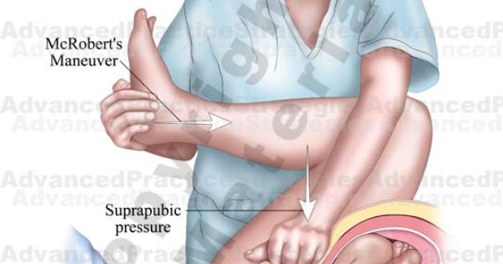
Sri Lanka College of Obstetricians & Gynaecologists
Scientific Activities & Research Committee

Slide 18
Sri Lanka College of Obstetricians & Gynaecologists
Scientific Activities & Research Committee

Slide 19
Suprapubic pressure
Sri Lanka College of Obstetricians & Gynaecologists
Scientific Activities & Research Committee
Can be employed together with the McRoberts’ manoeuvre to improve success rates.
Suprapubic pressure reduces the fetal biacromial diameter and rotates the anterior fetal shoulder into the wider oblique pelvic diameter.
The shoulder is then freed to slip underneath the symphysis pubis with the aid of routine axial traction.
Suprapubic pressure should ideally be applied by an assistant from the side of the fetal back in a downward and lateral direction just above the maternal symphysis pubis.
This reduces the fetal biacromial diameter by pushing the posterior aspect of the anterior shoulder towards the fetal chest.
There is no clear difference in efficacy between continuous pressure and ‘rocking’ movement.

Slide 20
Sri Lanka College of Obstetricians & Gynaecologists
Scientific Activities & Research Committee

Slide 21
What if the first line manoeuvres are not successful?
Sri Lanka College of Obstetricians & Gynaecologists
Scientific Activities & Research Committee

Slide 22
Sri Lanka College of Obstetricians & Gynaecologists
Scientific Activities & Research Committee
Proceeding to second line manoeuvres
All-fours position and internal manoeuvres are equal in the order as second line manoeuvres
It’s up to the discretion of clinicians’ experience to decide which one to be chosen.

Slide 23
Internal maneuvers
Sri Lanka College of Obstetricians & Gynaecologists
Scientific Activities & Research Committee
Internal rotational manoeuvres
or
Delivery of the posterior arm
Episiotomy – for access into vagina

Slide 24
Episiotomy
Sri Lanka College of Obstetricians & Gynaecologists
Scientific Activities & Research Committee
Gaining access to the vagina for internal manoeuvres
The most spacious part of the pelvis is in the sacral hollow; therefore vaginal access should be gained posteriorly, into the sacral hollow. The whole hand should be entered posteriorly to perform internal rotation or delivery of the posterior arm.
An episiotomy will not relieve the bony obstruction of shoulder dystocia but may be required to allow the healthcare professional more space to facilitate internal vaginal manoeuvres.
The use of an episiotomy does not decrease the risk of BPI with shoulder dystocia.

Slide 25
Internal rotational maneuvers
Sri Lanka College of Obstetricians & Gynaecologists
Scientific Activities & Research Committee
Originally described by Woods and Rubin
Achieved by pressing on the anterior or posterior aspect of the posterior shoulder.
Pressure on the posterior aspect of the posterior shoulder has the additional benefit of
Reducing the shoulder diameter by adducting the shoulders
Aim - Shoulders rotated into the wider oblique diameter, resolving the shoulder dystocia.
If pressure on the posterior shoulder is unsuccessful, an attempt should be made to apply pressure on the posterior aspect of the anterior shoulder to adduct and rotate the shoulders into the oblique diameter.

Slide 26
Sri Lanka College of Obstetricians & Gynaecologists
Scientific Activities & Research Committee

Slide 27
Delivery of the posterior arm
Sri Lanka College of Obstetricians & Gynaecologists
Scientific Activities & Research Committee
Insert the whole hand in to the sacral hollow.
The wrist of the posterior arm is grasped by fingers and thumbs of the operator
Removal of the posterior arm gently by sweeping across the fetal chest.
Delivering the posterior arm reduces the diameter of the fetal shoulders by the width of the arm.
The fetal wrist should be grasped and the posterior arm should be gently withdrawn from the vagina in a straight line.
Delivery of the posterior arm is associated with humeral fractures with a reported incidence between 2% and 12%.
Once you deliver the posterior arm, deliver the baby with gentle traction or rotate the fetus 180⁰ traction across the fetal chest.

Slide 28
Sri Lanka College of Obstetricians & Gynaecologists
Scientific Activities & Research Committee

Slide 29
Sri Lanka College of Obstetricians & Gynaecologists
Scientific Activities & Research Committee

Slide 30
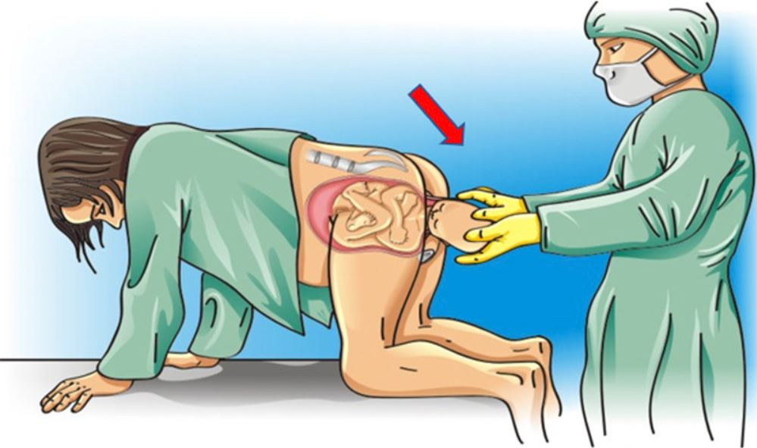
Sri Lanka College of Obstetricians & Gynaecologists
Scientific Activities & Research Committee
Delivery by all-fours position
Mother is asked to transfer onto her hands and knees
Gentle traction is applied to the fetal head to determine if the fetal shoulders have been released

Slide 31
When would you prefer delivery by all-fours position
Sri Lanka College of Obstetricians & Gynaecologists
Scientific Activities & Research Committee
With enough experience, it can be chosen over internal manoeuvres
Failing internal manoeuvres
When the mother is slim and mobile
When the mother is not on epidural anaesthesia.

Slide 32
Sri Lanka College of Obstetricians & Gynaecologists
Scientific Activities & Research Committee
Third-line manoeuvres should be considered very carefully to avoid unnecessary maternal morbidity and mortality.
It is difficult to recommend an absolute time limit for the management of shoulder dystocia as there are no conclusive data available,
Very low rate of hypoxic ischaemic injury is up to five minutes
Cleidotomy - surgical division of the clavicle or bending with a finger
Symphysiotomy - dividing the anterior fibres of symphyseal ligament
The Zavanelli maneuver. - cephalic replacement

Slide 33
Cleidotomy
Sri Lanka College of Obstetricians & Gynaecologists
Scientific Activities & Research Committee
Surgical division or fracturing of one or both clavicles,
Reduces the shoulder girth
Not easy in a term fetus & could damage the subclavian vessels and the brachial plexus.
Applicable in the case of a dead fetus or one with a lethal anomaly.
Specially designed ‘cleidotomy scissors’ have been developed

Slide 34
Sri Lanka College of Obstetricians & Gynaecologists
Scientific Activities & Research Committee

Slide 35
Symphysiotomy
Sri Lanka College of Obstetricians & Gynaecologists
Scientific Activities & Research Committee
Surgical division of the anterior symphyseal ligament to increase the pelvic dimensions
Ass with high incidence of maternal morbidity
Urethral/ bladder injury
Infection
Pain
Long term walking difficulty

Slide 36
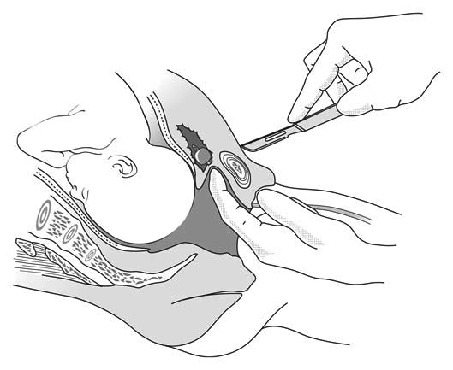
Sri Lanka College of Obstetricians & Gynaecologists
Scientific Activities & Research Committee

Slide 37
Zavanelli maneuvre
Sri Lanka College of Obstetricians & Gynaecologists
Scientific Activities & Research Committee
Replacement of the fetal head in the vagina followed by caesarean delivery.
Processes of the delivery of the head has to be reversed.
Done under regional or general anaesthesia
Uterine relaxation achieved by Tocolytics.
This is followed by
Rotation of the fetal head back to occipitoanterior position (reverse restitution) if restitution has occurred
and flexion of the fetal neck
Next, by applying upward, constant, firm pressure on the fetal head, it should be replaced in the vagina
Finally, a caesarean delivery is carried out.

Slide 38
Sri Lanka College of Obstetricians & Gynaecologists
Scientific Activities & Research Committee

Slide 39
Sri Lanka College of Obstetricians & Gynaecologists
Scientific Activities & Research Committee
The baby should be examined for injury by a neonatal clinician.
Brachial plexus injury is one of the most important complications of shoulder dystocia, complicating 2.3% to 16%
Other reported fetal injuries associated with shoulder dystocia include
Fractures of the humerus & clavicle
Pneumothoraces
Hypoxic brain damage

Slide 40
Sri Lanka College of Obstetricians & Gynaecologists
Scientific Activities & Research Committee

Slide 41
Sri Lanka College of Obstetricians & Gynaecologists
Scientific Activities & Research Committee

Slide 42
Risk management
Sri Lanka College of Obstetricians & Gynaecologists
Scientific Activities & Research Committee
Debriefing
Duty of candour
All maternity staff should participate in shoulder dystocia training
Proper documentation

Slide 43
Documentation
Sri Lanka College of Obstetricians & Gynaecologists
Scientific Activities & Research Committee
Time of delivery of the head and the delivery of the body
Anterior shoulder at the time of dystocia
Maneuvers performed time and sequence
Maternal perineal and vaginal examination
Estimated blood loss
Staff of attendance and time of there arrival
General condition of the baby
Umbilical cord pH and lactate

Slide 44
Sri Lanka College of Obstetricians & Gynaecologists
Scientific Activities & Research Committee

Slide 45
References
Sri Lanka College of Obstetricians & Gynaecologists
Scientific Activities & Research Committee
Green top guideline No: 42 Shoulder dystocia https://www.google.com/url?sa=t&source=web&rct=j&opi=89978449&url=https://www.rcog.org.uk/media/ewgpnmio/gtg_42.pdf&ved=2ahUKEwis48HEwIiLAxUbSmwGHaZVJ84QFnoECA8QAQ&usg=AOvVaw1rlzS76D3cKqn-xcsLzpij
Munro Kerr’s Operative Obstetrics 13th Edition
Obstetric emergencies - A practical manual
Obstetrics by ten teachers 20th edition

Slide 46
Thankyou
Sri Lanka College of Obstetricians & Gynaecologists
Scientific Activities & Research Committee
Dr. T. I. Jayasingha
Resident Obstetrician & Gynaecologist
German Srilanka Friendship hospital for women

